Slide 1
Secured Transactions & Collateral Registries
Global Perspectives & Registry Survey Results
Elaine MacEachern – Global Specialist
Secured Transactions & Collateral Registries
Magdalini Konidari – Operations Analyst
Doing Business Project
World Bank Group
June 06, 2016

Slide 2
LAO PDR – XAO BAN GROUP ( Yogurt Lady)
Insert Lao video.

Slide 3

1. Why Does the World Bank Group Focus on Secured Transactions Reform?

Slide 4
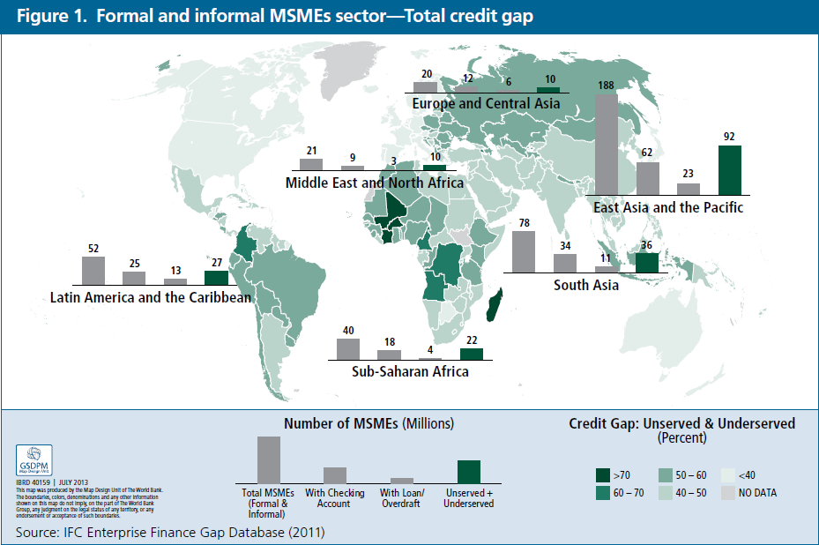
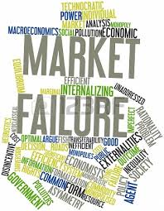
SME FINANCE GAP
400 million SMEs in developing world
50% unserved or underserved
14% with loan or line of credit
1. Why is IFC Focusing in this Area?: Clear Market Failure
Notes:
Developing world – Around 400 million SMEs, almost 50% are unserved or underserved and only 57 million (14%) out of 400 million have a loan or line of credit

Slide 5
COLLATERAL GAP
Capital Stock of Firms
Collateral Taken by FIs
Mismatch between assets owned by companies and collateral required
Source: World Bank Enterprise Surveys
Notes:
Impact of moveable collateral
There is an expanding evidence base on the importance of collateral in credit markets, including recent work on impact of collateral reforms in developing countries. In many instances the research analyzes the overall importance of secured lending and does not distinguish between fixed and moveable collateral. A few studies, however, do look at the impact of moveable collateral on lending markets. Impact findings both from studies focused solely on moveable assets, and from those analyzing moveable and fixed collateral:
Clear Priority – “Debt Enforcement Around the World”, Djankov, Hart, McLiesh and Schleifer. Journal of Political Economy, 2008.
Industrial Countries - Chaves, Rodrigo, Nuria de la Pena and Heywood Fleisig, 2004. “Secured Transactions Reform: Early Results from Romania.” CEAL Issues Brief, Center for Economic Analysis of Law, September 2004.

Slide 6
ACCESS TO CREDIT CONSTRAINTS

Slide 7
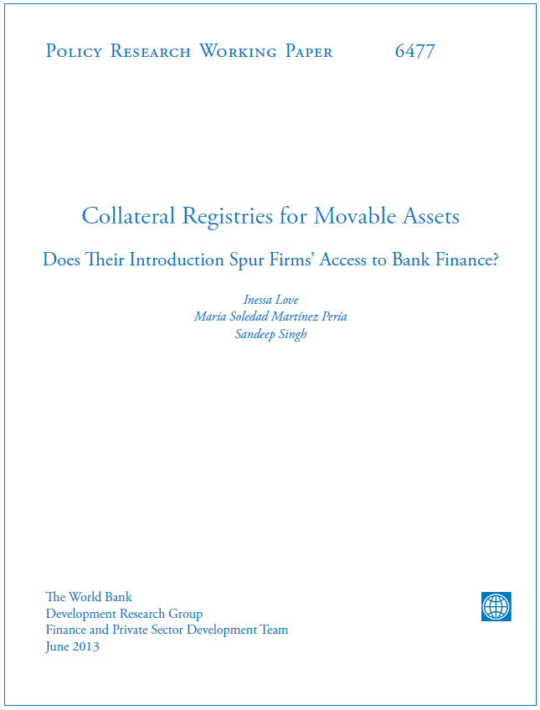
2. Potential Impact of Secured Transactions Reforms in Access to Credit

Slide 8

Collateral Registries for Movable Assets:
Does their Introduction Spur Firms’ Access to Finance?
by Inessa Love, Sole Martínez Pería and Sandeep Singh
Variable | Effect
Access to finance | 8 percentage points
Access to a loan | 7 percentage points
% of working capital financed by banks | 10 percentage points
Interest rates | 3 percentage points
Loan maturity | 6 months
Study also provides evidence that the impact of the introduction of movable registries on firms’ access to finance is larger among smaller firms, who also report a reduction in subjective, perception-based measure of finance obstacles.

Slide 9
Benefits of a Solid Secured Transactions System
BENEFITS OF A SOLID SECURED TRANSACTIONS SYSTEM
- Underserved MSMEs and women entrepreneurs
- Promotes risk management, prudent lending
INCREASES ACCESS TO CREDIT REDUCING THE RISK OF CREDIT
-
- Better
interest rates
- Move from informal to formal financing
- Cost savings for businesses
REDUCES THE COST OF CREDIT
- Credit risk diversification: immovable and movable
- Sector diversification in the portfolio
- Development of industries (factoring and leasing)
- NBFIs
PROMOTES CREDIT DIVERSIFICATION
INCREASES MARKET COMPETITION

Slide 10
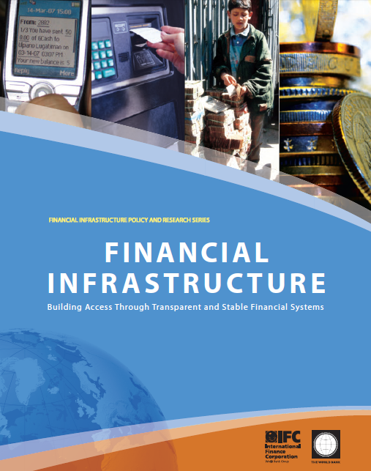
3. Secured Transactions Programs: Business and Delivery Model

Slide 11

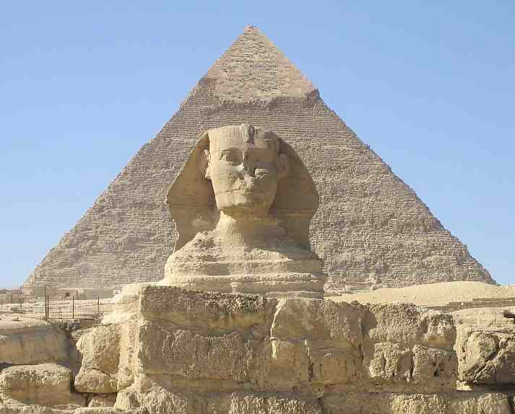

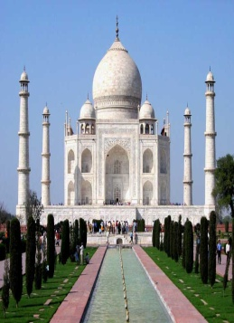
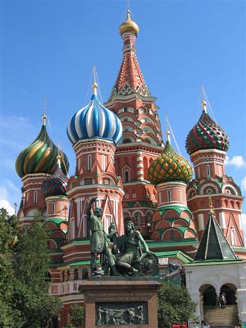

CURRENT GLOBAL PORTFOLIO STCR
AFRICA
  Burundi
  Ghana
  Liberia
  Malawi
  Nigeria
  Sierra Leone
  South Africa
  Zambia
  Kenya,
MENA
  Afghanistan
  Jordan
  Lebanon
  Palestine
  Morocco
  Egypt
EAST ASIA & PACIFIC
  Cambodia
  China
  Lao PDR
  Mongolia
  Philippines
  Vietnam
  Indonesia
  Myanmar
SOUTH ASIA
  India
  Sri Lanka
  Bangladesh
  Nepal
  Bhutan
ECA
  Azerbaijan
  Belarus
  Tajikistan
  Uzbekistan
  Kyrgyzstan
LAC
  Belize
  Chile
  Colombia
  Costa Rica
  Dominican Republic
  Haiti
  Trinidad and Tobago
Pipeline
Regional West & Central Africa, South Sudan, Uganda, Pakistan

Slide 12
BUSINESS AND DELIVERY MODEL – HOLISTIC APPROACH
1. Create Committee
2. Draft new STCR Law
3. Raise awareness
4. Submit Law to Parliament
5. Draft regulations
6. Revise Central Bank regulations
1. Support drafting of technical specifications
2. Support procurement process
3. Support operation of the registry
4.Training/awareness
CREATION OF ELECTRONIC REGISTRY
1. Training and awareness raising stakeholders (public & private stakeholders), including law and registry
2. Technical training to industry players
1. Develop M&E plan including baseline information
2. Conduct periodic monitoring of impact through registry indicators & surveys
3. Independent evaluations
4. Communications
BUILDING THE CAPACITY OF STAKEHOLDERS
MONITORING IMPACT & COMMUNICATIONS
LEGAL AND REGULATORY FRAMEWORK
1
2
4
3

Slide 13



OUR MODEL BASED ON INTERNATIONAL STANDARDS
UNCITRAL Registry Guide and Legislative Guide on Secured Transactions
World Bank Principles on Insolvency and Creditors Rights
IFC Guide on Secured Transactions and Collateral Registries

Slide 14
SECURED TRANSACTIONS PROGRAM MODEL
Clients
Beneficiaries
Funding Model
Value Added
In house expertise, global local presence, developed methodology and M&E standards, demonstrated impact.
Governments (Central Banks, Ministry of Finance/Economy/ Justice/Trade)
Financial Institutions, NBFIs, Firms (mostly MSMEs), Households and Consumers
WBG/IFC funds, Pooled donor funds, client contributions
IMPACT / RESULTS: (1) Value of financing facilitated secured with movable property (US$) and; (2) Number of Firms/MSMEs with increased access to credit

Slide 15


Potential effect of intervention
The benefits of secured transactions reform would include:
Improved legislative framework governing secured transactions which is more transparent, efficient and comprehensive;
New registry with robust platforms, proper capacity and wide usage;
Increased capacity of financial institutions to design and offer new products where movable assets are used as collateral.
The end result would be greater access to credit to SMEs; more jobs created and increased competition in the financial marketplace.

Slide 16

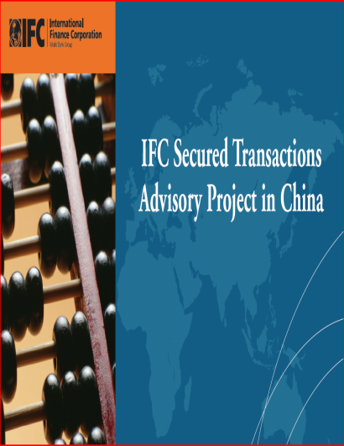
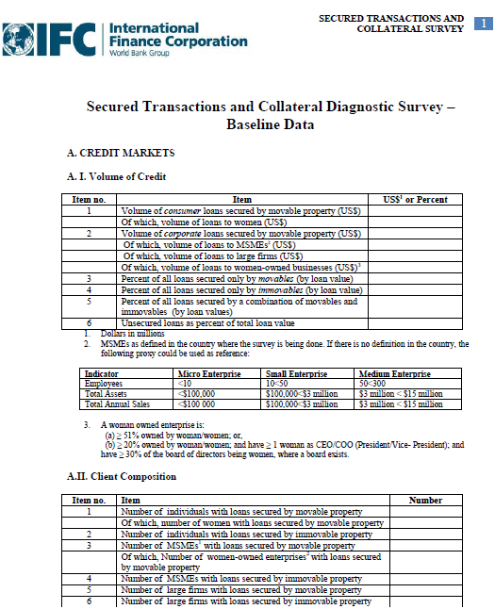

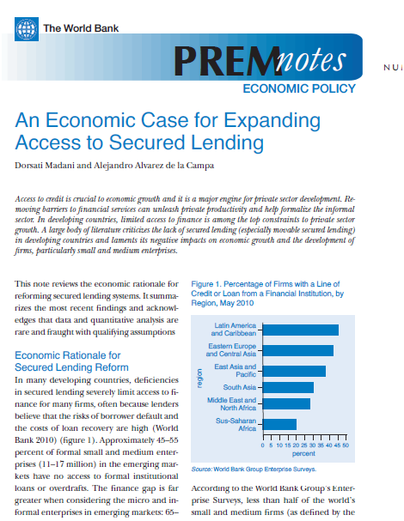
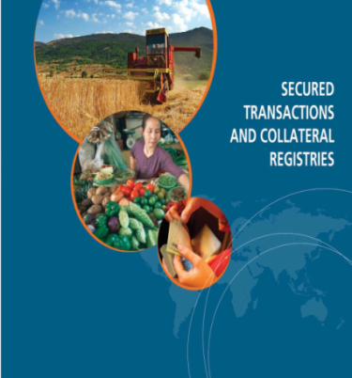
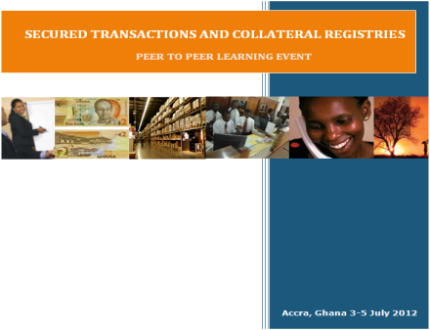

Program Highlights- Knowledge Management
Toolkits
Impact evaluation
Surveys
Network Building
Publications
Factsheets
Events – Peer learning
Knowledge Sharing

Slide 17


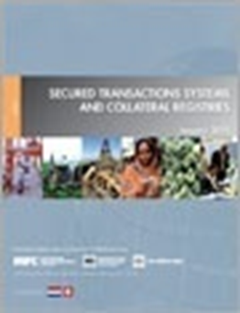
Preliminary Findings – Global Registry Survey!
http://globalpractices.worldbank.org/finance/Pages/en/AllGSGs.aspx

