Slide 1

New UCC Forms
Williamsburg, Virginia 2012
For use under the 2010 Amendments
effective July 1, 2013

Slide 2
A Special Thanks to the 2013 Form Revisionists:
Wally Boggus
Neil B. Cohen
Sherri DeMarco
Carol Nulty Doody
Paul Hodnefield
Mary Jackson
Judy Jobman
Kelly Kopyt
Robert Lindsey
Randy Moes
Harry Sigman
Edwin Smith
Mike Smith
Steve Weise
Tom Wrosch

Slide 3
History
On December 11, 2007, IACA proposed Article 9 statutory changes to the National Conference of Commissioners on Uniform State Laws ("NCCUSL"). Among these changes was an amendment to section 9·521, the Uniform Form of a Written Financing Statement and Amendment.
On June 28, 2008, the Joint Review Committee on Article 9 summarized issues that suggested possible statutory modifications to the Official Text of Article 9 of the Uniform Commercial Code. The issues were identified by the Article 9 Review Committee for consideration by the Joint Review Committee on Article 9. Among the issues related to filing were lACA's changes to the section 9-521 uniform forms.
During the course of the Joint Review Committee's revision process, a decision was made to keep a uniform form in statute and IACA was asked to participate in its revision. At the IACA 2010 Conference, drafts UCC1, UCC1Ad, UCC3 and UCC3Ad, revised April 19, 2010, were proposed by resolution for inclusion in Uniform Commercial Code Article 9 Draft, Section 9-521 . These revisions intended to simplify the forms, encourage ease of use and promote greater longevity of the revised forms. The proposed forms resolution passed unanimously.

Slide 4
History
Throughout the forms revision process, IACA was very diligent in its desire to revise the forms in a thoughtful, purposeful manner. Every proposed change was carefully considered to determine its impact on the filing community as well as the filing office. We also encouraged feedback from membership in an open environment, especially when the proposed change had the potential for greater impact than some other changes that could be considered minor.
Unfortunately, the revision process was prolonged by requests by the Joint Review Committee to consider additional changes – even after several deadlines for completion had passed.
Specifically, the JRC felt strongly that expanded debtor boxes be included in the revised forms while IACA believed (and still does) that the need for expanded debtor boxes is a perceived issue.
Fortunately, the JRC and IACA were able to reach an agreement that handled the perceived need for expanded debtor boxes (box 10 UCC-3 Amendment) in April 2011 (Rev. 04/20/2011).

Slide 5
Purpose
Revise form items and instructions in response to changes under the 2010 Amendments
Improve filer and filing office interaction following over a decade of experience with current forms
Overall simplification and clarification of form items and instructions

Slide 6
Form UCC1

Slide 7
UCC1

Slide 8
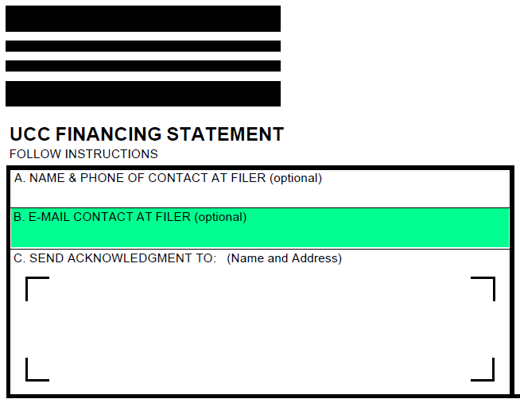
UCC1
Added e-mail for contact

Slide 9
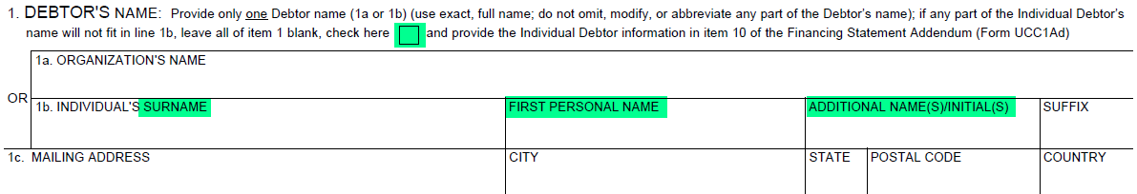
UCC1
Provided checkbox for use of extended individual debtor name item 10 UCC1Ad
Generic/international individual name terminology
Deleted additional info re Organization (e, f, and g)

Slide 10
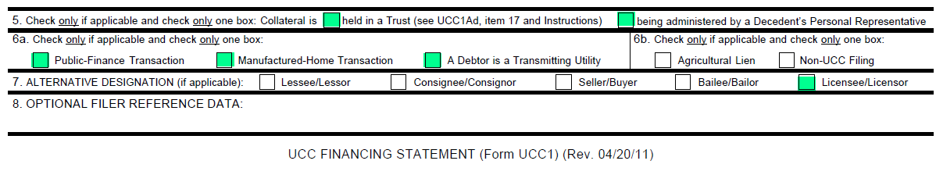
UCC1
Relocated UCC1Ad items to UCC1 to increase frequency of single page filings
  New item 5 replaces old item 17 of UCC1Ad
  Moved public finance, manufactured home, and transmitting utilities actions from item 18 of UCC1Ad to UCC1 Item 6a
New 6b parsed out of old item 5 “Alternative Designation”

Slide 11
Form UCC1Ad

Slide 12
UCC1Ad

Slide 13
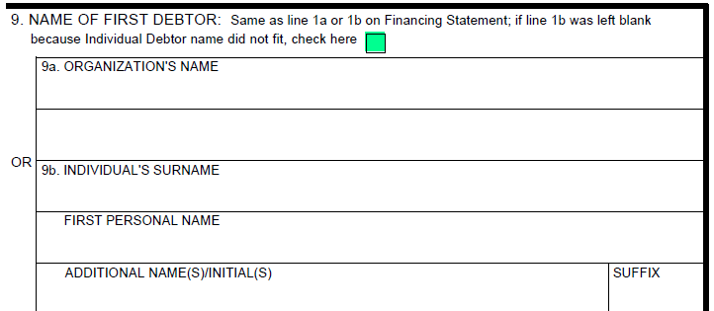
UCC1Ad
Added checkbox in item 9 to accommodate blank 1b (name given in item 10 of UCC1Ad)
Provided for longer individual debtor names

Slide 14
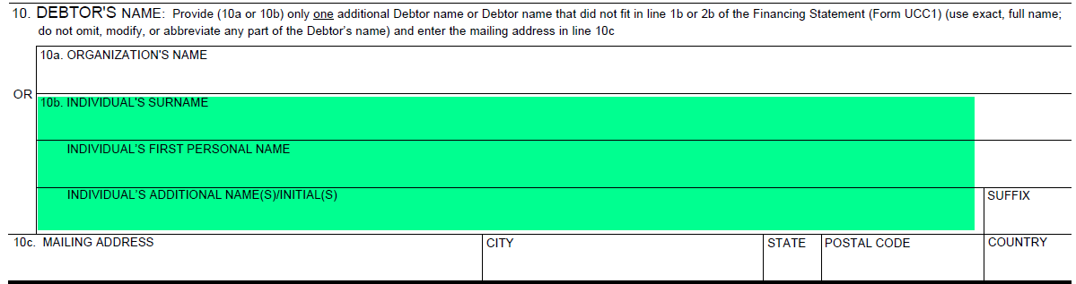
UCC1Ad
Item 10 redesigned to accommodate an additional debtor name or an extended individual debtor name that did not fit in 1b or 2b of the UCC1

Slide 15
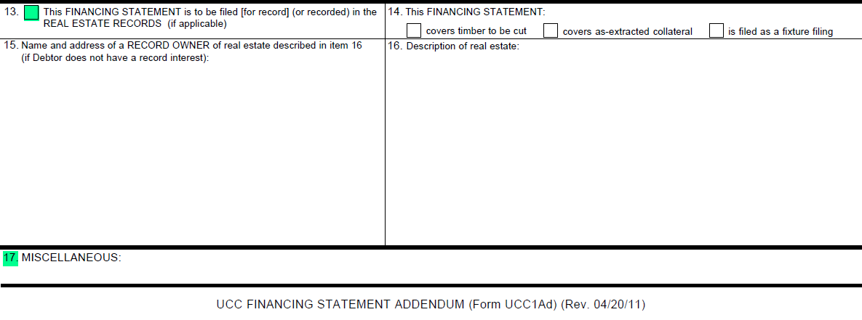
UCC1Ad
Old UCC1 item 1b (Real Estate) moved to UCC1Ad item 13
New Item 17

Slide 16
Form UCC1AP

Slide 17
UCC1AP

Slide 18
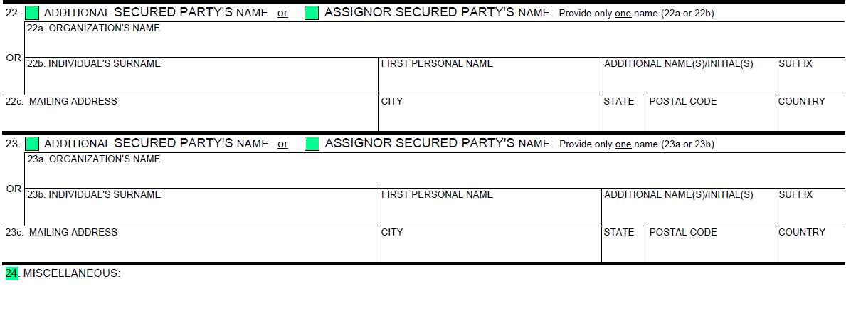
UCC1Ap
New checkboxes to designate additional or assignor secured party’s name
New item 24

Slide 19
Form UCC3

Slide 20
UCC3

Slide 21
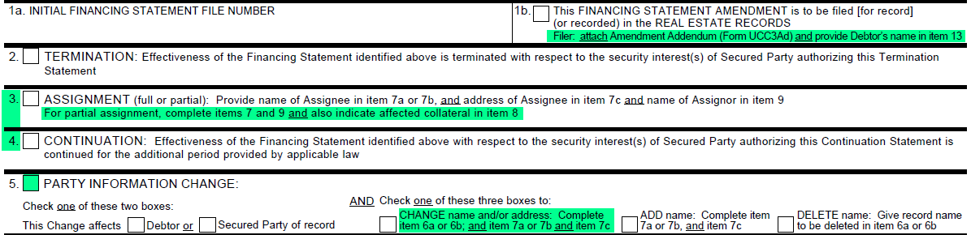
UCC3
Added Instruction for 1b to use UCC3Ad to provide debtor name in offices that require it (i.e., county clerks)
Reordered old continuation and assignment to prevent errant termination selection
Added Instruction in item 3 regarding partial assignment
Added party information change checkbox and reworked to simplify party change instructions and process

Slide 22
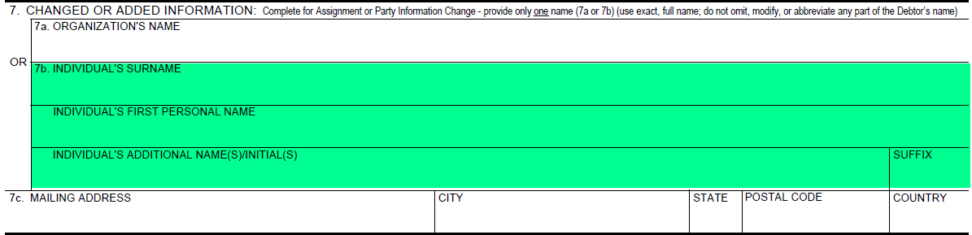
UCC3
Deleted prior item 7d (SSN, TIN) and additional info regarding organization (7e,f, and g)
7b includes extended individual debtor name fields

Slide 23
UCC3
Added collateral change checkbox
Reordered ADD and DELETE collateral checkboxes

Slide 24
Form UCC3Ad

Slide 25
UCC3AD

Slide 26
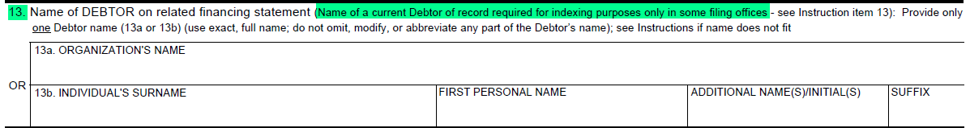
UCC3Ad
New item 13 to indicate name of debtor required for indexing in some offices (e.g., D.C., county clerks)

Slide 27
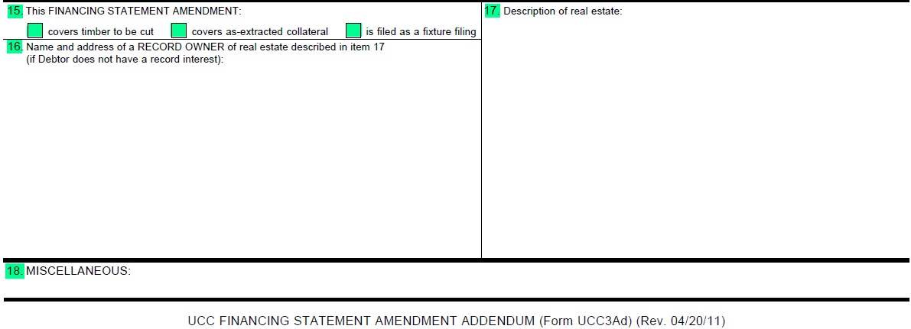
UCC3Ad
New items 15, 16, 17, and 18

Slide 28
Form UCC3AP

Slide 29
UCC3AP

Slide 30
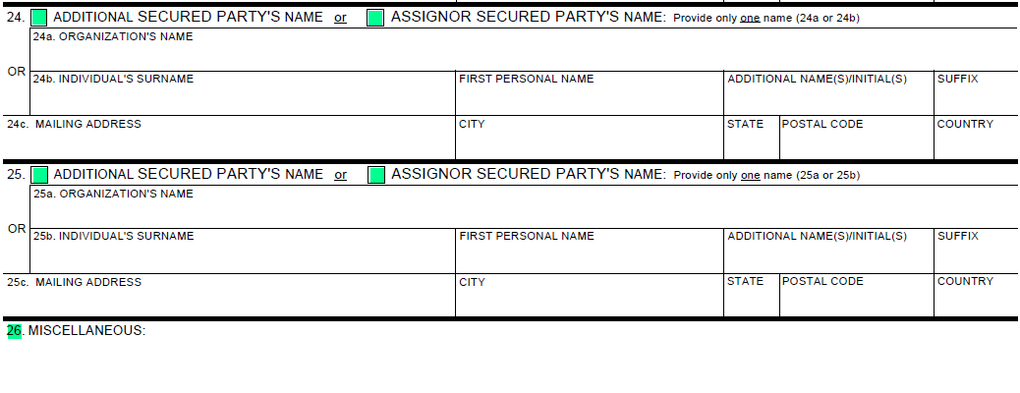
UCC3Ap
New checkboxes to designate additional or assignor secured party’s name
New item 26

Slide 31

UCC1
1. Debtor’s name. Carefully review applicable statutory guidance about providing the debtor’s name. Enter only one Debtor name in item 1 -- either an organization's name (1a) or an individual’s name (1b). If any part of the Individual Debtor’s name will not fit in line 1b, check the box in item 1, leave all of item 1 blank, check the box in item 9 of the Financing Statement Addendum (Form UCC1Ad) and enter the Individual Debtor name in item 10 of the Financing Statement Addendum (Form UCC1Ad). Enter Debtor’s correct name. Do not abbreviate words that are not already abbreviated in the Debtor’s name. If a portion of the Debtor’s name consists of only an initial or an abbreviation rather than a full word, enter only the abbreviation or the initial. If the collateral is held in a trust and the Debtor name is the name of the trust, enter trust name in the Organization’s Name box in item 1a.
1a. Organization Debtor Name. “Organization Name” means the name of an entity that is not a natural person. A sole proprietorship is not an organization, even if the individual proprietor does business under a trade name. If Debtor is a registered organization (e.g., corporation, limited partnership, limited liability company), it is advisable to examine Debtor’s current filed public organic records to determine Debtor's correct name. Trade name is insufficient. If a corporate ending (e.g., corporation, limited partnership, limited liability company) is part of the Debtor’s name, it must be included. Do not use words that are not part of the Debtor’s name.

Slide 32
UCC1
1b. Individual Debtor Name. “Individual Name” means the name of a natural person; this includes the name of an individual doing business as a sole proprietorship, whether or not operating under a trade name. The term includes the name of a decedent where collateral is being administered by a personal representative of the decedent. The term does not include the name of an entity, even if it contains, as part of the entity’s name, the name of an individual. Prefixes (e.g., Mr., Mrs., Ms.) and titles (e.g., M.D.) are generally not part of an individual’s name. Indications of lineage (e.g., Jr., Sr., III) generally are not part of the individual’s name, but may be entered in the Suffix box. Enter individual Debtor’s surname (family name) in Individual’s Surname box, first personal name in First Personal Name box, and all additional names in Additional Name(s)/Initial(s) box.
If a Debtor’s name consists of only a single word, enter that word in Individual’s Surname box and leave other boxes blank.
For both organization and individual Debtors. Do not use Debtor’s trade name, DBA, AKA, FKA, division name, etc. in place of or combined with Debtor’s correct name; filer may add such other names as additional Debtors if desired (but this is neither required nor recommended).
2. Additional Debtor’s name. If an additional Debtor is included, complete item 2, determined and formatted per Instruction 1. For additional Debtors, attach either Addendum (Form UCC1Ad) or Additional Party (Form UCC1AP) and follow Instruction 1 for determining and formatting additional names.

Slide 33
UCC1
3. Secured Party’s name. Enter name and mailing address for Secured Party or Assignee who will be the Secured Party of record. For additional Secured Parties, attach either Addendum (Form UCC1Ad) or Additional Party (Form UCC1AP). If there has been a full assignment of the initial Secured Party’s right to be Secured Party of record before filing this form, either (1) enter Assignor Secured Party‘s name and mailing address in item 3 of this form and file an Amendment (Form UCC3) [see item 5 of that form]; or (2) enter Assignee’s name and mailing address in item 3 of this form and, if desired, also attach Addendum (Form UCC1Ad) and enter Assignor Secured Party’s name and mailing address in item 11.
4. Collateral. Use item 4 to indicate the collateral covered by this financing statement. If space in item 4 is insufficient, continue the collateral description in item 12 of the Addendum (Form UCC1Ad) or attach additional page(s) and incorporate by reference in item 12 (e.g., See Exhibit A). Do not include social security numbers or other personally identifiable information.
Note: If this financing statement covers timber to be cut, covers as-extracted collateral, and/or is filed as a fixture filing, attach Addendum (Form UCC1Ad) and complete the required information in items 13, 14, 15, and 16.

Slide 34
UCC1AD
9. Name of first Debtor. Enter name of first Debtor exactly as shown in item 1 of Financing Statement (Form UCC1) to which this Addendum relates. The name will not be indexed as a separate debtor. The Debtor name in this section is intended to cross-reference this Addendum with the related Financing Statement (Form UCC1).
If the box in item 1 of the Financing Statement (Form UCC1) was checked because Individual Debtor name did not fit, the box in item 9 of this Addendum should be checked.
10. Additional Debtor’s name. If this Addendum adds an additional Debtor, complete item 10 in accordance with Instruction 1 of Financing Statement (Form UCC1). For additional Debtors, attach either an additional Addendum or Additional Party (Form UCC1AP) and follow Instruction 1 of Financing Statement (Form UCC1) for determining and formatting additional names.
11. Additional Secured Party’s name or Assignor Secured Party’s name. If this Addendum adds an additional Secured Party, complete item 11 in accordance with Instruction 3 of Financing Statement (Form UCC1). For additional Secured Parties, attach either an additional Addendum or Additional Party (Form UCC1AP) and complete applicable items in accordance with Instruction 3 of Financing Statement (Form UCC1). In the case of a full assignment of the Secured Party’s interest before the filing of this financing statement, if filer has provided the name and mailing address of the Assignee in item 3 of Financing Statement (Form UCC1), filer may enter Assignor Secured Party’s name and mailing address in item 11.

Slide 35
UCC1AP
18. Name of first Debtor. Enter name of first Debtor exactly as shown in item 1 of Financing Statement (Form UCC1) to which this Additional Party relates. The name will not be indexed as a separate Debtor. If line 1b of the Financing Statement (Form UCC1) was left blank because the Individual Debtor name did not fit, check the box in item 18 and enter as much of the Individual Debtor name from item 10 that will fit. The Debtor name in this section is intended to cross-reference this Additional Party with the related Financing Statement (Form UCC1).
22-23. Additional Secured Party’s name or Assignor Secured Party’s name. If this Additional Party adds additional Secured Parties, complete items 22 and 23 in accordance with Instruction 3 of Financing Statement (Form UCC1). In the case of a full assignment of the Secured Party’s interest before the filing of this financing statement, if filer has provided the name and mailing address of the Assignee in item 3 of Financing Statement (Form UCC1), filer may enter Assignor Secured Party’s name and mailing address in items 22 and 23.
24. Miscellaneous. Under certain circumstances, additional information not provided on the Financing Statement (Form UCC1) may be required. Also, some states have non-uniform requirements. Use this space or attach additional page(s) and incorporate by reference in item 24 (e.g., See Exhibit A) to provide such additional information or to comply with such requirements; otherwise, leave blank. Do not include social security numbers or other personally identifiable information.

Slide 36
UCC3
1b. If this Amendment is to be filed in the real estate records or in any other filing office where the name of current Debtor is required for indexing purposes, check the box in item 1b and enter Debtor name in item 13 of Amendment Addendum (Form UCC3Ad). Complete item 13 in accordance with instructions on Amendment Addendum (Form UCC3Ad). If Debtor does not have an interest of record, enter the name and address of the record owner in item 16 of Amendment Addendum (Form UCC3Ad).
Note: Show purpose of this Amendment by checking box 2, 3, 4, 5, or 8 (in items 5 and 8 you must check additional boxes); also complete items 6, 7, and/or 8 as appropriate. Some, but not all filing offices accept multiple actions on an Amendment. Filing offices that accept multiple actions may charge an additional fee. Some filing offices that accept multiple actions may only index one of the actions requested. Consult the administrative rules of the designated filing office to determine the extent to which multiple actions will be accepted, indexed, and the applicable filing fees for multiple actions.
3. Assignment. To assign (1) some or all of Assignor’s right to amend the identified financing statement, or (2) the Assignor’s right to amend the identified financing statement with respect to some (but not all) of the collateral covered by the identified financing statement: Check box in item 3 and enter name of Assignee in item 7a or 7b; always enter the Assignee’s mailing address in item 7c. Also enter name of Assignor in item 9. If assignment affects the right to amend the financing statement with respect to some (but not all) of the collateral covered by the identified financing statement, check the ASSIGN collateral box and indicate the particular collateral covered in item 8.

Slide 37
UCC3
5-7. Party Information Change. To indicate a party information change, check this box; also check additional boxes (as applicable) and complete items 5, 6, and/or 7 as appropriate.
To change the name and/or address of a party (items 5, 6, and 7): Check box in item 5 to indicate whether this Amendment relates to a Debtor or Secured Party of record; and check the CHANGE name and/or mailing address box in item 5 and enter name of affected party (current record name) in item 6a or 6b; and repeat or enter the new name in item 7a or 7b; always enter the party’s mailing address in item 7c.
To add a party (items 5 and 7): Check box in item 5 to indicate whether this Amendment relates to a Debtor or Secured Party of record; and check the ADD name box in item 5 and enter the added party’s name in item 7a or 7b; always enter the party’s mailing address in item 7c. For additional Debtors or Secured Parties, attach Amendment Additional Party (Form UCC3AP), using correct name format.
To delete a party (items 5 and 6): Check box in item 5 to indicate whether this Amendment relates to a Debtor or Secured Party of record; and check the DELETE name box in item 5 and enter the deleted party’s name in item 6a or 6b.

Slide 38
UCC3AD
13. Name of Debtor on related Financing Statement. If this Amendment (Form UCC3) is to be filed in the real estate records or in any other filing office where the name of a current Debtor of record is required for indexing purposes, enter Debtor name in item 13a or 13b. Item 13 is intended to cross-reference the Amendment (Form UCC3) and Amendment Addendum with the related Financing Statement (Form UCC1). If more than one current Debtor, enter additional name(s) in item 14 or on additional Amendment Addendum (Form UCC3Ad). Do not use item 13 to change, add, or delete a Debtor name.
14. Additional Space for Item 8 (Collateral). If space in item 8 of Amendment (Form UCC3) is insufficient or additional information must be provided, enter additional information in item 14 or attach additional page(s) and incorporate by reference in item 14 (e.g., See Exhibit A). Do not include social security numbers or other personally identifiable information.
18. Miscellaneous. Under certain circumstances, additional information not provided on the Financing Statement Amendment (Form UCC3) may be required. Also, some states have non-uniform requirements. Use this space or attach additional page(s) and incorporate by reference in item 18 (e.g., See Exhibit A) to provide such additional information or to comply with such requirements; otherwise, leave blank. Do not include social security numbers or other personally identifiable information.

Slide 39
UCC3AP
21-23. Additional Debtor’s name. If this Amendment Additional Party adds additional Debtors, complete items 21, 22, and 23 in accordance with Instruction 1 of Financing Statement (Form UCC1).
24-25. Additional Secured Party’s name or Assignor Secured Party’s name. If this Amendment Additional Party adds additional Secured Parties, complete items 24 and 25 in accordance with Instruction 3 of Financing Statement (Form UCC1). In the case of an assignment of the Secured Party’s interest, filer may enter Secured Party and/or Assignor Secured Party’s name and mailing address in items 24 and 25.
26. Miscellaneous. Under certain circumstances, additional information not provided on the Financing Statement Amendment (Form UCC3) may be required. Also, some states have non-uniform requirements. Use this space or attach additional page(s) and incorporate by reference in item 26 (e.g., See Exhibit A) to provide such additional information or to comply with such requirements; otherwise, leave blank. Do not include social security numbers or other personally identifiable information.

Slide 40
Filing Office Impact

Slide 41
UCC Checklist
Database
Data entry UI
Web filing UI
B2B/XML
Imaging and data mapping
Search report
Admin Rules
Staff training
Public notice
Legacy form acceptance

Slide 42

Texas Web filing changes

Slide 43
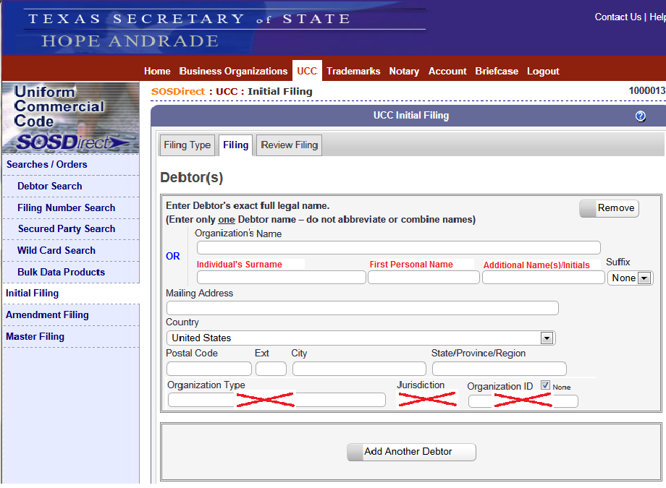
UCC1 - Debtor

Slide 44
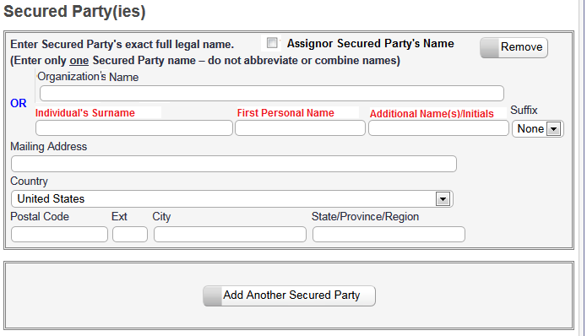
Ucc1 - Secured Party/Assignor

Slide 45
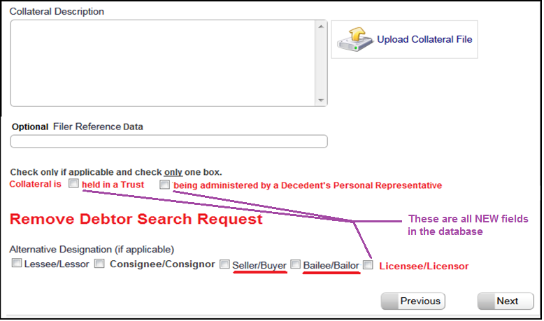
UCC1 - Collateral/Other

Slide 46
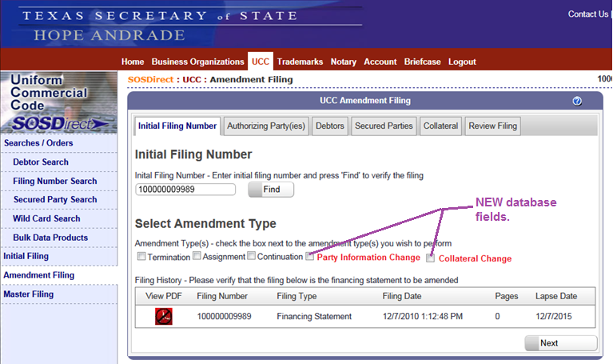
UCC3 - Amendment Type

Slide 47
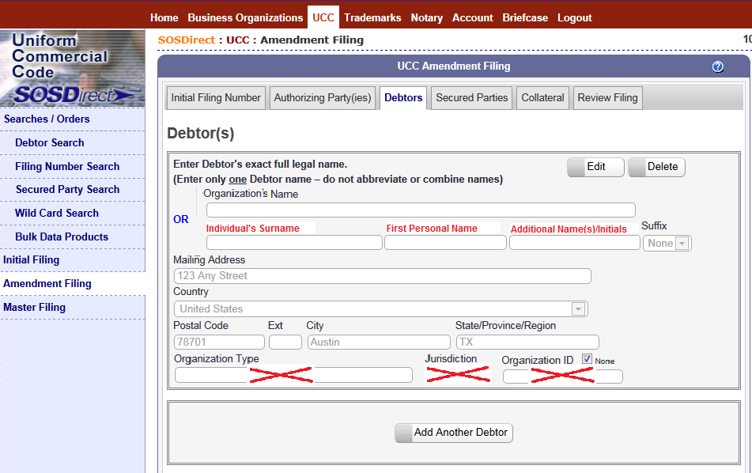
UCC3 - Debtor

Slide 48
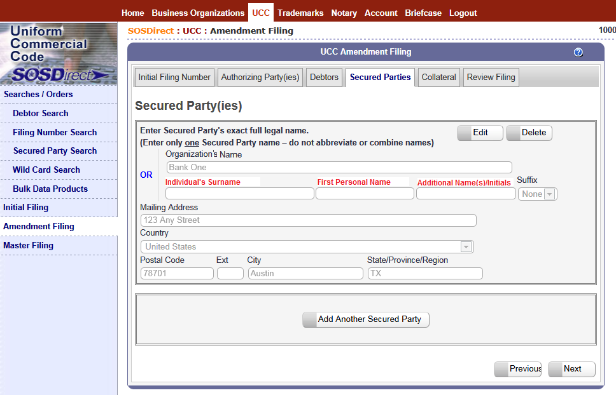
UCC3 – Amend Secured Party

Slide 49
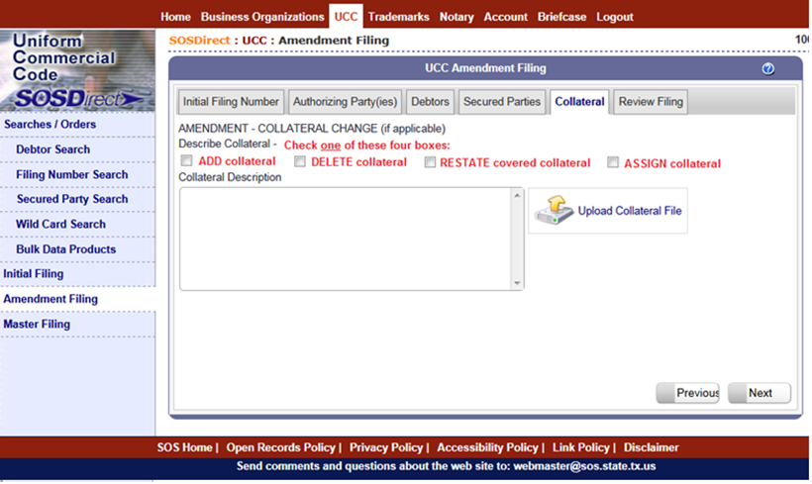
UCC3 - Collateral Change

Slide 50
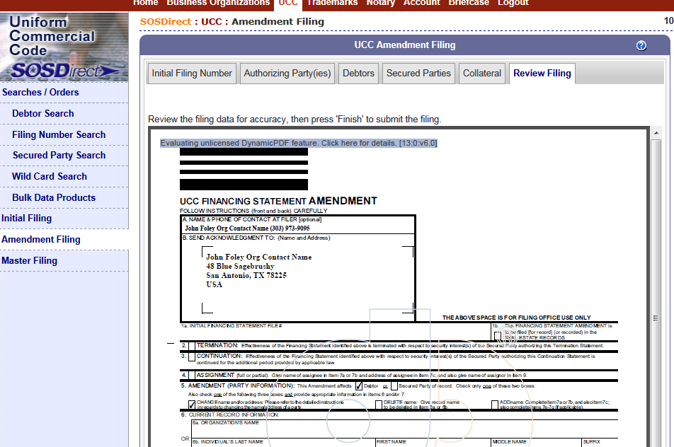
UCC1 & UCC3 - Map data to 2013 forms

Slide 51
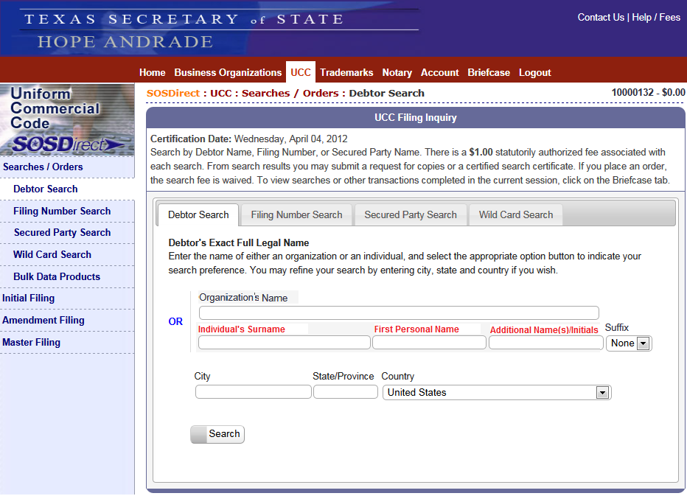
Search - Debtor/secured/wildcard

Slide 52
UCC Checklist
Database ✓
Data entry UI ✓
Web filing UI ✓
B2B/XML – Stick around for 3pm session on XML.
Imaging and data mapping ✓
Search report ✓
Admin Rules - Covered in 10:45am Tuesday session.
Staff training – Minor – get folks familiar with new forms
  No more e, f and g
  Should reduce problems with long names
  Boxes shifted around
  Simplify UCC3 – Party changes

Slide 53
Other Considerations
Public notice – Things to think about
  IACA Approved Printer and Supplier List (Texas only)
    Right after the conference we will begin working with the people on this list so they are aware of the form changes effective July 1, 2013.
  Stuffers
    On January 2, 2013 we are going to start including a colored stuffer in all our paper acknowledgments notifying people that they must start using the new forms on July 1, 2013.
  Electronic Filers – January 2, 2013.
    Post a notice on our website for our web customers. Include a message in electronic acknowledgments.
    Contact/work with our XML customers.

Slide 54
Other Considerations
Legacy form acceptance
  Must file new form beginning July 1, 2013. All other forms will be rejected?

Slide 55
Thank You!
For a copy of this 2012 presentation and others, please visit the STS page at: http://www.iaca.org.

