Slide 1
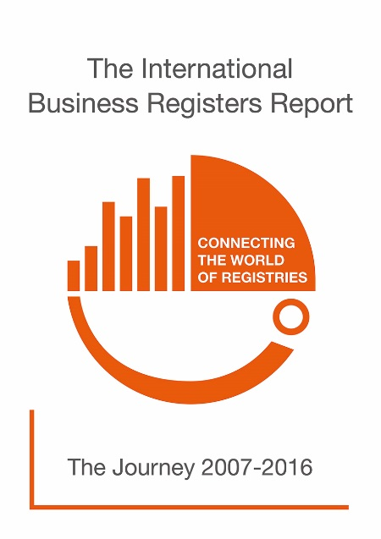
Marissa N. Soto-Ortiz
Office of the Secretary of the Commonwealth of Massachusetts
Monica Grahn
Swedish Companies Registrations Office

Slide 2
We in the Working Group
Hayley E. Clarke, Canada
Kasper Sengeløv, Denmark
Celia Johnston, Germany
Jens Grobelny, Germany
Snežana Tošić, Serbia
Latha Kunjappa, Singapore
Annika Bränström, Sweden
Monica Grahn, Sweden
Magdalena Norlin Schönfeldt, Sweden
Stacey-Jo Smith, UK
Marissa Soto-Ortiz, USA

Slide 3
Changes this Year
The Survey – February -- June
The Report 2017 – October/November

Slide 4
Changes this Year
The Survey – February -- June
Is running now
The Report 2017 – October/November
…and if you have questions – Welcome to visit us!

Slide 5
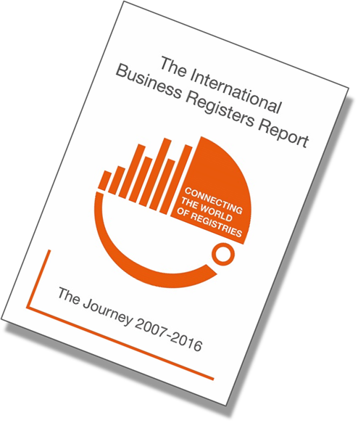
The Journey – 2007 -- 2016

Slide 6
Centralised vs Decentralised

Slide 7
Share Capital

Slide 8
The Digital Journey

Slide 9
The World is (Becoming) Digitised

Slide 10
… and the Business Registries
Development
e-Services
Legislation

Slide 11
… and the Business Registries
Development
e-Services
Legislation
Processing Time!

Slide 12
Register Online

Slide 13
Mandatory or not

Slide 14
Positive Effect

Slide 15
Digitisation + Globalisation = True

Slide 16
A need for information cross border
Business Registers Interconnection System (BRIS)
The European Business Register (EBR)
Collaboration between Australia and New Zealand
Interconnection of Latin Amarican Business Registers

Slide 17
Case Studies
Notes:
Why do we include case studies?

Slide 18
The questions asked
Timeline?
Obstacles?
Changes?
Results?
The Future?

Slide 19
The Participants
Bogotá | Massachusetts
Québec | Latvia
Republic of Macedonia | Denmark
Lesotho | Solomon Islands
Slovenia

Slide 20
We learned that …
… we need to be digital ready through regulations and legislation.
… we need the digital infrastructure and to be prepared to take the cost.
… the role of the Business Register’s workforce may change.
… we see an overall increase of electronic filing, which results in faster processing times.

Slide 21
Beneficial Ownership

Slide 22
Why do we need Beneficial Ownership Registers?
Hidden financial dealings
Tax evasion
Fraud
Corruption
Money laundering
Terrorism financing

Slide 23
A lack of Corporate Transparency
Came into sharp focus due to the release of the Panama papers in April 2016
It was a well-known issue before that:
G8 summit in Lough Erne in 2013
G20 summit in Brisbane 2014
FATF Recomendations
EU Fourth Anti Money Laundering Directive
Notes:
The lack of corporate transparency came into sharp focus in April 2016

Slide 24
What is a Beneficial Owner?
A natural person who directly or indirectly exercises ultimate control over a legal entity or arrangement, and the definition of ownership covers control through other means in addition to legal ownership*.
*Definition provided by Transparency International
Notes:
Definitions provided from different sources may vary
Art. 3 (6) of the Anti Money Laundering Directive provides a lengthy and complicated Definition

Slide 25
Europe
The main focus is on meeting the transposition deadline of the Fourth AML
ECRF is hosting bi-annual workshops for its members
So far Jersey (as a third country) and the UK have implemented Beneficial Ownership registers

Slide 26
Asia-Pacific
Most jurisdictions have not yet implemented Beneficial Ownership registers
There are jurisdictions with reporting requirements for certain company types
Australia
Hong Kong
Malaysia
New Zealand

Slide 27
Africa and the Middle East
The registration of beneficial ownership details is still a relatively new concept in Africa and the Middle East. Most jurisdictions in Africa are now in the process of discussing and adopting the relevant legislation.

Slide 28
The Americas - USA
Currently in the United States there is no federal legislation requiring business registries to collect beneficial owner information
Business registries in the United States are not responsible for receiving and verifying beneficial ownership information, there are several financial institutions that will be required to do so as of May 11, 2018

Slide 29
The Americas - Canada
Financial institutions in Canada are subject to the Proceeds of Crime (Money Laundering) and Terrorist Financing Act (PCMLTFA) which is overseen by the Financial Transactions and Reports Analysis Centre of Canada (FINTRAC)
While neither the Act nor the Regulations requires the registries in Canada to maintain beneficial ownership information, this law requires covered financial institutions to identify and verify this information.

Slide 30
Case Study - Register of Beneficial Ownership, United Kingdom
The UK’s Register of Beneficial Ownership was planned and built over the time period of 9 months
Small Business, Enterprise and Employment (SBEE) Act of March 2015
What is a PSC? – Person/People of significant control
Reporting Requirements (such as name, state of residence, nationality, date of birth, residential address)
Security of protected information
The vast majority of information is automatically publicly available
Certain restrictions apply for sensitive information.

Slide 31
Challenges

Slide 32
The Digital Age – Challenges Past and Present
Past
Transparency vs. Privacy
Structure of Business Registries
Long term data storage
Economic Crime
Unique id/Identification
Automation
Present
Beneficial Ownership
Enforcement and compliance
Cross border communication and identification
Open data vs. fees
Lack of resources

Slide 33
… and in the Future
The Digital Age
Digital filing
New technologies
Interoperability and Exchange
Legislation

Slide 34
Thanks! Marissa & Monica

