Slide 1
How Colorado Embraces Change
Mike Hardin
Business and Licensing Division Director
May 20, 2014

Slide 2
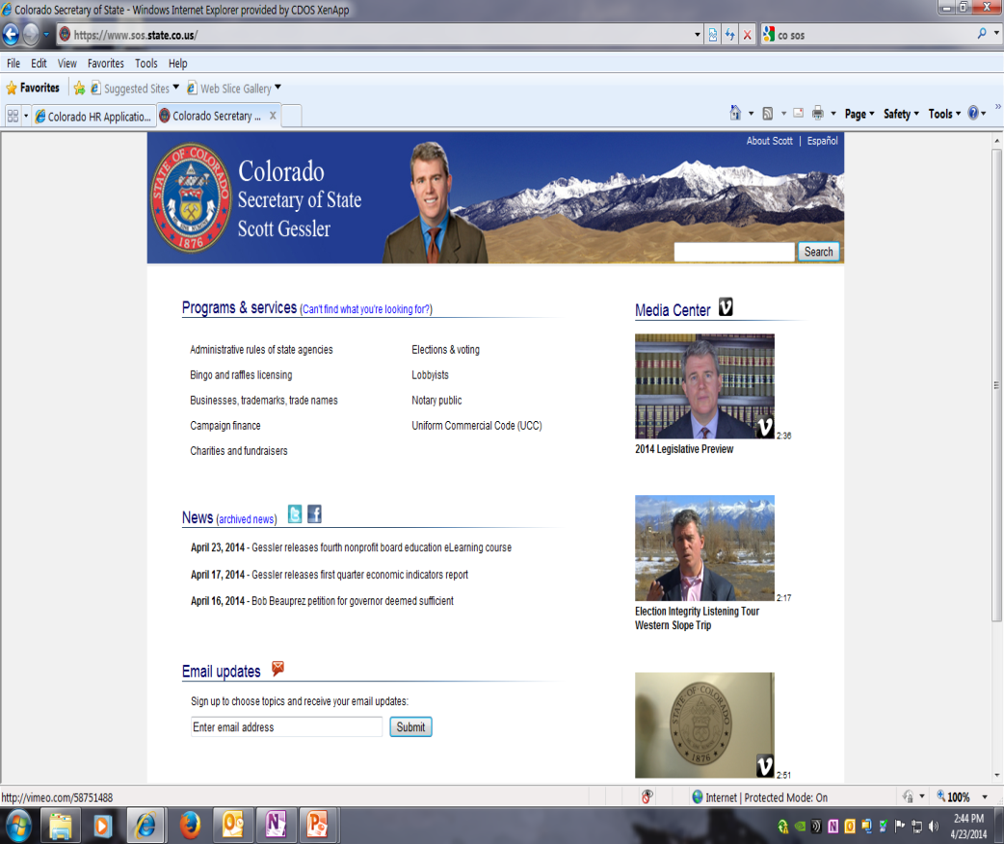
Then and now

Slide 3
timeline
2011
Post Card Notification
Eliminated
2012
UCC Mandatory Online
2010
Combined Business and
Licensing Division
2010
All Business Filings Online
2007
Trademarks
2006
Trade Names
2009
Mandatory Statement of Change/
Corrections for Business Entities
2004
First External Online System Offered
2004
SOS Authorized to mandate any filing online
2002
Legislation mandating SOS enable online filing
of business entity documents.
2002
UCC First offered Online
2001
First Online Certificate of Good Standing
First Periodic Report Online
1980s
Combined UCC and
Business Division

Slide 4
Evolution
Before
After
Paper Filing
Online Filing
Call Center
Service Center
Mail and Fax
Phone, Web, and Email
Checks and Cash
Credit Cards and Prepaid Accounts
1 Week to 4 Months Processing
Instant Processing
Monday Thru Friday 8am – 5pm
24/7
Data Entry of Forms
Customer Populates Forms

Slide 5
Evolution Continued
Before
After
Microfiche
Web-based Imaging with Scanning
Mail Additional Documents
File Attachments
Expedited Fees
No Expedited Fees
Manual Searches
Instant Searches
Manual Certifications
Online Certification
Volume Drives Resources
Volume Doesn’t Impact Resources
Manual IRS Filing
Manual IRS Filing

Slide 6
Communication
Website Messaging
FAQs
GovDelivery
Embedded Video – Vimeo
Email Notifications
Service Center Phones
Service Center Emails
E-learning Modules
Outreach Activities
Social Media
Email
2013
Postcards
2001
Letters
1970s

Slide 7
Legislation Tips
Aggressively Track Legislation That Affects Your Office
Use Stakeholder Groups for Support and Ideas
Use of Office Liaison
Host Focused Taskforce Sessions
Testify at Committee Hearings
Policy Group (Draft Leg, White Paper)
Post Legislation Rule Making
Include Rulemaking Authority
Fiscal Notes
Delay Effective Dates

Slide 8
Staffing
Multiple Reorganizations
Normal Attrition
Cross-training
Hiring New Skillsets
Hiring Practices
Career Progression
Employee Engagement
Training and Education

Slide 9
Funding and resources
Colorado Secretary of State is fully cash funded.
Ability to run the office like a business matching revenue and expenses.
IT Division – Late 1980s, leveraged charitable gaming legislation.
Authority to maintain a 16.5% cash balance.
Still required to request appropriations to support office activity.
Advantages:
Flexibility
In-house IT solutions
Not as Vulnerable to Economic Swings
More Control

Slide 10
Adoption Tips
Computers Available at Office
Fee Incentives
Fee Holidays
Build Stakeholder Coalitions
Use Taskforces
CLE Presentations
Stakeholder Testing
Service Center Assistance
Roadshow
FAQs
Filing Tips
Publicize
Secure Site
Track Progress
Use of Hybrid Systems
Usability Testing

Slide 11
Thank you!

