Slide 1
Colorado’s Service Center Approach
Mike Hardin
Business and Licensing Division Director
May 20, 2014

Slide 2
Call Center vs Service center
Call Center
Service Center
Paper Form Based
Calls Only
Business Customer Only
Lacked Escalation Process
No Metrics
Forwarded Calls to Programs
Where you ended your Career
Less Sophisticated Communicator
No Technical Knowledge Required
Web Based
Calls, E-mail, Mail
Seven Programs
Structure Escalation Process
Handles Broad Customer Inquires
Measured Performance
Where you start your career
Master Communicator
Technical Knowledge

Slide 3
Personnel Restructuring
Analyzed Call and Email Volumes Over 12 Month Period
Added Elections Division Support
Expanded from 7 to 10 Service Agents
Restructured Creating Expertise Levels from Tech I to Tech III
Implemented Escalation Process
Created “Talent Pipeline”

Slide 4
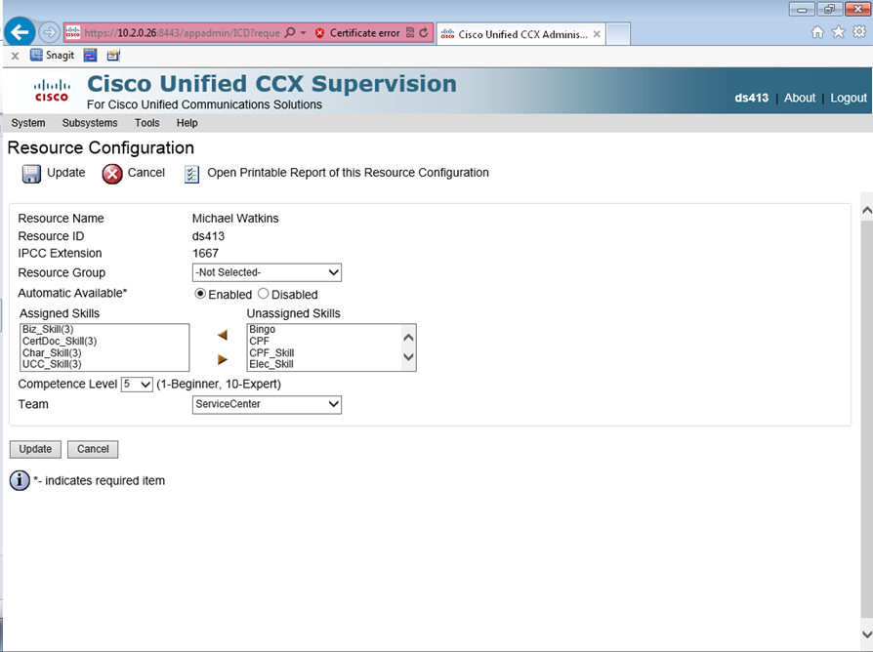
Queue management
Use of Auto Call Distribution System Tool
Match Agent Experience Level with Customer Needs
Manage Volume and Free Agents for Other Tasks
Adjustments Made by Supervisor for Efficiency
Integrate Voicemail Option with Common Extension

Slide 5
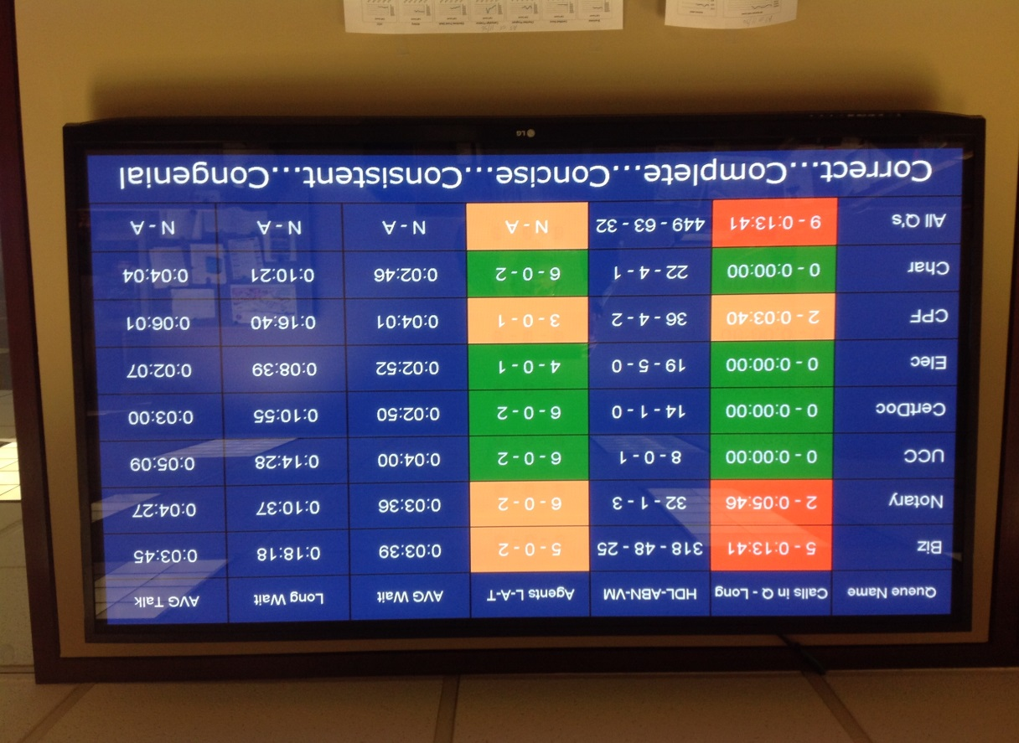
Wall Board Tool
Collaborative Effort with Service Center Personnel and IT Division
Provides Important Performance Data
Real Time
Drives Behaviors
Added Messaging
Internal Web-Link for Other Department Employees

Slide 6
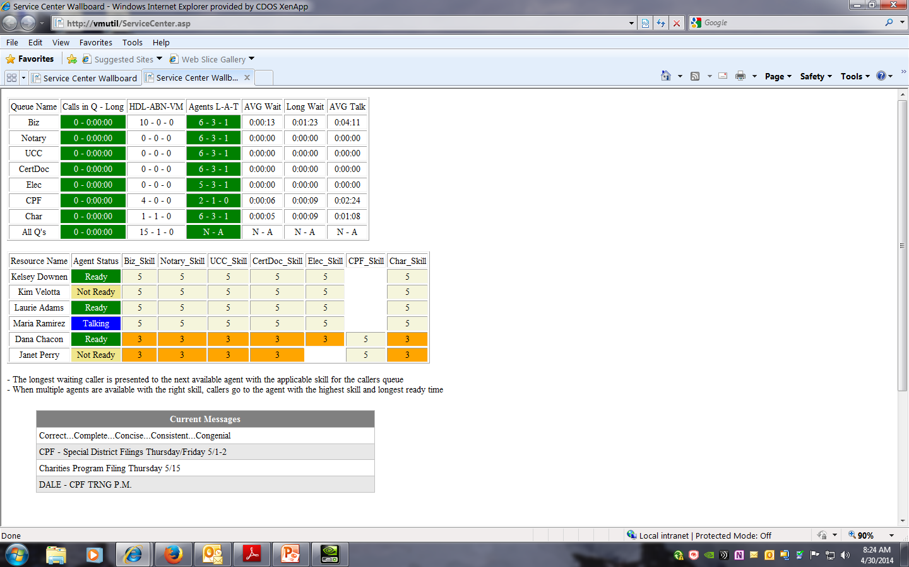
Wall Board Tool Continued…

Slide 7
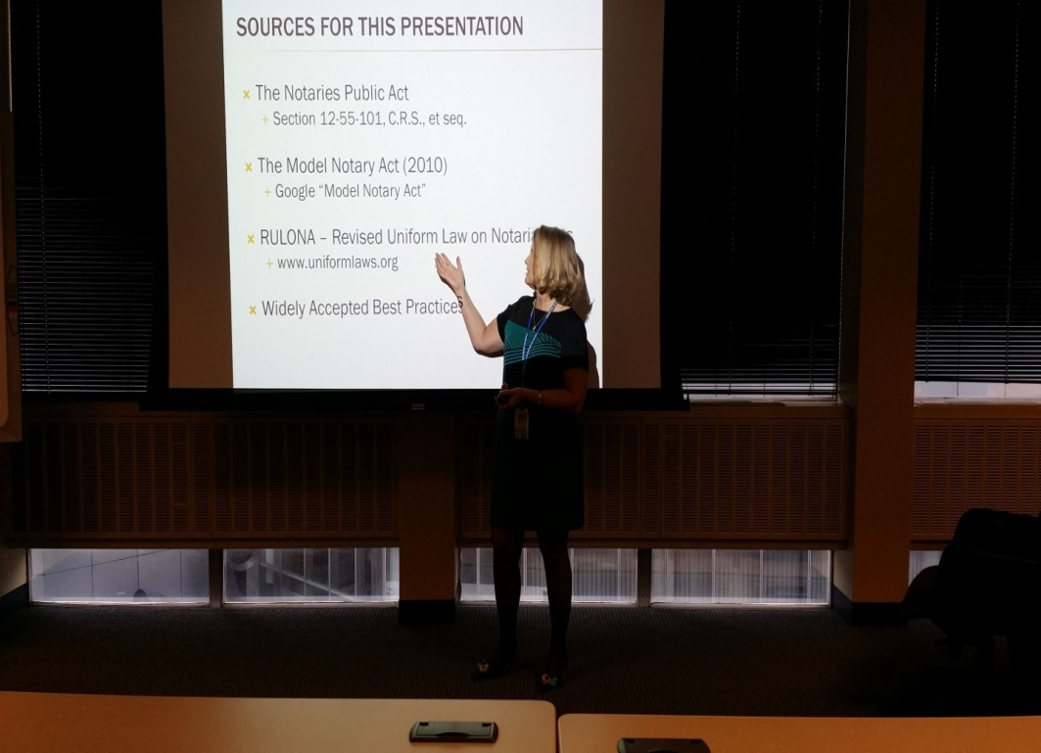
Cross Training
Supports Internal and External Customers
Increases Program Capacity
Improves Morale
Exposes Employees to Other Growth Opportunities
Improves Customer Support

Slide 8
Program Support Transitions
Customer Synch Meetings
Ongoing Program Support and Escalation
Periodic Training
In Program Training with Action Plan
Agent Participation in System Testing

Slide 9
Results and Lessons Learned
Centralized Service Center for multiple programs leads to better customer service and program efficiencies.
Exceeding Global Call Metrics:

Slide 10
Results and Lessons Learned Continued…
Fewer Interruptions for Program Managers
Position agents who are learning the same topics close to one another.
Incorporate agents into the system development process to improve internal user acceptance, system learning, and system testing.
Employees like to be challenged and learn new skills.
Service Center increase career opportunities.
Prior planning in critical to a smooth transition of duties.
Tiered structure within the Service Center provides better customer service.

Slide 11
Thank you!

