Slide 1
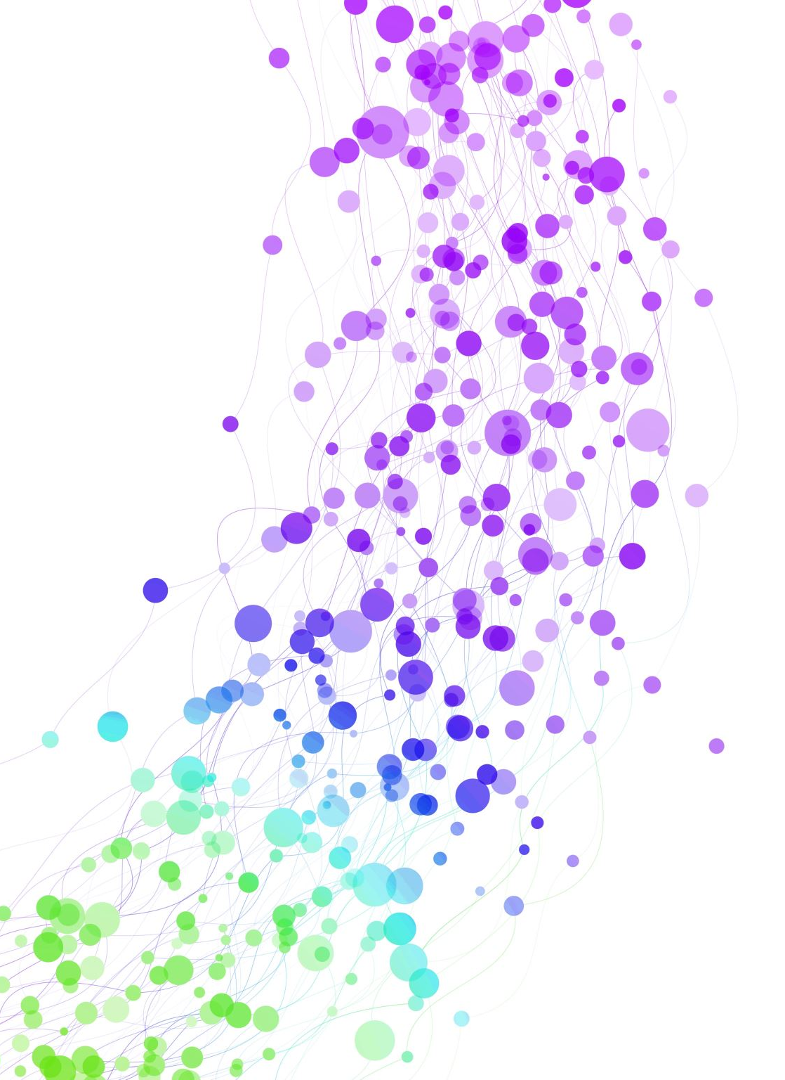
What Use is Registry Data?
PARTNERSHIP
CORPORATION
AGENT
NOT FOR PROFIT
NAME
SOLE
PROPRIETOR
EIN
REGISTERED
ADDRESS
LLC
TIN

Slide 2
Anna, Bob, Reg and Rich
A corporate love story
Peter Bainbridge-Clayton
peter.bainbridge-clayton@moodys.com

Slide 3












Register Business
File Accounts
Change Address
Director
Shareholder
File Accounts
Close Company
Bob
CLOSED
Anna
Reg

Slide 4






Register Business
File Accounts
Change Address
Director
Shareholder
File Accounts
Close Company
Bob
CLOSED
Anna
Reg
ALERT!
ALERT!
ALERT!
ALERT!
?
?
KYC
KYC
AML
?
AML
CFT
CFT
Rich
CSB
CSB

Slide 5
Key Points:
Know Your Customer
Anti Money Laundering
Countering Financing of Terrorism
Countering Sanctions Busting
Key Points:
Banks and other FI’s and Obliged Entities need YOUR data both for internal governance, risk management and regulatory compliance
Business owners are not a ‘Golden’ source – Registers are
The rules exist to catch the TINY minority without unduly affecting the well-behaved majority
YOU are part of the fight against crime and terrorism
Key Issues:
DATA must be easy to access without human intervention (APIs) and traceable to source
DATA must be accurate and RELEVANT
DOCUMENTS are important for the record
KYC/AML/CFT/CSB compliance is a LEGAL requirement
Know Your Customer. Anti-Money Laundering. Countering Financing of Terrorism. Countering Sanctions Busting.

Slide 6


Slide 7
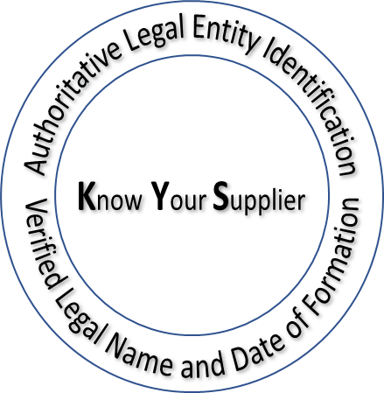


Supply Chain 2.0
International Standards for
identifying and describing
fundamental concepts that support supply chain interoperability and integration
SUPPLY CHAIN DATA
Who
(Legal Entity Identification)
What
Where
When
Flexible
Resilient
Minimal waste
Zero fraud
Sustainable
ISO 8000-116
ISO 8000-115
ISO 8000-118
ISO 8601
INTEROPERABLE DATA FORMAT (.idf)
ISO 8000-114
Data Verification
ISO 25500
"He who has access to the fountain does not go to the water-jar.“
Leonardo Da Vinci

Slide 8

Two years
165 Countries - One country One vote
Committee Review
Committee Draft
Draft International Standard
International Standard
New Work Item
Supply Chain Data Standards
Standard | Scope | Status
ISO 22745 | Open technical dictionaries and concept encoding | International Standard
ISO 8000-051 | Formatting data governance policies | International Standard
ISO 8000-114 | Formatting of portable data using the interoperable data format (.idf) | International Standard
ISO 8000-115 | Formatting of identifiers (PO numbers, part numbers, asset numbers, certificate numbers) | International Standard
ISO 8000-116 | Formatting of Authoritative Legal Entity Identifiers (ALEI) | International Standard
ISO 8000-117 | Formatting of identifiers in blockchains to allow secure links to off chain data | International Standard
ISO 8000-118 | Formatting of Natural Location Identifiers (NLI) | Approved Draft International Standard
ISO 8000-119 | Formatting of Transport Unit Identifiers (TUID) | Approved New Work Item
ISO 25500-1 | Supply Chain Interoperability and Integration - Overview | Out for comment as Committee Draft
ISO 25500-2 | Supply Chain Interoperability and Integration - Vocabulary | Out for comment as Committee Draft
ISO 25500-3 | API Verification of authoritative legal entity identifiers (ALEI) | Out for comment as Committee Draft
ISO 25500-100 | API verification of supply chain data | Out for comment as Committee Draft
ISO 25500-110 | API verification of certificate data | Out for comment as Committee Draft
ISO 25500-120 | API verification of localization data | Out for comment as Committee Draft
ISO 25500-240 | Strategic Sourcing concepts, principles and data requirements | Out for comment as Committee Draft

Slide 9
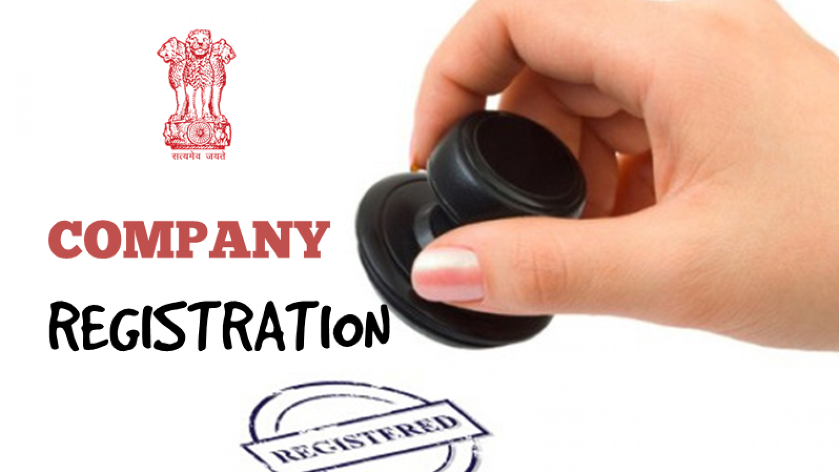
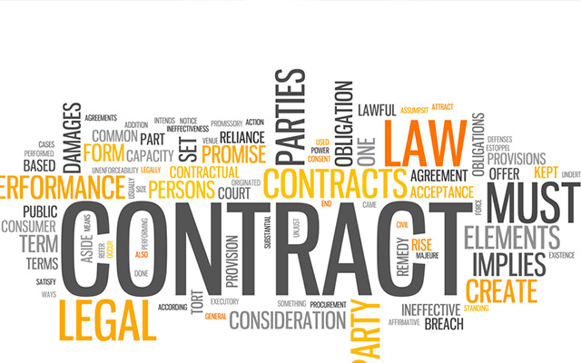
An Authoritative Legal Entity Identifier (ALEI) is the unique record number issued by a government when a natural person or a legal person is registered by a government.
ISO 8000-116 is the international standard for formatting an ALEI as a globally unique identifier
Authoritative Legal Entity Identifier (ALEI)
Issued and verifiable by government
Universal (every legal entity has one)
Unrestricted use
Globally unique in the ISO 8000-116 format
Recommended party identification in contracts:
“This Agreement is entered into by and between
DFM Data Corp. Inc [US-GA.BER:19056389] and
Code Management Association [US-DE.BER:3031657]”

Slide 10


An “identifier” identifies a data set
In a database the identifier is the primary key of a record (data set)
An identifier is a pointer to a data set
ISO 8000-115 quality identifiers
Data
A quality identifier shall begin with a prefix element and end with an identifier element. The prefix element shall represent the owner of the quality identifier (ISO 8000-115)
Identifier
Quality Identifier
Authoritative Identifier
identifier issued by an organization that is the originator of the object identified (ISO 8000-2)
US-DE.BER:3031657
US-CT.BER:0108336
US-MI.BER:801497453
SA.CR:1010074978
CA.FC:882775-3
Corning.LS:2962-1L
Proxy Identifier
(Value Added Identifier)
identifier issued by an organization that is not the originator of the object identified (ISO 8000-2)
DnB.DUNS:107684529
NATO.NCAGE:1U6M8
GLEIF.LEI:506700GE1G29325QX363
GS1.GTIN:600603171987
Grainger:48WZ66
ISO 8000-116 formatted Authoritative Legal Entity Identifier (ALEI)
"He who has access to the fountain does not go to the water-jar.“
Leonardo Da Vinci

Slide 11
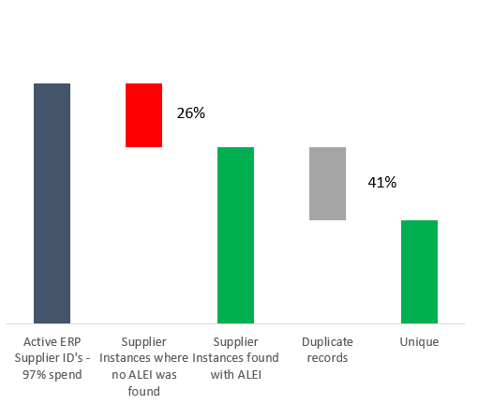

Verification and Consolidation Supplier Records (80,000+ records in 200+ registries)
Authoritative Legal Entity Identifier (ALEI)
Issued and verifiable by government
Universal (every legal entity has one)
Unrestricted use
Globally unique in the ISO 8000-116 format

Slide 12







Value Added Data Providers
The ALEI allows data aggregation and verification of legal entity data across value added data providers
*
*
Authoritative Government
Data
ISO 8000-116 formatted ALEI
*
*
Jurisdiction (ALEI)
Legal name
Date of Origin
Status
Sufficient for the purposes of identification
.
.
.
.
* Proxy legal entity identifiers issued by non-government authorities are copyright; their use is limited to that allowed by their license, as a rule they can only be used to access data distributed by the data provider

Slide 13
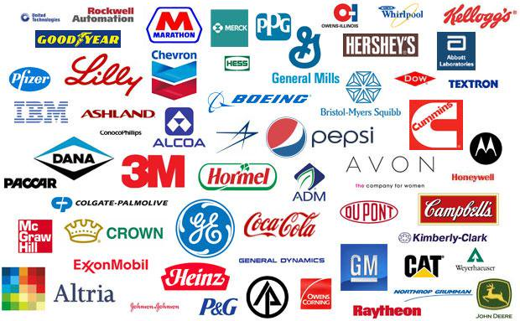

The goal is to eliminate corporate identity fraud by using an API to perform real time status check at time of payment
Registrar
Data
ISO 25500-3 API
Jurisdiction (ALEI)
Legal name
Date of Origin
Status
Sufficient for the purposes of identification
Just like they use an API for
Taxpayer Identification Number (TIN) Matching
Incorrect data on annual report subject to a fine of $260 per record

Slide 14

The goal is to make it easier to verify “Domestic” registration, and for other government agencies to verify business data
Registrar
Data
ISO 25500-3 API
Jurisdiction (ALEI)
Legal name
Date of Origin
Status
Sufficient for the purposes of identification

Slide 15
Registrar web portals research summary (as of 2024-04-24)
Total web portals
(excludes economic zones)
383
Searchable On-line
236 (62%)
96% of World GDP
Not Searchable on-line
147 (38%)
4% of World GDP
API/Bulk Data Available
62 (26%)
API/Bulk Data Not Available
56 (24%)
Research in progress
118 (50%)
API
43 (69%)
Bulk Data
19 (31%)

Slide 16

Please make sure your IT team or contractor is aware of ISO 25500-3* the open international standard API for requesting or verifying registrar data
*The standard is in its approval stage – there is still time for input

Slide 17
What is a “good” registry API
Simplicity
Intuitive design for developers
Reliability & Error Handling
Continuous 24/7 access to the API
health check endpoint for timely notifications about interruptions
Efficiency & Performance
Response within 30 s.
Asynchronous processes for tasks that take >30 s., e.g. document retrieval​
Adherence to industry best practices
Minimal list of endpoints
Accurate and comprehensive documentation
Data dictionary
EN descriptions for both responses and params
Scalability and pricing
Increased traffic handling
Clear, predictable and simple pricing model
Accommodating enterprise users
Data & Design
Efficient search functionalities
Streamlined document retrieval and availability checks per entity
Metadata for documents
Well-organized dataset with data level differentiation
Moody’s internal standards

