Slide 1

UCC Foundations
Daniel W. Lias, Esq.

Slide 2


Disclaimer
Please note that this presentation is intended for educational purposes only. It is not intended to serve as legal advice or form an attorney-client relationship.
Please do not record this presentation or distribute the slides outside of your organization.

Slide 3
AGENDA
UCC Background and Scope
The “W”s Of Filing
UCC 1
UCC 3
Sample Case
Questions

Slide 4


Background UCC

Slide 5

What Is The Uniform Commercial Code?
A set of business-related laws dealing with the sale of goods, their transportation and delivery, financing, storage, payments, and various other commercial transactions.
Uniform Commercial Code (UCC)
Intended to harmonize business transactions in the U.S.
Collected into separate parts called Articles
Focus on Article 9 or as it is commonly called Revised Article Nine

Slide 6
When Does Article Nine Apply?
YES
NO
YES | NO
Consensual Security Interests Personal Property (tangible & intangible) Fixture Filings i.e. UCC filings that relate to real property Leases, Consignments, Bailments (all meeting required criteria) | Non-Consensual Liens E.g., tax liens, judgment liens, mechanic’s liens, etc. Real Property Filings E.g., mortgages, deeds of trust, etc. THESE NEED SEPARATE FILINGS!

Slide 7
Transaction Types Covered By Article 9
Real Estate (and Fixtures)
Mergers and Acquisitions
Comp Asset Purchase and Sales
Loans
Equity/Investments
Bankruptcy Restructuring
Consignment Agreement
Leases
Transmitting Utilities
Any Type of Restructuring

Slide 8
Who Is Who in Revised Article 9 World?
National Conference of Commissioners for Uniform State Laws (NCCUSL) http://www.uniformlaws.org/
American Law Institute http://www.ali.org
American Bar Association, UCC Committee https://www.americanbar.org/groups/business_law/committees/ucc/
International Association of Commercial Administrators (IACA) http://www.iaca.org

Slide 9
The “W”s of UCC Filing

Slide 10
Why File?
RISK AVOIDANCE
It boils down to risk---filers want to minimize their risk on business transaction
Best way to minimize this risk is to be in best position possible with other creditors
UCC system in US is “time-based” If you file before others you are in better position
This “better” position is called priority—It is key to our system
Another key reason to file is to “PERFECT” your claim
It does not do you any good to be first in line if filing is too poor to perfect your claim
Perfection is making sure the data you are listing in timely manner is the correct data
While the base data is fairly simple-(three things) number of issues remain trip people up
Thus to be properly filed under the code your aim to prioritize your perfected claim

Slide 11
Who Is Filing? The Big Four
1.) Small Business/Individual----Very limited knowledge/few filings—(watched Youtube)
2.) Bank/Financial Institution- VOLUME! Thousands filings every year-have knowledge but driven by “their” processes---this may be different than yours
3.) Law firms—Highly skilled filers---many know the law better than you. Brought in on more complicated/high value matters. Their questions will be very different than others
4.) Financing Funds---Nor as many filings as a bank but typically the values are quite high—many use law firms to help with filing but then management/refiling may fall on them

Slide 12
UCC 1: The Base

Slide 13
UCC 1
A legal document and a public record
Standard form used across all 50 states (with variation)
Composed of UCC-1 + filed record relating to initial filing
Prepared against the exact legal name of the debtor

Slide 14
What Is The “Location of Debtor”
Entity | Where to File
Registered Entity | Jurisdiction of organization
Non-registered Entity | Jurisdiction of Chief Executive Office
Individual | Jurisdiction of debtor’s residence
Foreign Debtor | If home country has a filing system → Follow that jurisdiction’s rules If no filing system but office in U.S. → File where office is located If none of the above → File in Washington D.C.

Slide 15
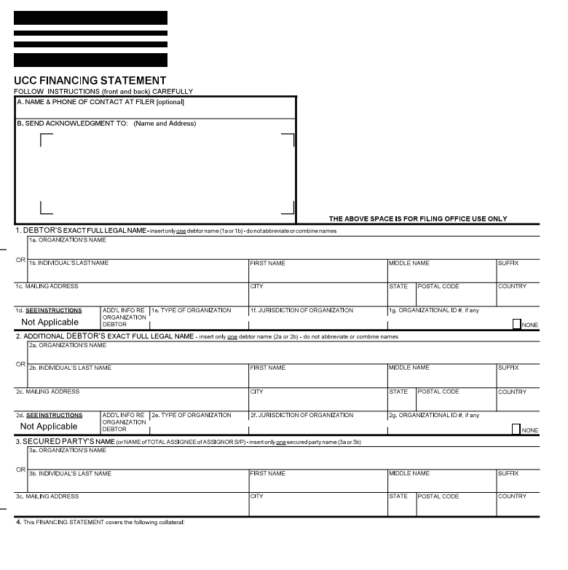
Requirements For “Legal Sufficiency”
9-502:
A financing statement is sufficient only if it provides:
Debtor’s Name
Secured Party
Collateral

Slide 16
Errors & Omissions
9-506:
  a financing statement with minor errors or omissions is effective, unless the errors or omissions make the financing statement “seriously misleading”
  A financing statement that fails to sufficiently provide the name of the debtor in accordance with Section 9-503 is “seriously misleading”

Slide 17
What Is Search Logic
A series of operations, performed by the filing office’s computer system, that transforms a debtor name into a KEY.
Filing Key:
created when a debtor name is entered upon filing
Search Key:
created when a debtor name is entered when searching
Search Key Should Match Filing Key

Slide 18

UCC 3s

Slide 19
UCC-3 Financing Statement
Changes information relating to debtor, secured party, or collateral
Continuation
Assignment
Termination
Amendment
Transfers rights to the collateral (the security interest) to a new secured party
Terminates a security interest
Will remain on the public record until lapse date + 1 year
Extends the life of the UCC-1 by 5 years;
Must be filed in the 6-month window prior to lapse date

Slide 20
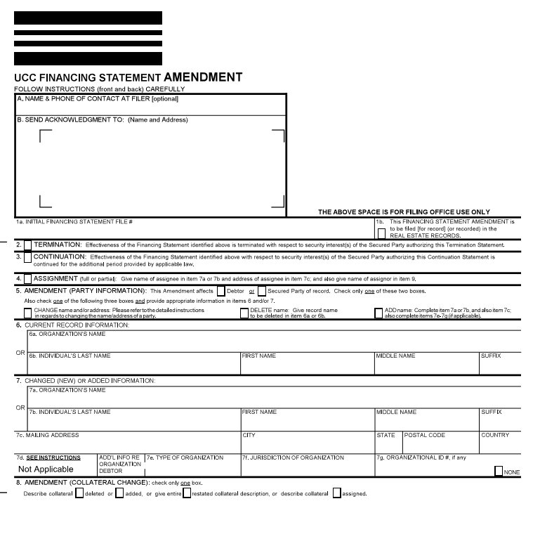
UCC-3 Financing Statement: Example
Initial Financing Statement file #
T/A/C/Amendment
Current vs. New Information

Slide 21
CASE LAW EXAMPLE

Slide 22
Case Law
Scarver v. Silverline Servs
605 B.R. 264, Georgia
The debtor is a limited liability company. The name was officially changed from NTC Waste Group LLC to Wastetech, LLC in July of 2017
From June 2017 to September 2017, six UCC filings were filed against the name NTC Waste Group LLC
All filings included same vague collateral language
Debtor filed for bankruptcy
Trustee objects to both name and collateral statement
Is the name on the filings misleading?
Is the collateral language sufficient?
SP tries to use the
4-month rule for incorrect name
Court looks at 9-502, & 9-503(a)-debtor name only sufficient if consistent with name of debtor on public organic record. If not then you end up in “SERIOUSLY MISLEADING”
Court says 4 month does not apply
Collateral - Court said contain “KEY” information
Court determined the collateral description is INSUFFICIENT
Filings deemed seriously misleading

Slide 23
Collateral Description—Scarver Case
Grant of Security Interest/UCC-1 Financing Statements. To secure the performance of [Debtor's] obligations hereunder, [Debtor] grants to [Defendant] a continuing security interest in all of [Debtor's] Future Receivables, inventory, equipment, goods, accounts, investment property, and other personal property and assets, and [Debtor] authorizes [Defendant] to file one or more UCC-1 Financing Statements prior to each sale of Future Receivables for purposes of providing public notice of the purchase by [Defendant] from [Debtor] of the Receivables Purchased Amount of Future Receivables and [Defendant's] security interest in all of [Debtor's] Future Receivables, inventory, equipment, goods, accounts, investment property, and other personal property and assets. The UCC-1 Financing Statements will state that the sale of the Future Receivables is an outright sale and not an assignment for security

Slide 24
Summary—Revisiting The Agenda
UCC Background and Scope—Business Needs—Very Wide
The “W”s Of Filing---Why and Who
UCC 1---Our Foundation Document
UCC 3----The Swiss Army Knife
Sample Case---Gives us the Dimension
Questions----AND NOW---QUESTIONS?

Slide 25

THANK YOU

