Slide 1
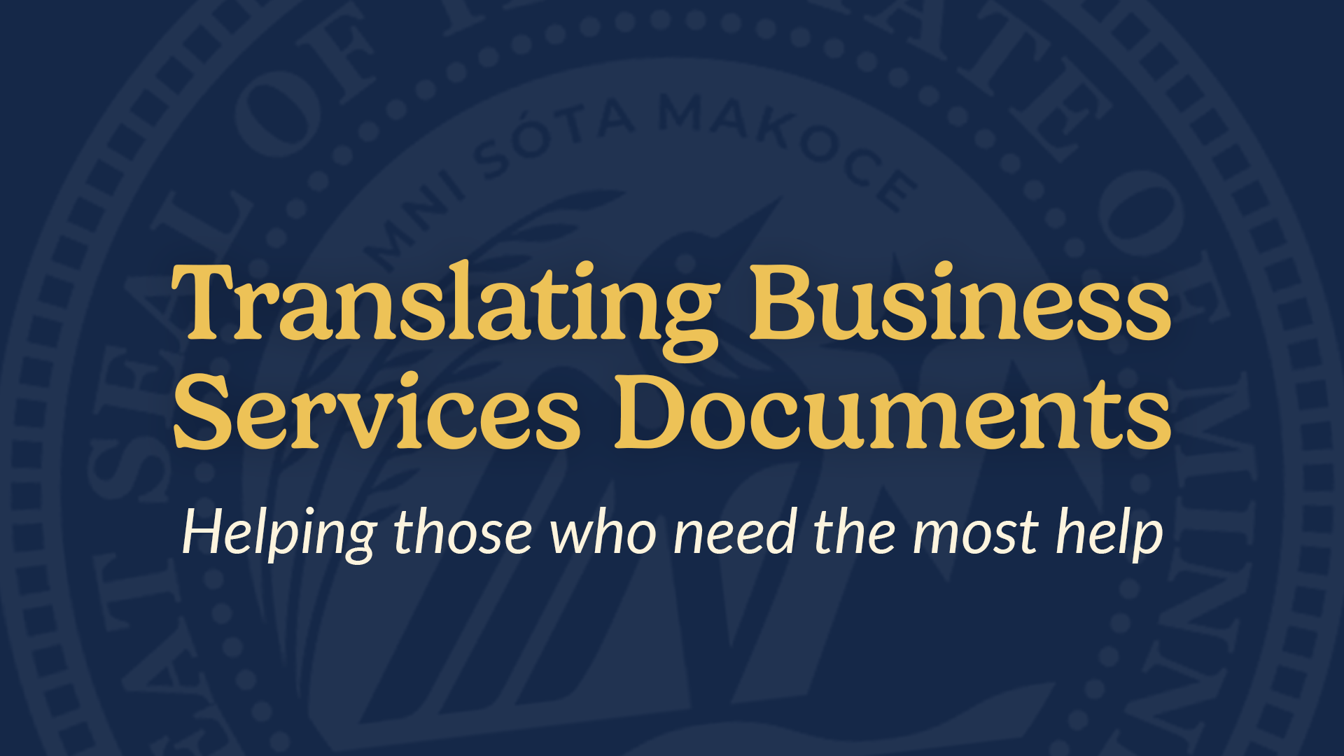

Slide 2
As it will become VERY CLEAR
I am not an expert.

Slide 3
Well, what do all of the rest of you do?

Slide 4
What do the other states translate?
Elections
Apostille
Business Services
UCC
All Four?
17 States
8 States
4 States
3 States
Zero States

Slide 5
What languages?

Slide 6
Spanish
Somali
Hmong
Russian
Chinese
Karen
Lao
Vietnamese
Amharic
Khmer
Oromo
“How to Register your Business”
“How to Renew or Amend Your Business Filing”
“Additional Actions Yellow Sheet”
“How to Create an Account”
“How to Get an Apostille”
“How to Order Copies”
“CTA/BOI”
Language Hub Welcome Language

Slide 7
How much does
Google Translate cost?

Slide 8
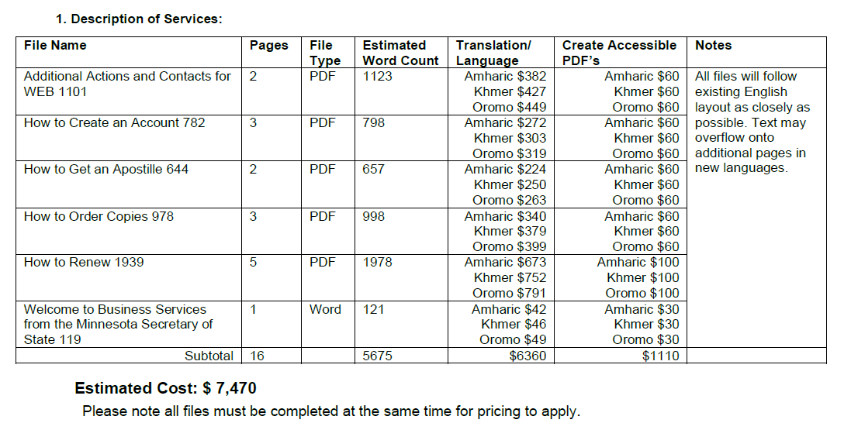
AMHARIC - $0.34 | KHMER - $0.38 | OROMO - $0.39

Slide 9
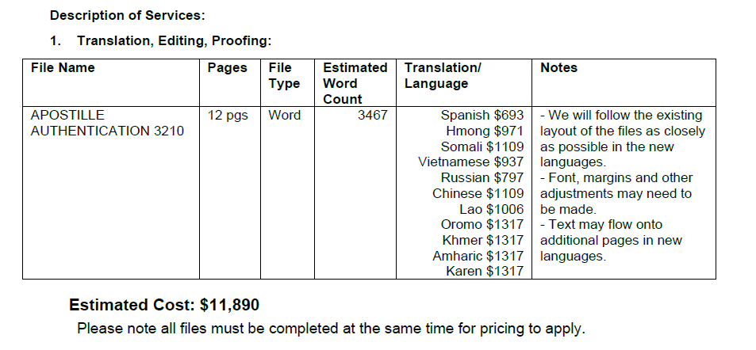
In 2023 we received an ongoing $40K appropriation for translation and outreach.
Plus an FTE!

Slide 10
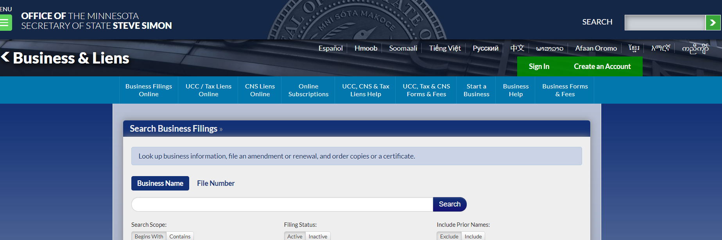
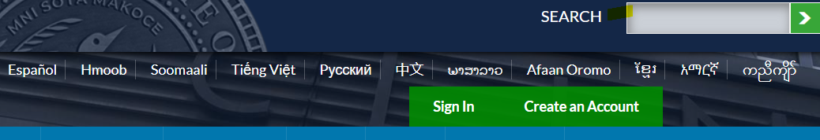

Slide 11
Language Hubs vs
Integrated Content

Slide 12
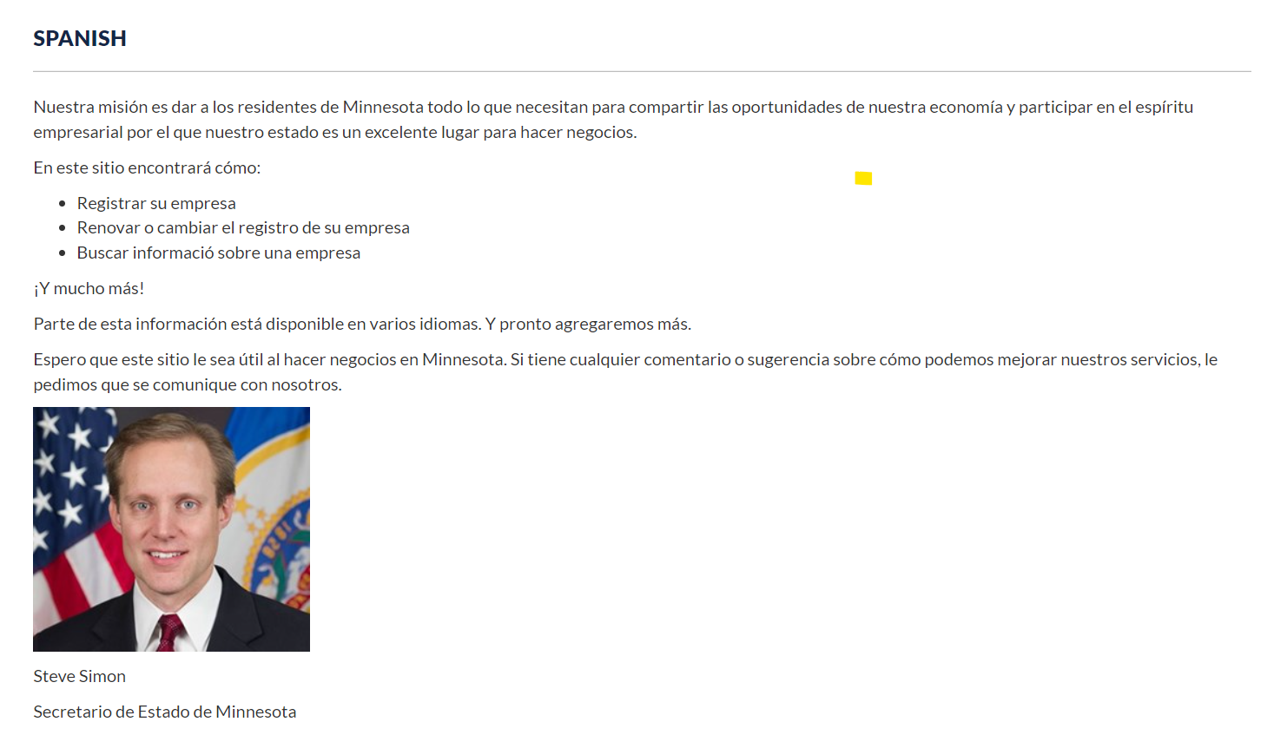

Slide 13
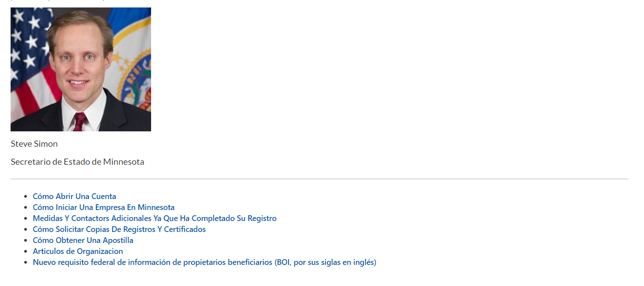

Slide 14
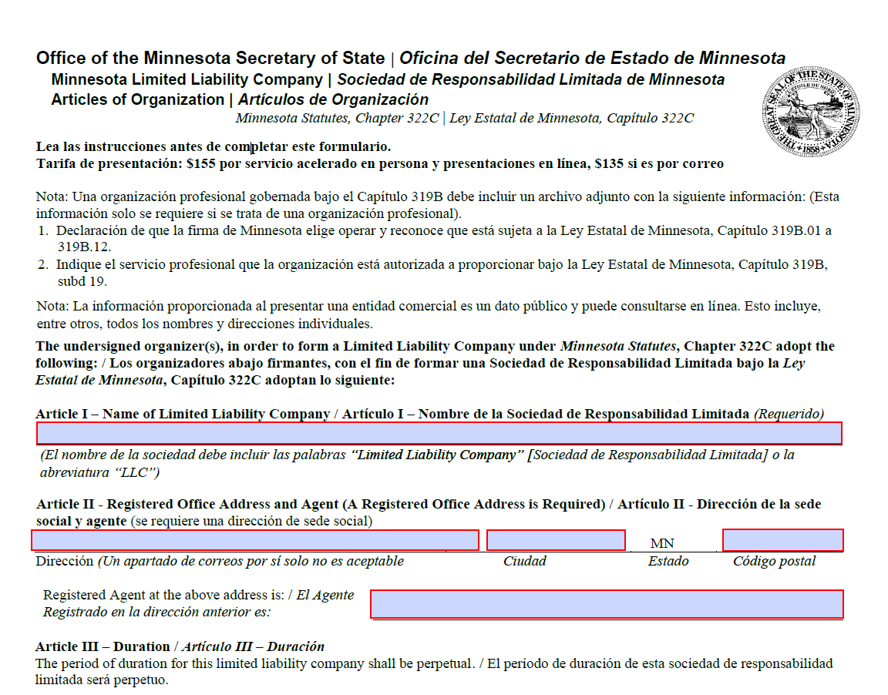

Slide 16
