Slide 1
Business Continuity
&
Disaster Recovery
By William Rosenstein

Slide 2
Over 30 year of Information Technology experience
5 Rapid Response teams
2 Disaster Design and Audit teams
In both the private and public sectors
(Uniquely Qualified – NDs – GroupWise – Exchange - File Servers – Hardware failures – DOS – Hacking)
Introduction

Slide 3

What is Business Continuity and disaster Recovery?
Business Continuity and Disaster Recovery
Do I need to plan for it?
Policies and Procedures
The Plan
Testing
The Results

Slide 4
What is Business Continuity and disaster Recovery?
BC is a detailed plan that outlines the steps an organization will take to return to normal business functions in the event of a disaster.
DR More detailed in nature than BCs, disaster recovery plans consist of contingency plans for how enterprises will specifically protect their IT systems and critical data during an interruption.
Hardware Failure, DOS, Hacking, Infrastructure, Weather, VIRUS (Computer/COVID), Power, Protest
Anything that stop business from taking place

Slide 5
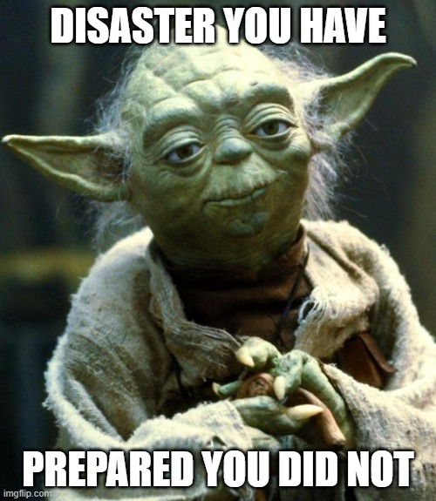
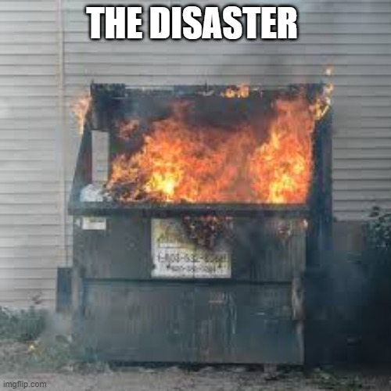
Why I need To PLAN
Why do I need a plan?
Who should be involved in the plan?
What should the plan include?
Are your systems Cloud based or onsite?
Backup media

Slide 6
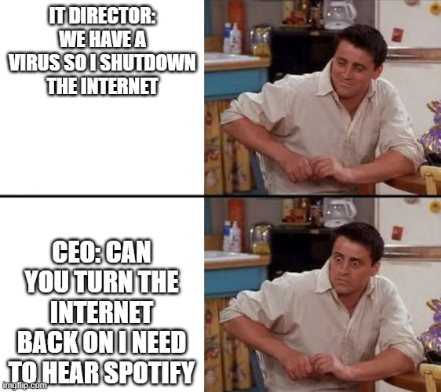
Policies and Procedures
  What happens when:
    Hacked
    Hardware failure
    Virus (computer/human)
    DOS
    Weather
    Power (backup power)
Procedures need to be defined, along with approval from the appropriate people

Slide 7
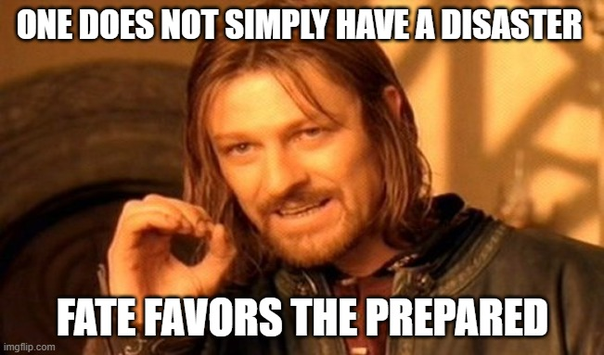
The PLAN
What systems are mission critical?
What systems can wait?
What kind of teams do you need?
  Mission critical
  Commutations
  Non-Mission critical
Are vendors needed?
What steps need to be taken?
Print a hard copy
Review the plan yearly
Included in the hard copy of the plan are: contact phone numbers for all vendors phone system and internet system Employee contact info and The Press if needed
Once the issue has been identified:
  What is the scope?
  What teams are needed?
  Commutations/internal and external

Slide 8

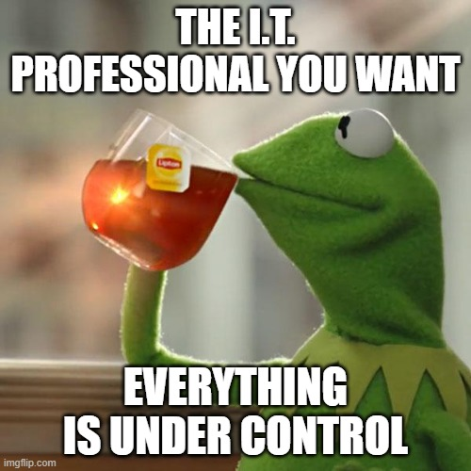

Testing
Test Site:
You test the same way you would if you had a real disaster. NO SHORT CUTS
Treat all systems as if they are down!
The pressure should feel the same during testing as it will in real life. Put up deadlines on how long task should take.

Slide 9
The Results -- aftermath
Every time you test or have a disaster you need to do a review of what happened, what went wrong and what went right.
Identify issues in the procedures and correct them.
Identify what went as planned and document those as well.
Be open minded… mistakes will happen. The goal is not let the same mistake happen twice.
Review the plan yearly, staff, vendors, software, phone numbers change
Seek feedback
Reflect on performance
Explore new techniques
Iterate and adapt

Slide 10
THANK YOU
William Rosenstein
William.Rosenstein@ct.gov

