Slide 1




  INTERNATIONAL BUSINESS
  REGISTERS REPORT

Slide 2
Utilization of International Business Registers Report

Slide 3
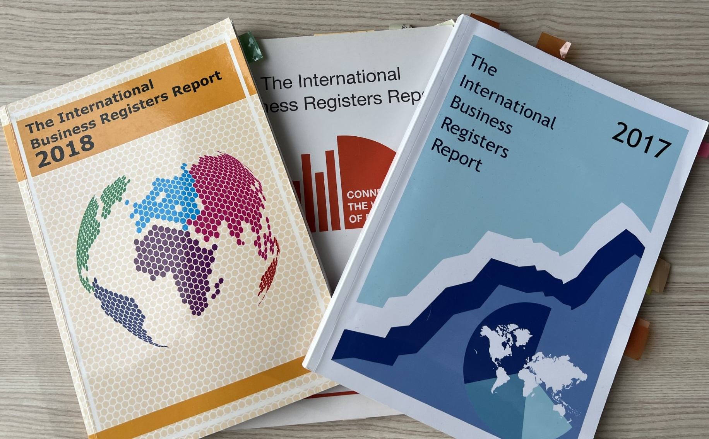

Slide 4
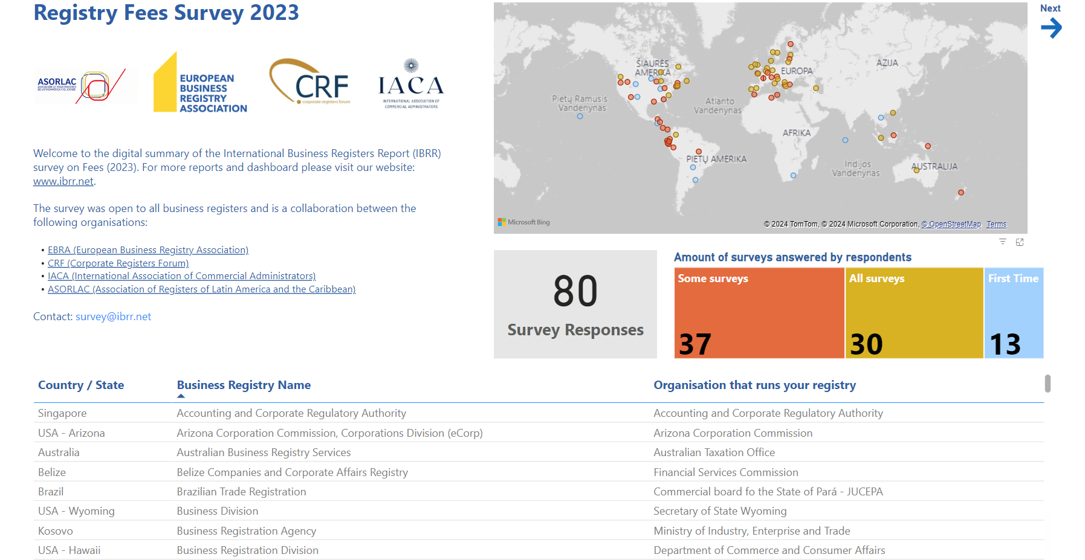

Slide 5




Implementation of the Digital Solutions – it’s not just “Digital”
Legal Framework
Assessments and diagnostics of the current digitalization landscapes
Design of advanced legal frameworks
Organization
Preparation for organizational reforms
Design and implementation of change management
Transfer of knowledge
Procedures
Reengineering existing procedures
Advisory on digital services implementation
Technology
BUSREG
BOREG
LIREG
SECREG
CRVS
OTHER REGISTERS

Slide 6
Utilizing the International Business Registers Report
  Useful Tools for NRD Companies:
  Benchmarking and Comparison
  Market Research
  Product Development
  Tailored Solutions
  Performance Monitoring and Analysis
  Partnership and Collaboration

Slide 7
Utilizing the International Business Registers Report
  Useful Tools for Registrars:
  Comparative Analysis
  Benchmarking
  Informing Decision-Making
  Identifying Trends
  Policy Formulation
  Capacity Building

Slide 8
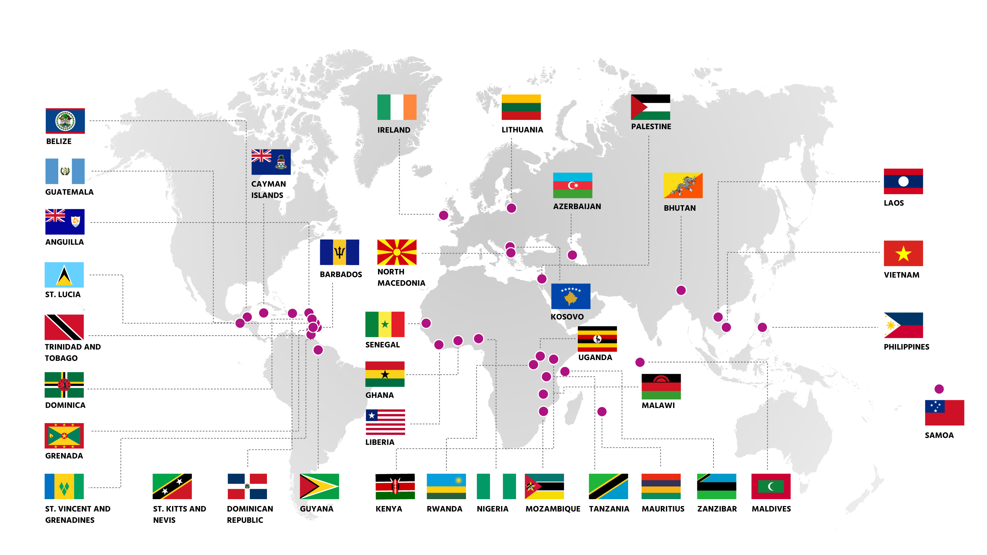
NRD Companies Implemented Register-Related Projects

Slide 9
Make your mark by contributing your data to the International Business Registers Report!

Slide 10
Why Data Verification
  Decision Making
  Compliance
  Customer Trust

Slide 11
Benefits of Comparing Different Jurisdictions
  Best Practices
  Benchmarking Performance
  Risk Mitigation
  Regulatory Compliance
  Market Analysis
  Enhanced Trust and Transparency

Slide 12

Upcoming Survey
Data Verification
  Launch 1st of October
  Deadline 15th of November

Slide 13
Business Registry Insights
  BR Insights
  Why the change?
  What does BR Insights mean?
  Advantages of rebranding
  Our Vision
New Website – coming soon
New Logo – coming soon
Stay tuned and don’t miss our upcoming announcements

