Slide 1






European Business Registry Association
EBRA update 2024 – Ana Del Valle

Slide 2

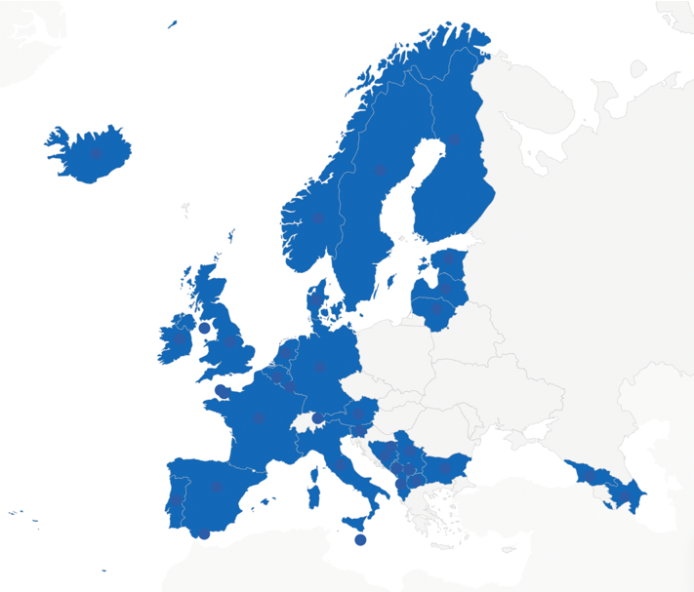
EBRA is growing
EBRA Board run the Association
43 Business Registry Members from EU and non-EU countries representing 36 jurisdictions
January 2023 - new members Bulgaria
and Iceland
December 2023 - Cyprus joined

Slide 3



​
EBRA Working Groups
Meet 2-3 times a year
Over 60 participants at each meeting
Online and in-person attendance
Members communication Platform (Basecamp)
Beneficial Ownership Working Group
Company Law Working Group

Slide 4
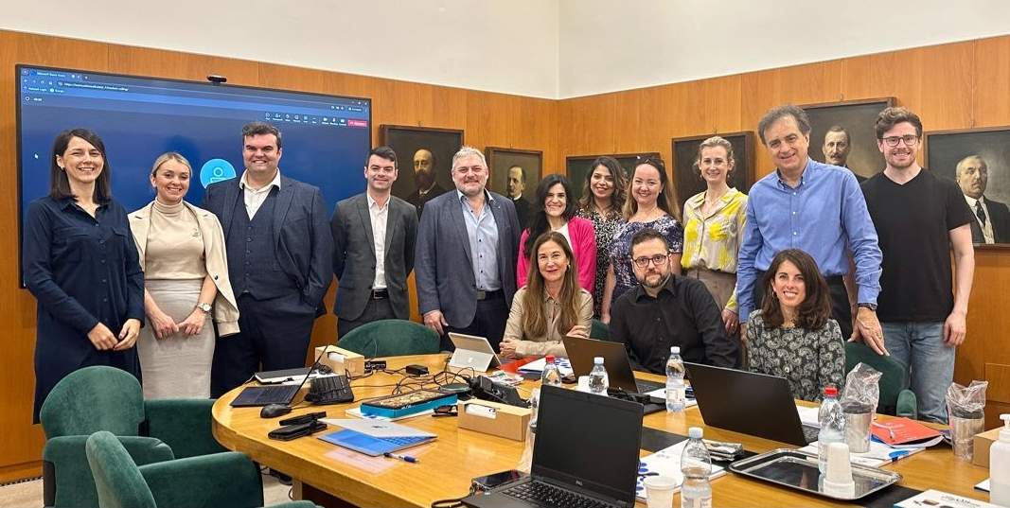



International BRs Report Project
Managed by a group of registry experts from across the world
Survey is fully digital
Two surveys every year
Results are available in a digital dashboard
Last survey had over 90 responses
In collaboration with:

Slide 5

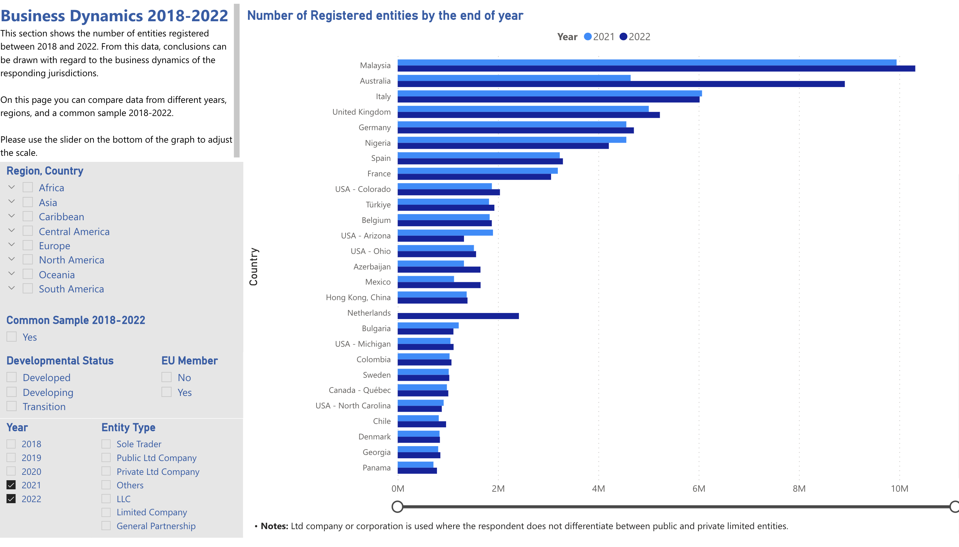
International Survey and Report
www.ibrr.net
Results are published in a digital dashboard
In collaboration with:

Slide 6
​
EBRA’S NEW STRATEGY 2024 - 2028
During 2023, the EBRA board developed a new strategy for the Association
Members were kept informed and provided feedback via workshops
Earlier this year, the final strategy was finalised and published

Slide 7
​
EBRA’S NEW STRATEGY 2024 – 2028:
six strategic themes
Increase the dialogue with European institutions
Explore the possibility of a better knowledge management platform for members
Engage with members to understand and define best practice for registers
Create improved governance for EBRA working groups
Mandate the Board to explore opening EBRA membership to other register types (related to the business registers)
Mandate the Board to explore opening EBRA membership to business registers outside of Europe

Slide 8
EBRA: Looking Forward
Implementing the new EBRA Strategy
The future of the EBR Platform – pilot project
Cybersecurity Network

Slide 9


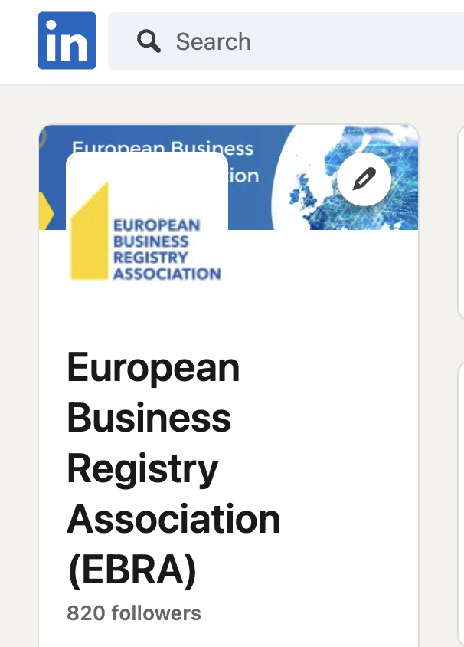


FOLLOW EBRA
@EBRA_BusReg
www.ebra.be

Slide 10

Thank you

