Slide 1
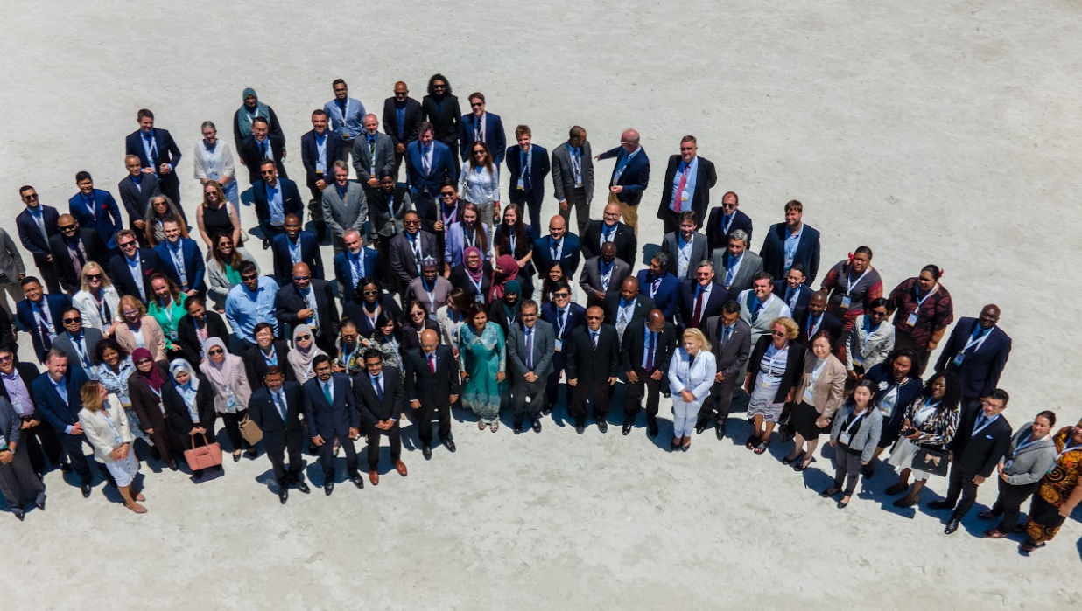

Presentation by La Donna John
Executive Member of the Corporate Registers Forum
CORPORATE REGISTERS FORUM UPDATE
IACA Conference, May 2024
Notes:
Bonjour tout le monde (two ler mon-duh).

Slide 2
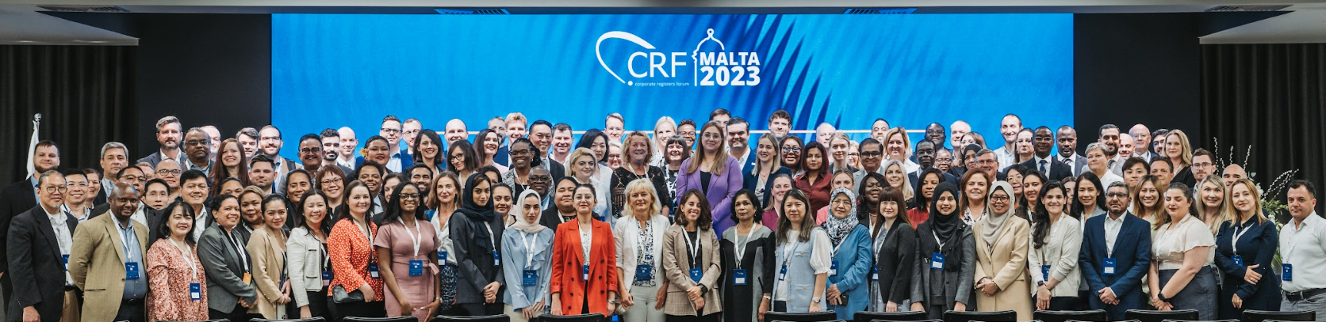
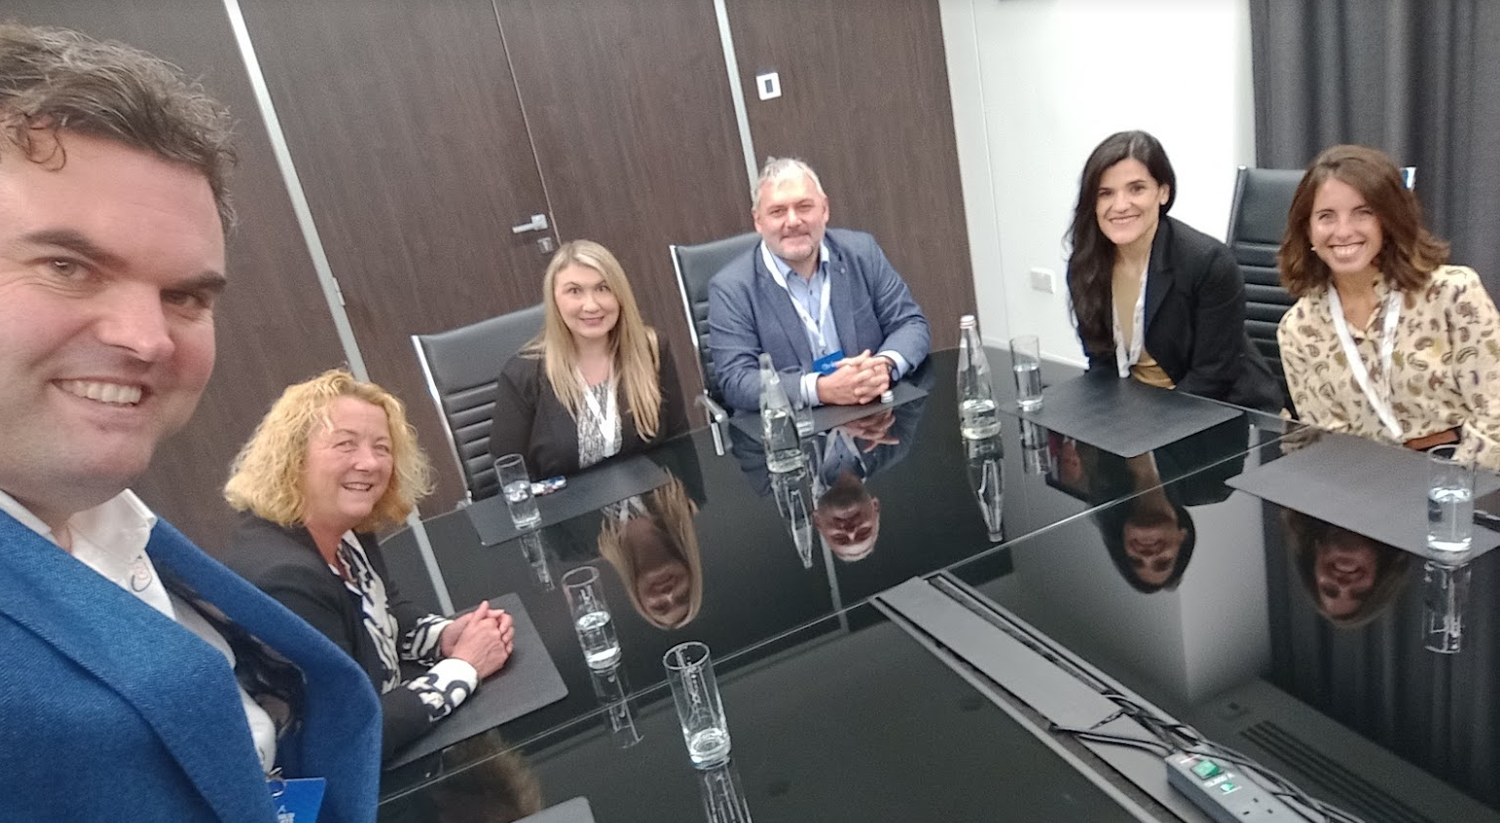
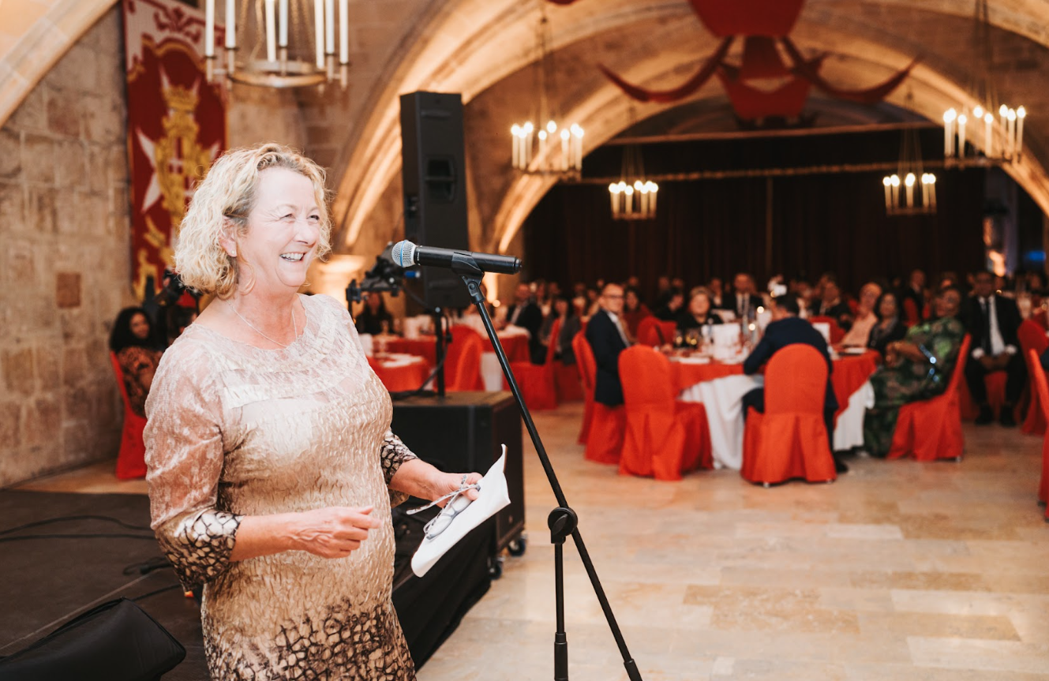
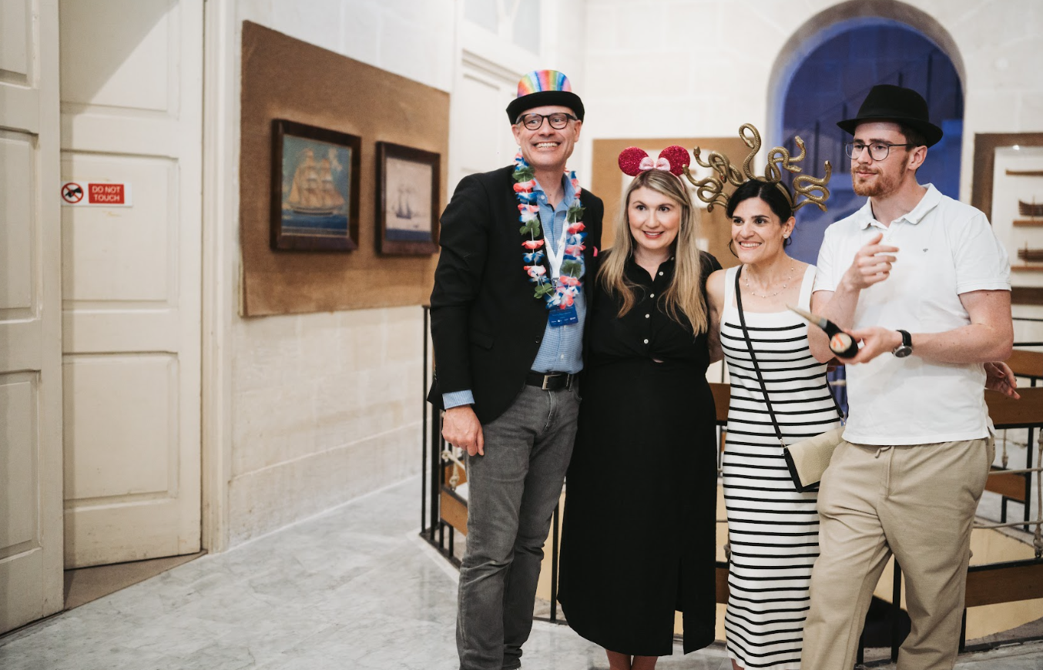
CRF 2023, Malta
Presentation by La Donna John
Executive Member of the Corporate Registers Forum
CORPORATE REGISTERS FORUM UPDATE
IACA Conference, May 2024

Slide 3
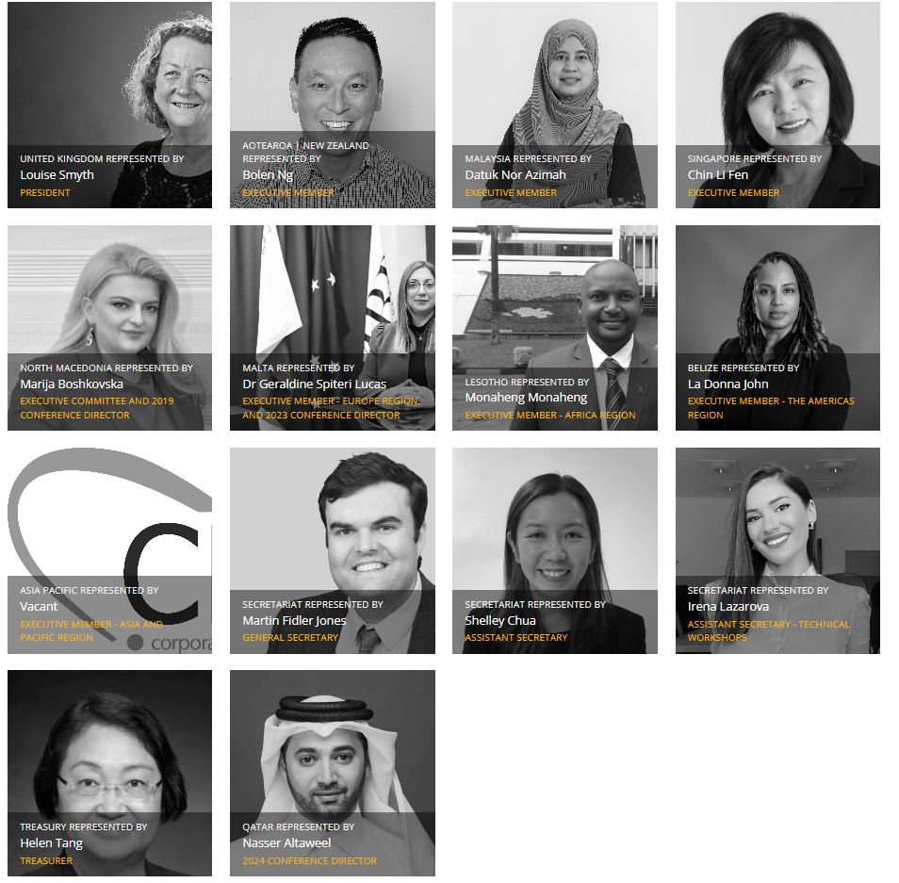
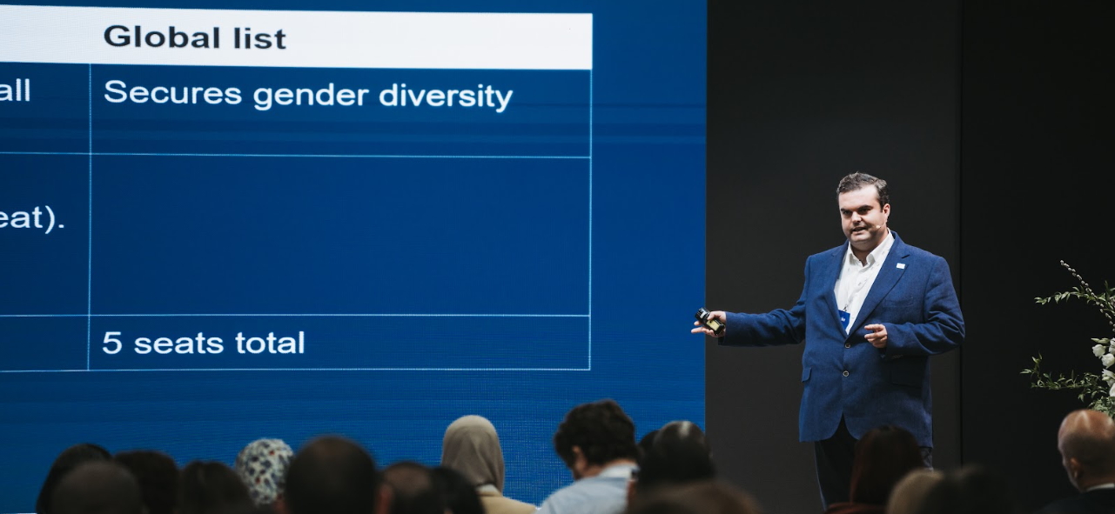
New constitution
Executive:
  Regional members
  Gender balance
64 members
  5 continents
Presentation by La Donna John
Executive Member of the Corporate Registers Forum
CORPORATE REGISTERS FORUM UPDATE
IACA Conference, May 2024
Notes:
Our executive committee (EXCO) meets on a monthly basis from 4 corners of the globe.
We are really proud to have such a diverse mix of people, and thought and, incredibly female led! We reformed our constitution in 2024, introducing an innovative twin track system that gives us regional representatives, as well as enshrining gender diversity for the very first time.

Slide 4
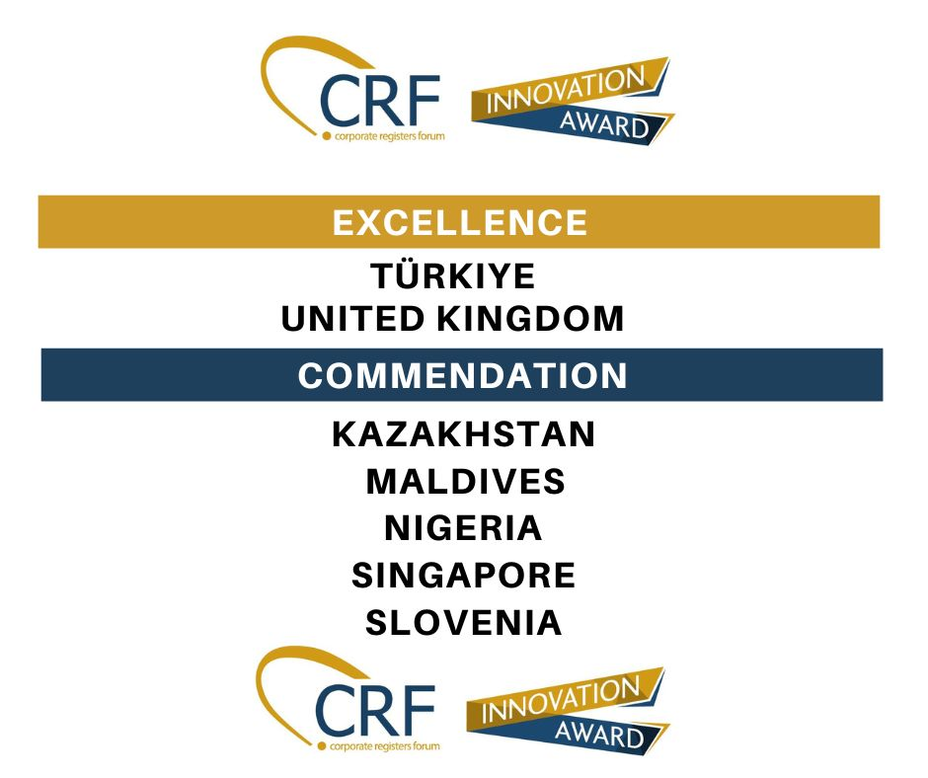
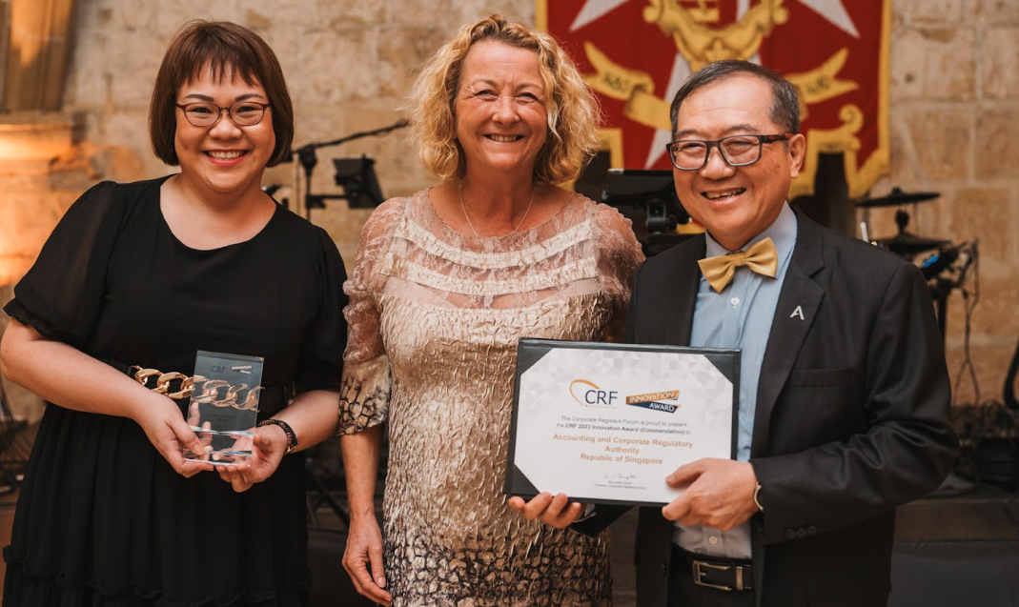
Innovation Awards
13 submissions
10 members
2 Excellence awards
5 Commendations
Award ceremony at 2023 Annual Conference
Presentation by La Donna John
Executive Member of the Corporate Registers Forum
CORPORATE REGISTERS FORUM UPDATE
IACA Conference, May 2024
Notes:
Excellence winners presented at our annual Conference in Malta.
Commendation winners presenting to our Technical Workshops (next slide)

Slide 5
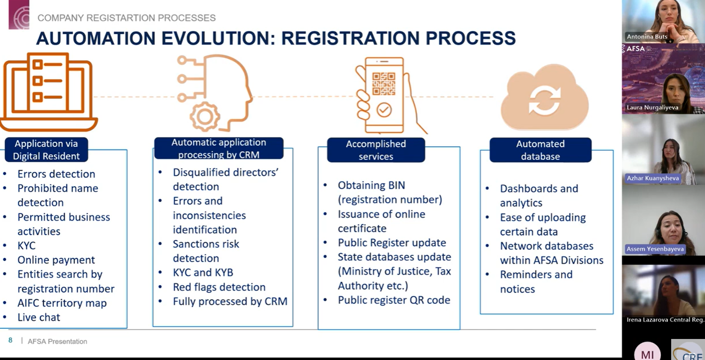
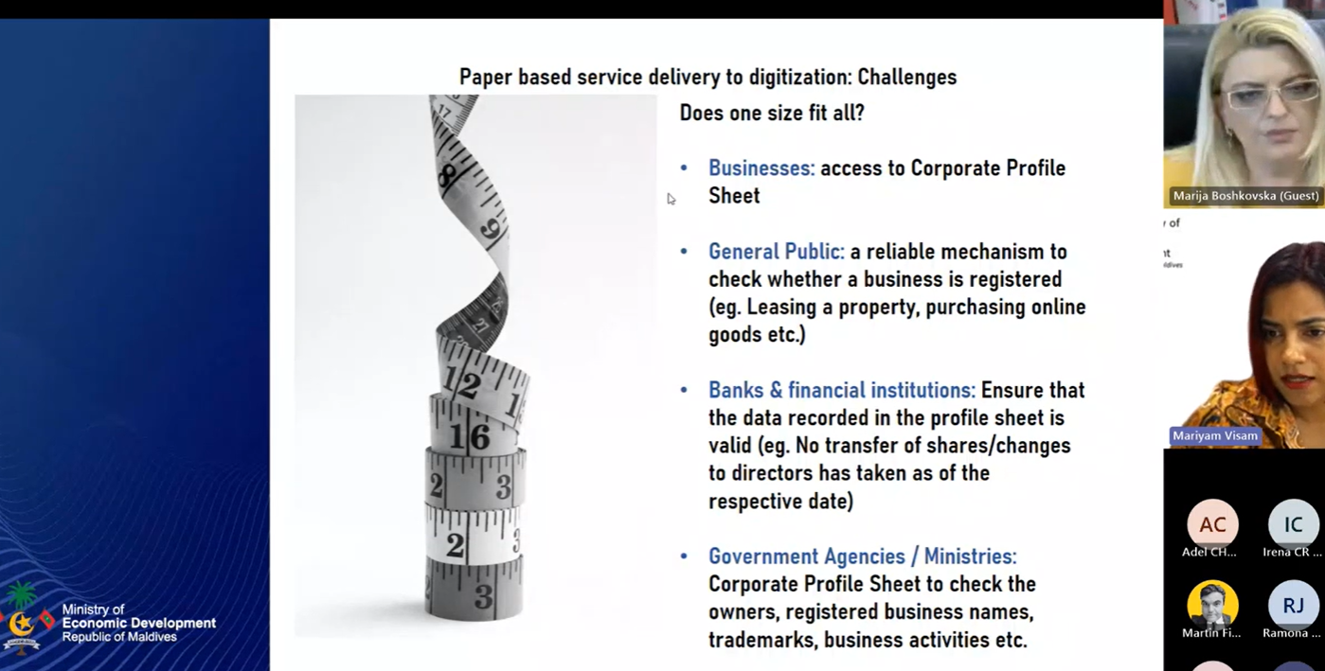
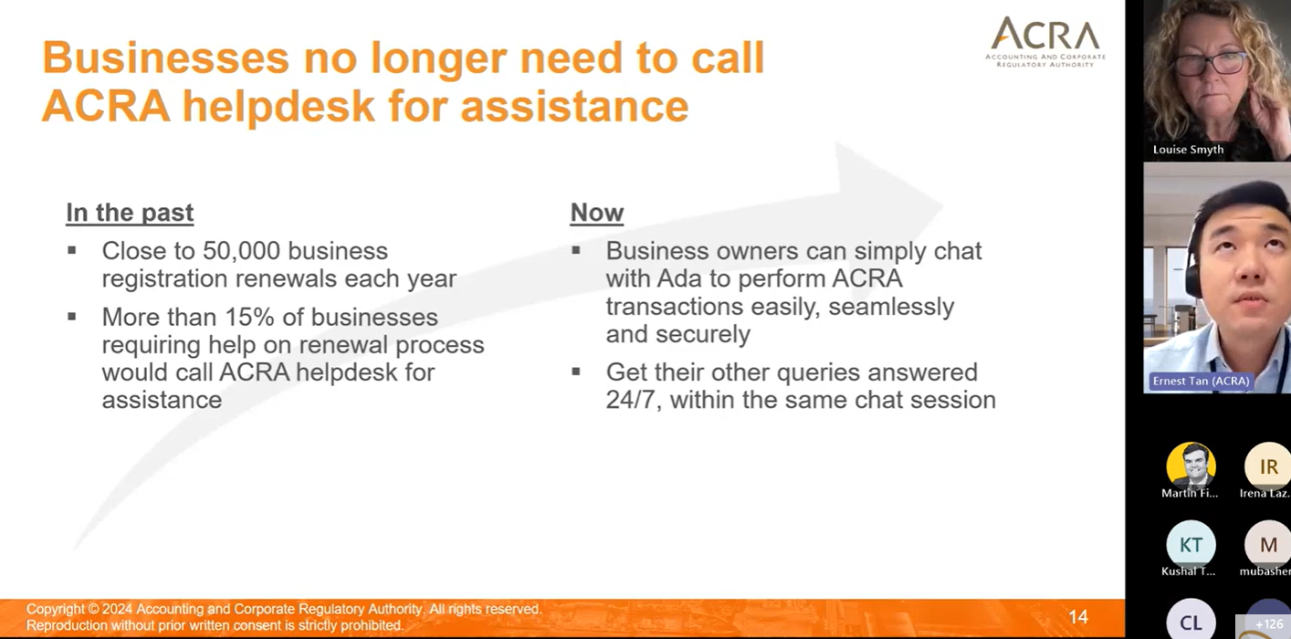
Technical Workshops
Maldives
Singapore
Kazakhstan
Presentation by La Donna John
Executive Member of the Corporate Registers Forum
CORPORATE REGISTERS FORUM UPDATE
IACA Conference, May 2024
Notes:
One of the things we've really continued to embrace is quarterly technical workshops. These workshops are a chance for us to share best practices and learn from each other.
In September 2023, we held a workshop on the Maldives Corporate Profile Sheet & Verification Service.
In January 2024, Singapore showcased their Ask ADA chatbot while just last month Kazakhstan demonstrated their powerful Digital Resident platform.
We're really excited about these workshops. They're a great way to learn, network, and stay up-to-date on the latest work of our members.
We hope that these workshops will give our members to connect with other professionals, learn new things, and feel a little bit more connected.

Slide 6
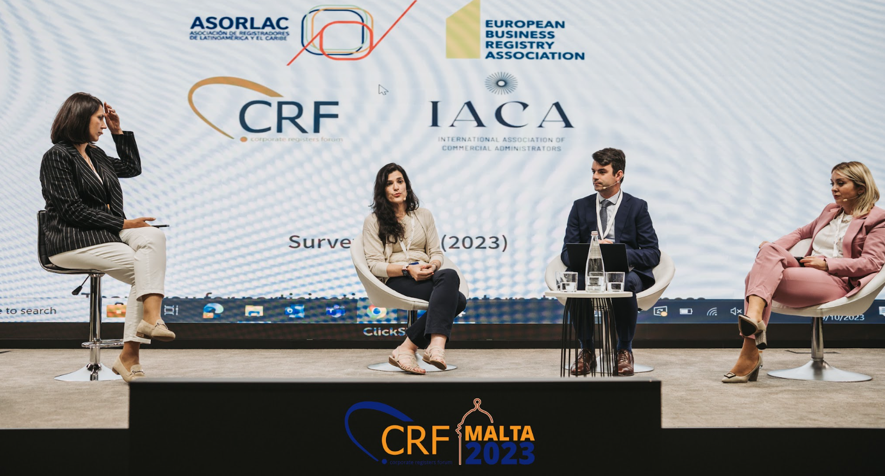
Business Registry Insights
(formerly IBRR survey)
Presentation by La Donna John
Executive Member of the Corporate Registers Forum
CORPORATE REGISTERS FORUM UPDATE
IACA Conference, May 2024
Notes:
We are proud of our international and inter-association collaboration between ASORLAC, IACA, EBRA and CRF which as I know IACA members proudly participate in (even if sometimes you need a little reminding from Marissa!). The IBRR was recently rebranded to the Business Registry Insights and the steering group are a true international collaboration of registry professionals.

Slide 7
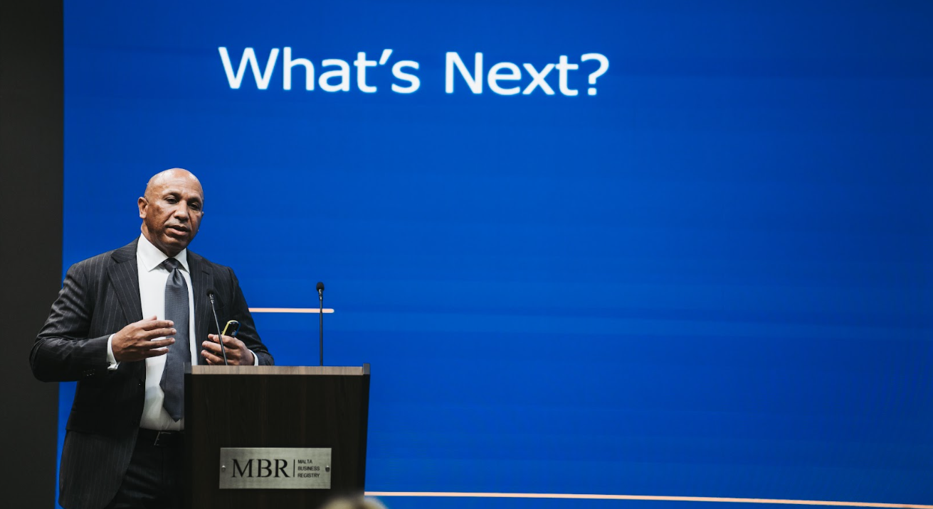
Global Beneficial Ownership Working Group
New partnership model
Presentation by La Donna John
Executive Member of the Corporate Registers Forum
CORPORATE REGISTERS FORUM UPDATE
IACA Conference, May 2024
Notes:
Launching new global Beneficial Ownership Working Group in July with the first in person meeting at our Qatar Conference.
Also working on further governance reform, to allow the wider ecosystem of corporate registry world to be more involved in the CRF, beyond corporate registries.

Slide 8
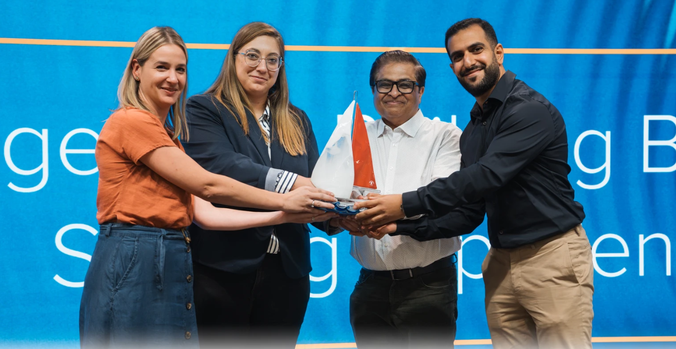

CRF 2024, Qatar
Malta passing the baton onto Qatar.
3-7 November in Doha.
Early bird registration will open next month!
Presentation by La Donna John
Executive Member of the Corporate Registers Forum
CORPORATE REGISTERS FORUM UPDATE
IACA Conference, May 2024

