Slide 1
Ethics for AI and Robotics
Benjamin Kuipers
Computer Science & Engineering
University of Michigan, Ann Arbor
Notes:
Panel at International Association of Commercial Administrators (IACA),
Conference in Detroit, Michigan, 21 May 2024

Slide 2
CSE 543: Ethics for AI and Robotics
My AI research is on commonsense knowledge.
  I consider Ethics to be a type of common sense.
  This upper-level course is mostly for grad students.
Major topics:
  Foundations
    Philosophy, game theory, evolution, trust and cooperation
  Autonomy and Safety
  Privacy and Surveillance
  Fairness and Bias
  Jobs and Economic Inequality
  Existential Threats to Society or Humanity

Slide 3
CSE 543: Ethics for AI and Robotics
My AI research is on commonsense knowledge.
  I consider Ethics to be a type of common sense.
  This upper-level course is mostly for grad students.
Major topics:
  Foundations
    Philosophy, game theory, evolution, trust and cooperation
  Autonomy and Safety
  Privacy and Surveillance
  Fairness and Bias
  Jobs and Economic Inequality
  Existential Threats to Society or Humanity
Notes:
In this talk, I will talk about Privacy and Surveillance.
Another highly relevant topic for this audience is Fairness and Bias, but we won’t have time today.
In a different talk, I spent time on Autonomy and Safety, and on Jobs and Economic Inequality.
All of these are important.

Slide 4
What is Ethics for?
Ethics
Ethics balances the interests of individual decision-makers with the interests of the society that supports them.
Society
Notes:
Ethics balances the interests of individual decision-makers with the interests of the society that supports them.

Slide 5
What is Ethics for?
Ethical principles
Ethics balances the interests of individual decision-makers with the interests of the society that supports them.
Trustworthiness
Trust
Cooperation
Social norms
Positive-sum
outcomes
Save resources for
defense & recovery
Resources
for society

Slide 6
What is Ethics for?
Ethical principles
Trustworthiness
Trust
Cooperation
Social norms
Positive-sum
outcomes
Save resources for
defense & recovery
Resources
for society

Slide 7
Trust and Trustworthiness
Trust:
  Trust is a psychological state comprising the intention to accept vulnerability based on positive expectations of the intentions or behavior of another.
      [Rousseau, Sitkin, Burt & Camerer, 1998]
Trustworthiness:
  Ability, Benevolence, Integrity
      [Mayer, Davis & Schoorman, 1995]
  Integrity: willingness to honor previous commitments, even after learning that a better choice is available.
Notes:
Positive-sum games don’t guarantee that every participant comes out ahead.

Slide 8
Cross-cutting Themes
Trust and cooperation are central to the success of a society, and of individuals within it.
  Supports “positive-sum” interactions.
Many ethical failures are due to “invisible hazards.”
  Models that omit critical things make bad decisions.
    Trust as a valuable capital asset.
Are corporations and agencies types of AIs?
  They are not people. People are components.
    Plus: documents, corporate procedures, committees.
  They are mechanisms for cooperation.

Slide 9
AI Problems, and Solutions
Privacy and Surveillance
  We are observed everywhere, all the time.
  Is it OK to aggregate, correlate, and sell that data?
Fairness and Bias
  AI is recommending (or making) decisions.
  Is everyone treated fairly?
  What does “fair” actually mean?
Notes:
This talk will cover Privacy and Surveillance, not Fairness and Bias.

Slide 10
Privacy and Surveillance
We are observed everywhere, all the time.
  Location via GPS and cell tower connections
  Video tracking via cameras, Ring doorbells,
  Voice via cell phones, Siri, Alexa,
  Identity via license plates, facial recognition, DNA
  Interests via web browsing, search, LLM use.
  Friends and associates via social media and email.
  . . . And more . . .
Our data is sold, aggregated, correlated, re-sold.
  Strong conclusions from large amounts of weak data.
  “Creepy omniscience” about our interests.

Slide 11
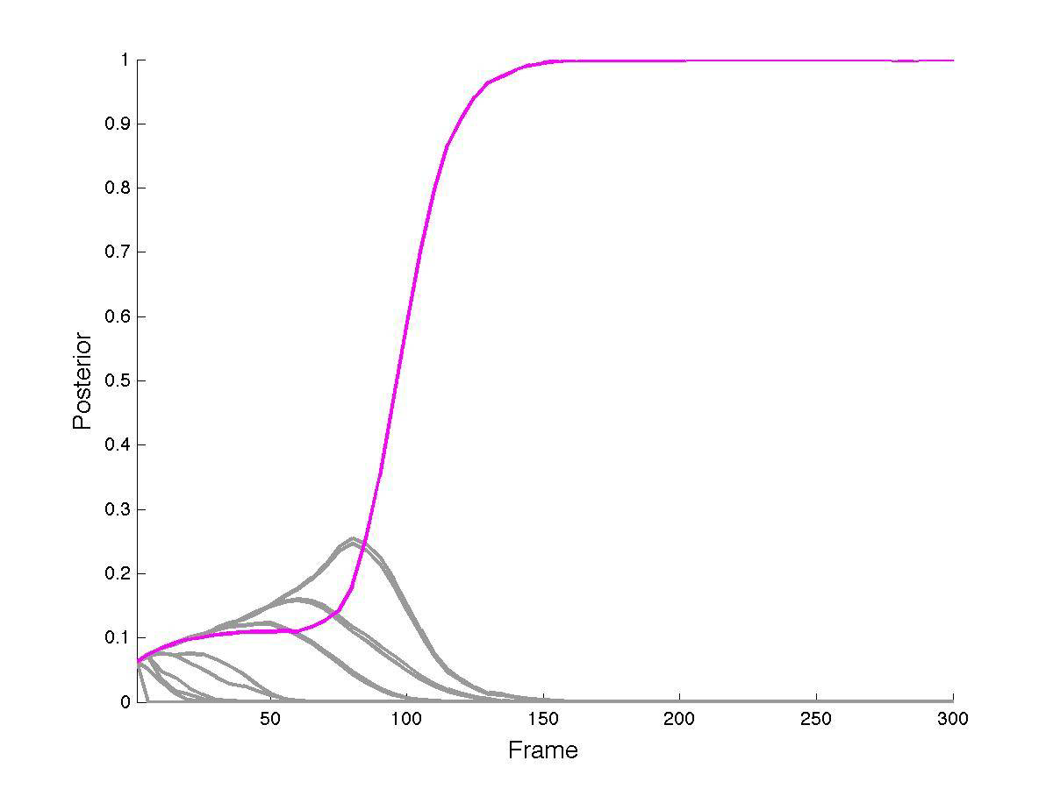
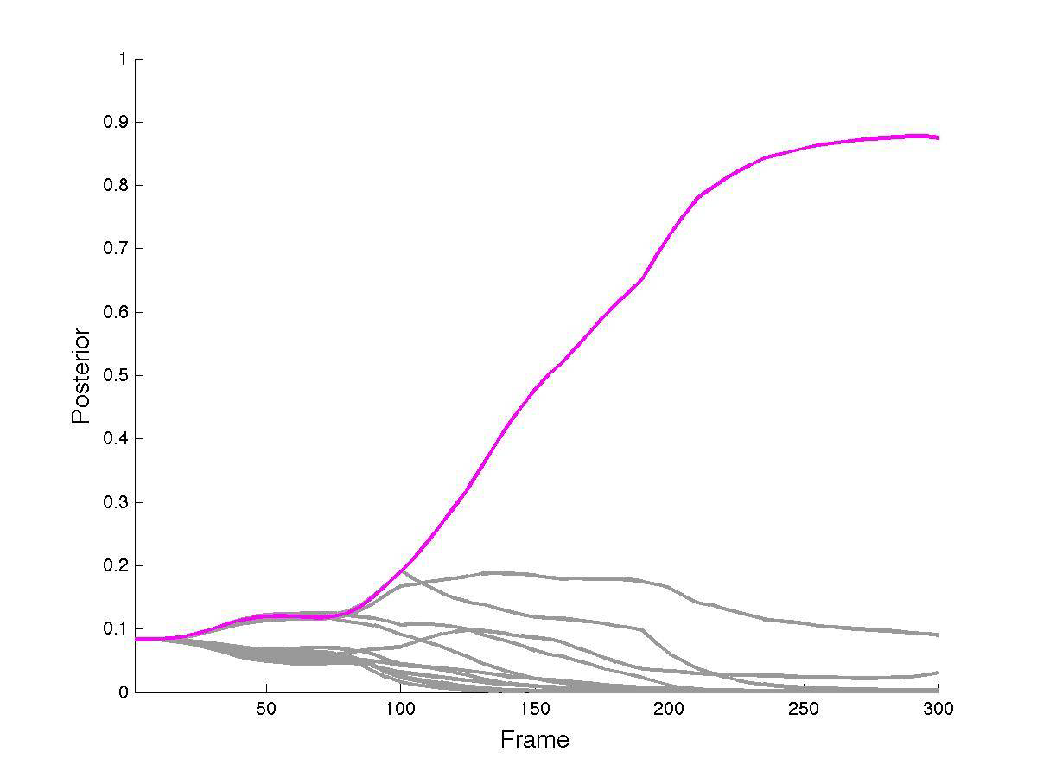
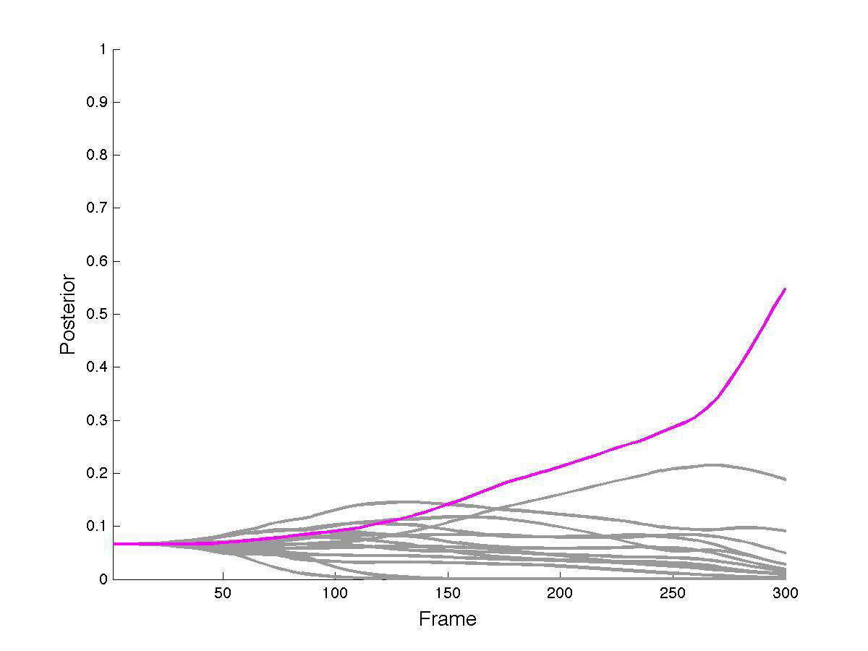
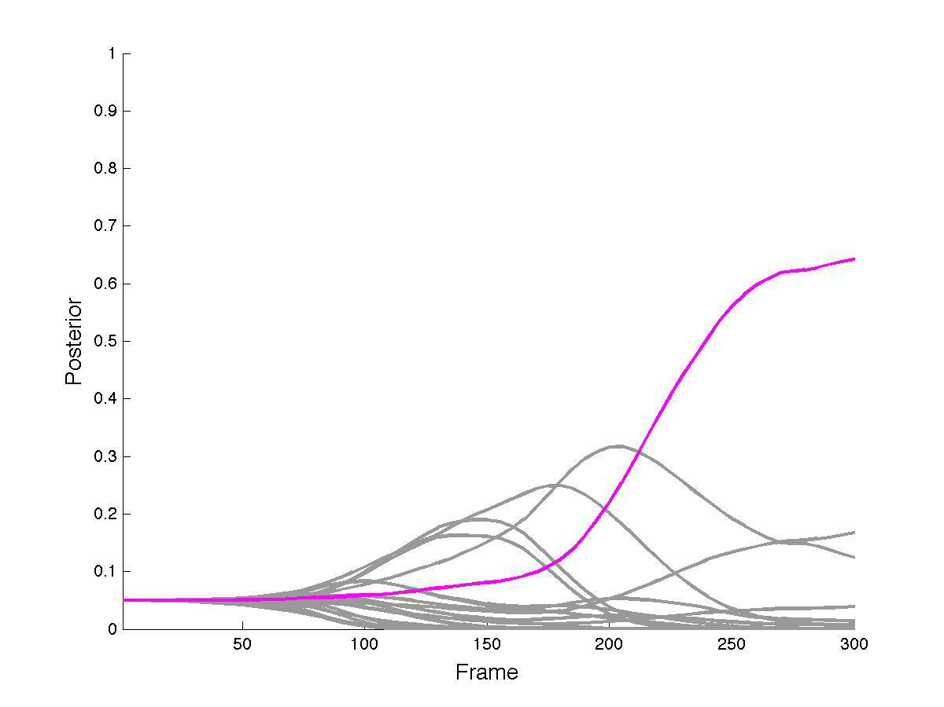
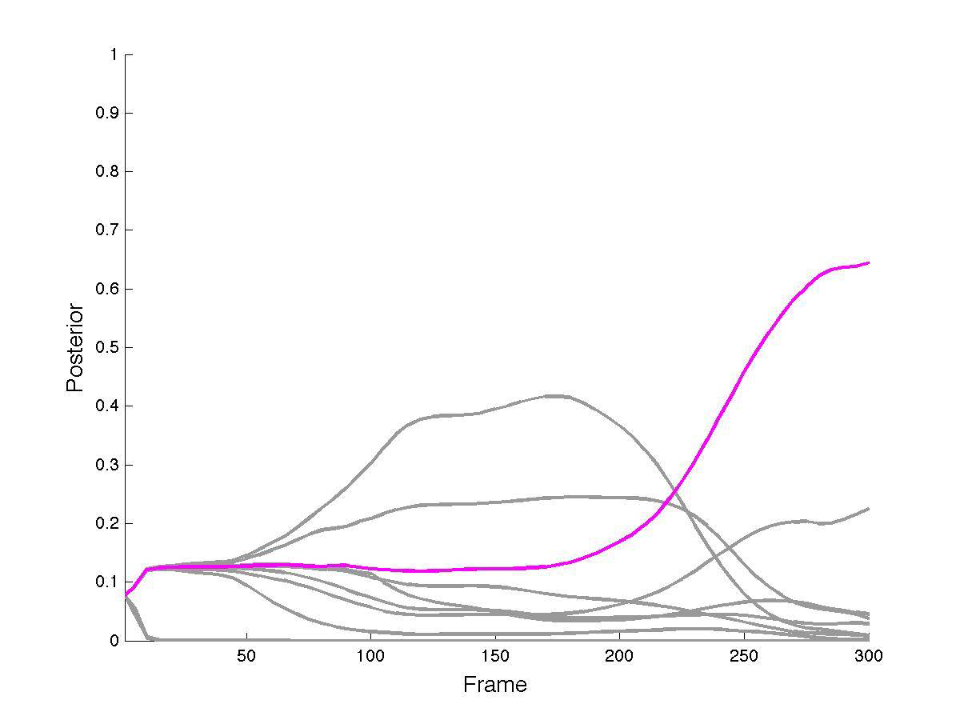
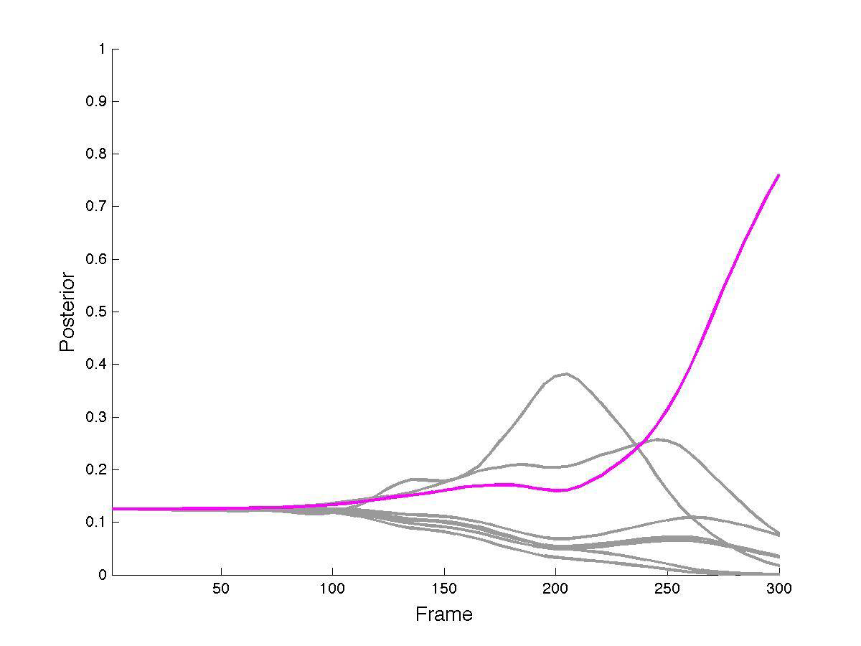
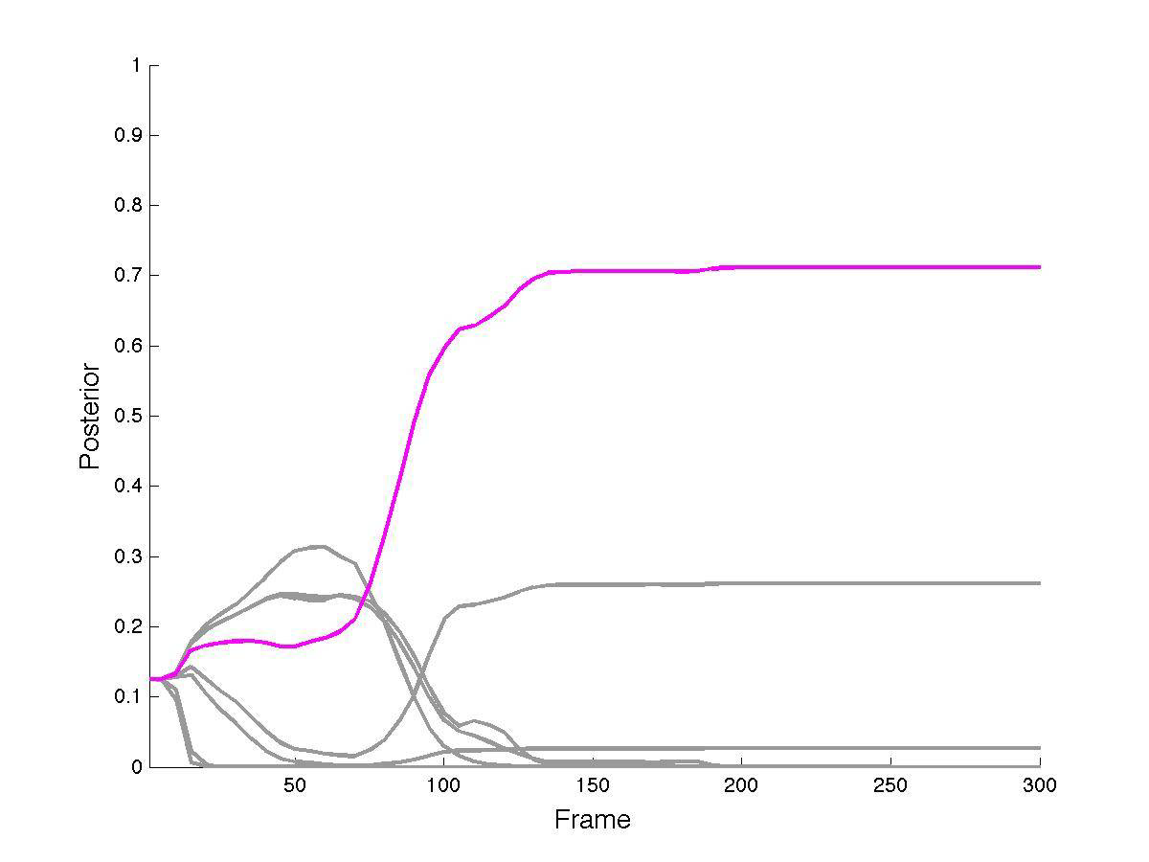
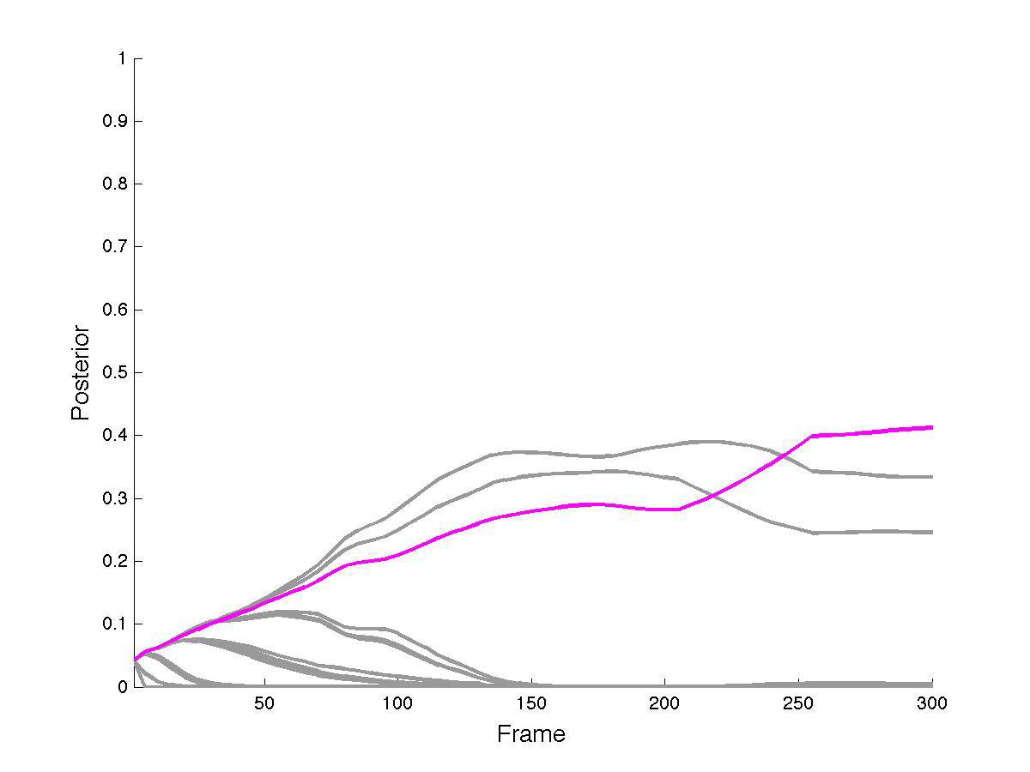
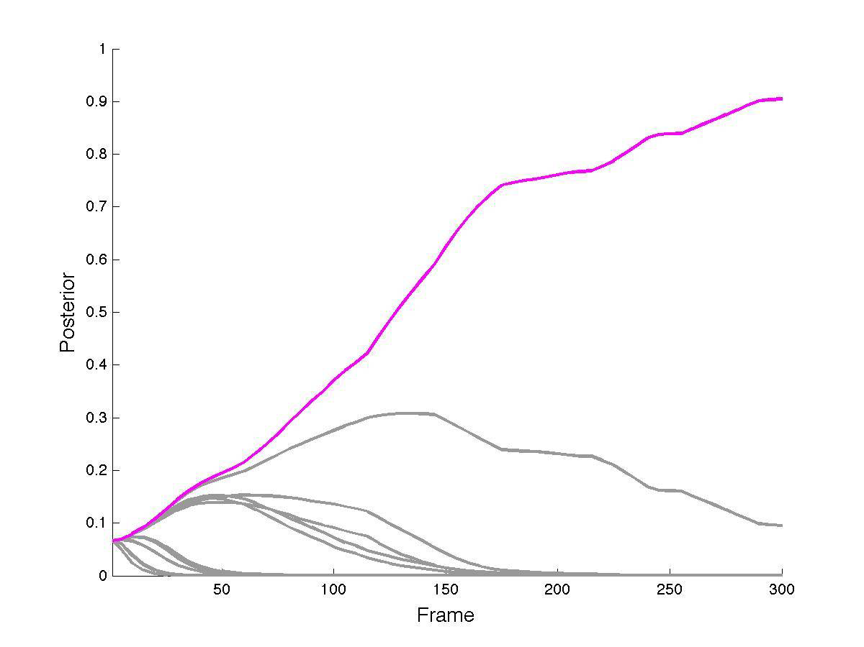
Strong Conclusions from Weak Data
Bayesian inference draws strong conclusions.
Notes:
Tsai & Kuipers (ICCV, 2011). Visual feature change during motion selects among hypotheses about 3D structure of the environment.

Slide 12
The Problem of Surveillance
The sensors and analysis tools for surveillance are everywhere.
  We have lost control of our information.
  We may be left with no privacy.
It might be possible to regulate surveillance.
  We need to understand what drives it.
Two major feedback loops drive surveillance:
  Surveillance Capitalism
  Authoritarian Control

Slide 13
Surveillance Capitalism
Your behavior provides clues about your nature:
  Your beliefs, desires, goals, plans, and actions.
  Both online and offline behavior are accessible.
This information is valuable to advertisers
  to identify receptive individuals
  to get them to buy products or vote for candidates.
Data brokers aggregate, correlate, and re-sell data.
  The more data they collect about more people, the more valuable it is.

Slide 14
The Value of Engagement
The longer a user spends on an app,
  the more valuable data they provide;
  the more time they are available for advertisements;
  the more money the app company makes.
    A positive feedback loop
Companies study what keeps users engaged:
  Moderate levels of outrage (“click bait”).
  Unintended consequence: cultural and political polarization.

Slide 15
What To Do About Surveillance?
Who owns your data?
  Do you? Or is it the app or website that collects it?
  Whoever owns it, can choose to sell it to others.
    Today: Whoever collects it, owns it. They can sell it.
You should own it. You decide who can see it.
  No one should use your data without your permission.
  What can a corporation offer you, for that permission?
This will require legislation.
  Opposition will be powerful.

Slide 16
Authoritarian Control
In a crisis, we may need quick decisive action.
What about the next pandemic? Contact tracing will be important.
  Test individuals for sign of infection.
  Trace their contacts, using data from surveillance.
    Test those contacts. Repeat.
  Contact tracing technology focuses health care resources more efficiently.
What about public safety and national security?
  There are real criminals and terrorists out there.
  Surveillance may help catch offenders.

Slide 17
Surveillance Threatens Democracy
Contact tracing is also a way to identify and isolate political opposition.
  Once you identify the structure of a social network, there are ways to disrupt them.
First Amendment: speech, press, gathering . . .
  These exist to allow ordinary citizens to provide negative feedback to those with political power.
    Negative feedback helps the U.S. survive bad leaders.
    People in power dislike negative feedback.
    When ordinary people speak up, they need protection.
Surveillance tools are dangerous to the mechanisms that preserve our country.

Slide 18
Contact Tracing
Under some circumstances, these tools may be essential for public health or national security.
  Under other circumstances, the same tools can be used for oppression, and are destructive to democracy.
Who should have access to my data?
  Available to anyone willing to pay?
  Access only via court order and/or search warrant?
    Can courts be trusted?
  Restricted to certain special agencies?
    Can government agencies be trusted?

Slide 19
Trust in Corporations and Agencies
Trust is a capital asset.
  Without people’s trust, you can’t do your job.
    Especially in a sudden crisis.
  Once trust is lost, it’s already too late.
    When the crisis occurs, nothing can be done.
You need to earn, build, and accumulate trust.
  Trust is earned slowly. It can be lost very quickly.
    Trust is not earned through PR or advertising.
  Trust is earned through costly signaling.
    Visibly invest resources in being trustworthy.
Notes:
Look at Boeing. Will they survive?
Think about Johnson & Johnson responding to the Tylenol poisoning crisis (Chicago, 1982).

Slide 20
Who Is This Lesson For?
Ethics, Trust, and Cooperation are essential to the welfare of our society.
Who are members of our society?
  Humans: individuals who make action decisions.
  Corporations: existing goal-oriented problem-solvers controlling vast wealth.
  Robots and AIs: near and far future decision makers.
Trust is an essential asset.
  Make earning and maintaining trust an explicit priority.

Slide 21
More AI Problems, and Solutions
AI Autonomy and Safety
  Deadly Dilemmas are not to be solved, but avoided.
  Learn about upstream decision points to avoid them.
Jobs and Economic Inequality
  Automation can eliminate jobs, and then creates more.
  But this requires an act of will, not the “invisible hand”.
Existential Threats to Society or Humanity
  Will super-intelligent AI kill us all? (I doubt it.)
  Don’t give super-power to not-so-intelligent AI.
Notes:
The Safety and Jobs issues are described in the 1st Presbyterian 5-24 presentation.

Slide 22
Thank you!

