Slide 1
ALL ABOUT THE
e-APP
A
Presented by:
Lori Hamm
Notary & Certifications Administrator
Montana Secretary of State’s Office
47th Annual IACA Conference
May 22, 2024

Slide 2
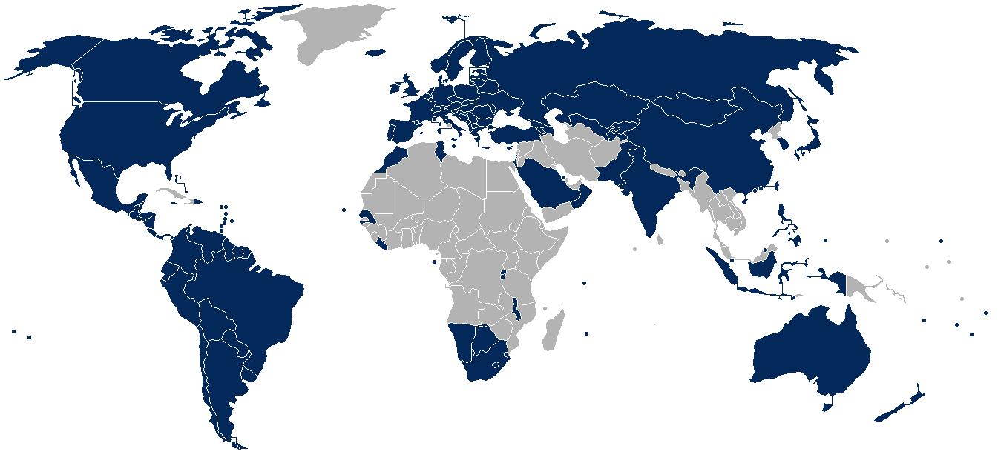
COVERAGE OF APOSTILLE CONVENTION
126 CONTRACTING PARTIES
A

Slide 3
The Electronic-Apostille Programme
“e-APP”
Seeks to promote and encourage the use of technology under
the Apostille Convention
Improves accessibility and usability of the Convention using commonly available technologies
Streamlines work processes of Competent Authorities,
generates more user-friendly Apostilles, and enhances security
of cross-border transfer of documents
A
What Is the e-APP?

Slide 4
e-Register
The Article 7(1) Register maintained in a publicly accessible, electronic form
Allows any interested person to verify their Apostille online
While many Contracting Parties maintain an electronic register, the publicly accessible element is what determines whether it will be classified as an e-Register
e-Apostille
An Article 3(1) Certificate issued in electronic form
Signed by electronic signature with a digital certificate
e-Apostilles may be issued on:
  electronic documents
or
  paper documents that have been scanned/converted into electronic form
A
e-APP COMPONENTS

Slide 5
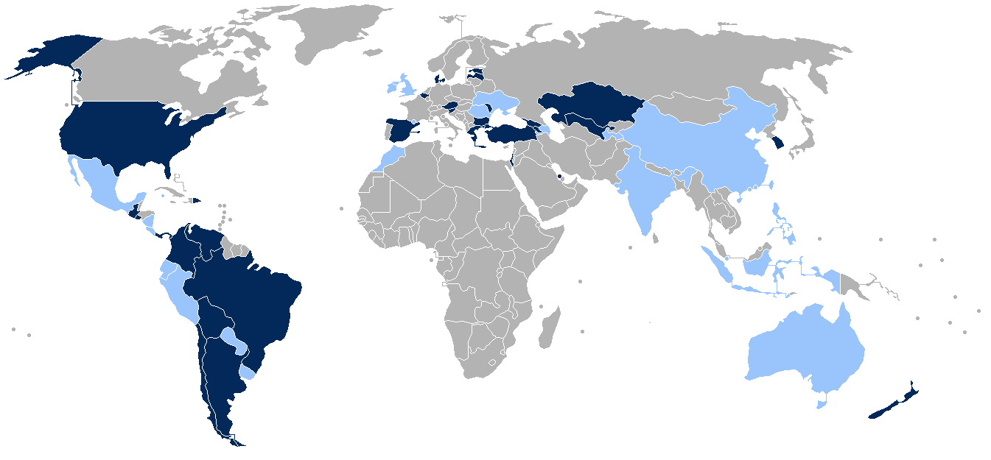
e-APP IMPLEMENTATION
test
A
32 e-APOSTILLE & e-REGISTER * 53 e-REGISTER (ONLY)

Slide 6
E-Registers (only)
Arkansas
California
Colorado
Delaware
New York
North Carolina
Tennessee
Texas
West Virginia
E-Apostilles &
e-Registers
Connecticut
Maryland
Minnesota
Montana
Rhode Island
Utah
Washington
*
69
A
e-APP IN THE UNITED STATES

Slide 7
An Apostille, or e-Apostille, validly issued by one Contracting Party must be accepted by other Contracting Parties
E-Apostilles must be presented in electronic form
Documents may not be rejected on the sole ground that they are e-Apostilles
Same requirements as paper Apostilles under the Convention:
    Competent Authority must authenticate signature, capacity of person signing, and seal or stamp
    Must be issued by Competent Authority of the State from which the document emanates
    Must be attached to (logically associated with) the public document
    Must follow the model Certificate in the Convention
A
The Rules

Slide 8
Accessibility | Integrity | Verification | Acceptance | Updates
e-Apostilles, and related services, should be accessible for all users. | Competent Authorities should preserve the integrity of the e-Apostille and the underlying public document. | e-Registers should facilitate frequent and reliable verification of Apostilles. | Contracting Parties should have systems in place to facilitate the acceptance of e-Apostilles. | Competent Authorities should regularly update and upgrade their Apostille practices, including e-APP infrastructure.
e-APP Principles & Practices

Slide 9
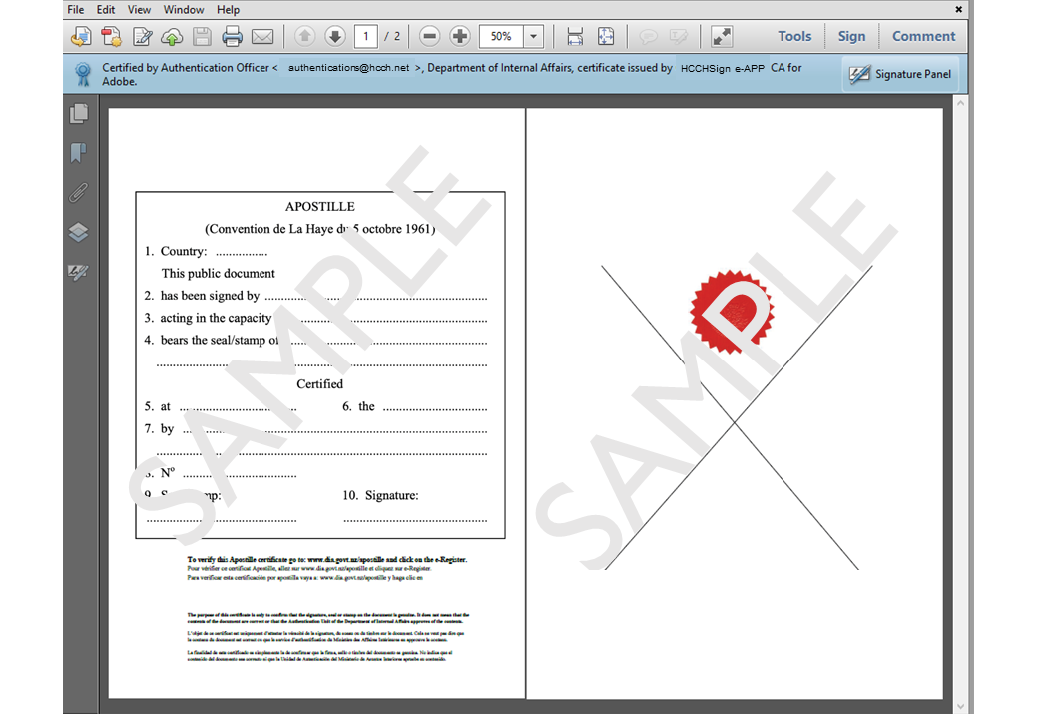
Digital signature
e-Apostille
Underlying public document
A
REQUIRED ELEMENTS OF AN e-APOSTILLE

Slide 10
Lack of Demand
Acceptance by Destination Countries
Cost to Implement System
Cost to Customer
Statutory Impediments
CONCERNS

Slide 11
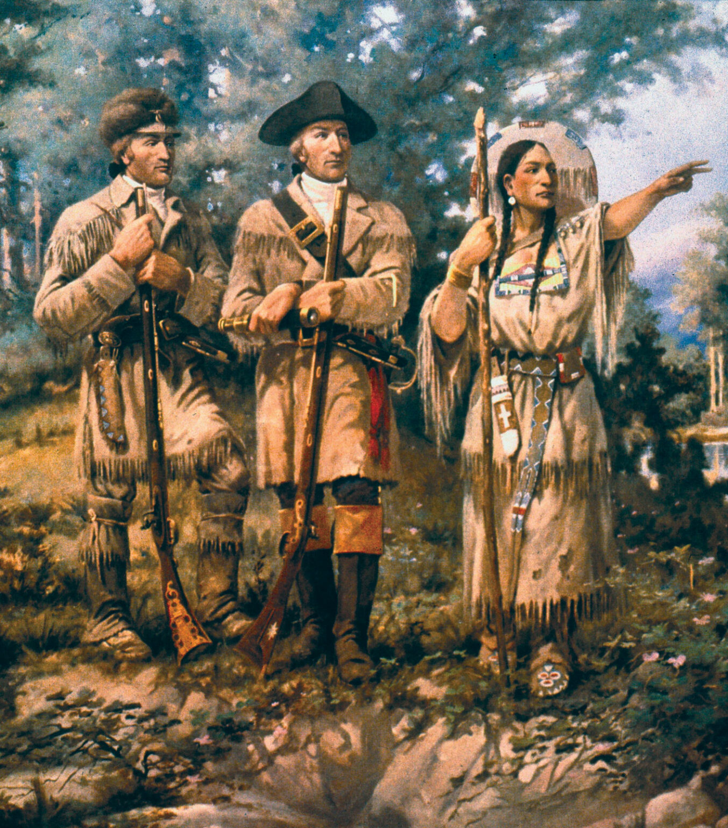
A 21st Century Expedition
Issued 4 e-Apostilles
  1 Customer in California
  RON Notary in Montana
  3 Accepted, 1 Rejected
Spreading the Word
  Presentation at NASS
  Working with State Dept
  Created Advisory Board
In Production
  Partner with MT RONs
  35% e-Aps YTD
  Promoting e-APP
2020
2022
2024
2021
2023
2025
Partner with Paradigm
  In-depth research
  Focus on CeDiploma
  Outreach to universities
  Worked with HCCH, Israel
Ready to Launch
  Phase 1 – Pilot
  First 2 e-Aps - Georgia
  Underwhelmed - Back to the drawing board
  SUCCESS! 75 e-Aps
Moving Forward
@Gov platform operational
Fully automated process
Work towards digital Vital Records
Target 55% e-Ap by EOY
A
MONTANA’S STORY

Slide 12
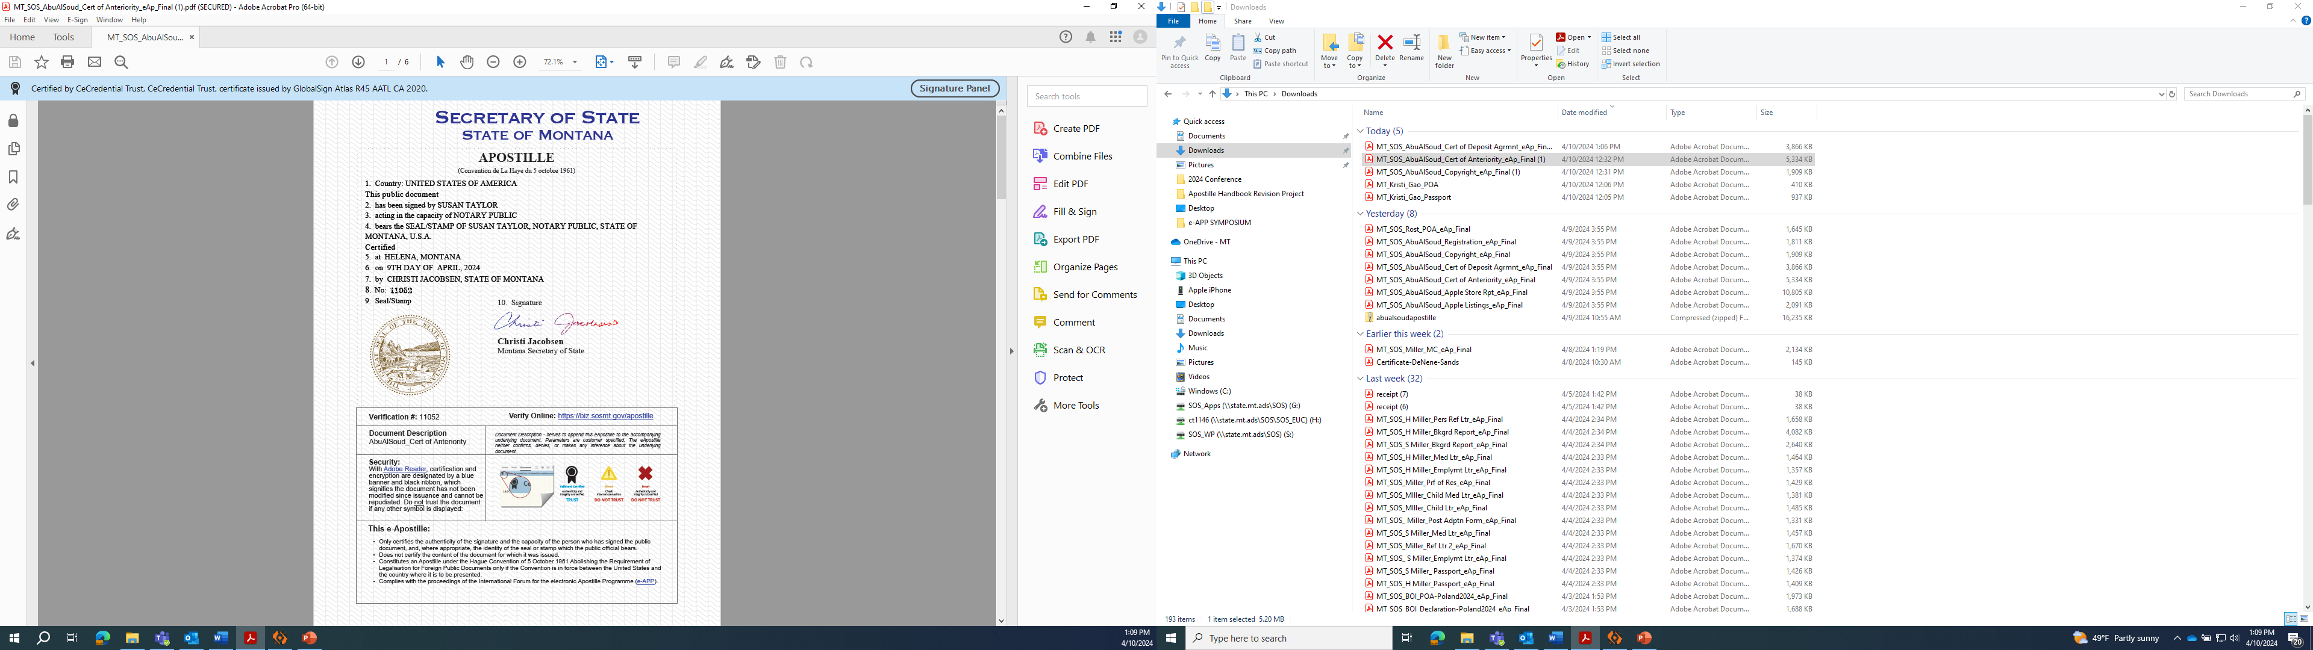
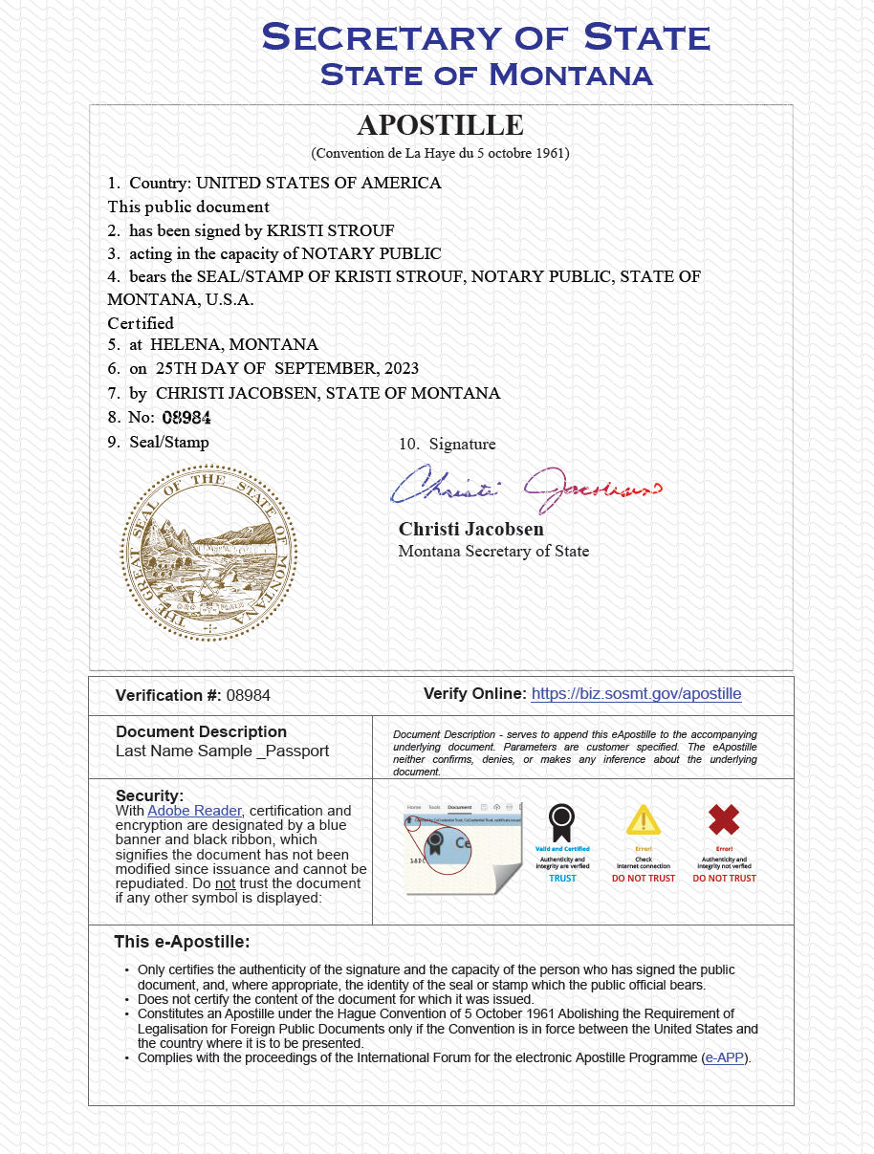
Security Features
Digital Signature
Background Filaments
Woven through text
Contains all the required elements of an Apostille
Verifies all the same information as paper Apostille
Both documents are contained in a secure tamper-evident file
Underlying record can be electronic or scanned copy of hard-copy document
Completed file with e-App and document transmitted to recipient electronically
Entire process takes less than 1 day
e-Apostille Border
Microscopic text, not solid line
Competent Authority Digital Signature
Multi-colored
State Seal Embossed
Looks dimensional
Active Hyperlink
Links to e-Register
Document Description
Identifies underlying document
AMONTANA’S e-APOSTILLE
MONTANA’S e-APOSTILLE

Slide 13
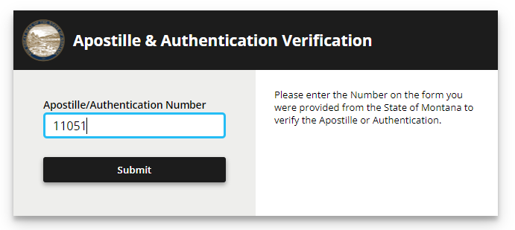
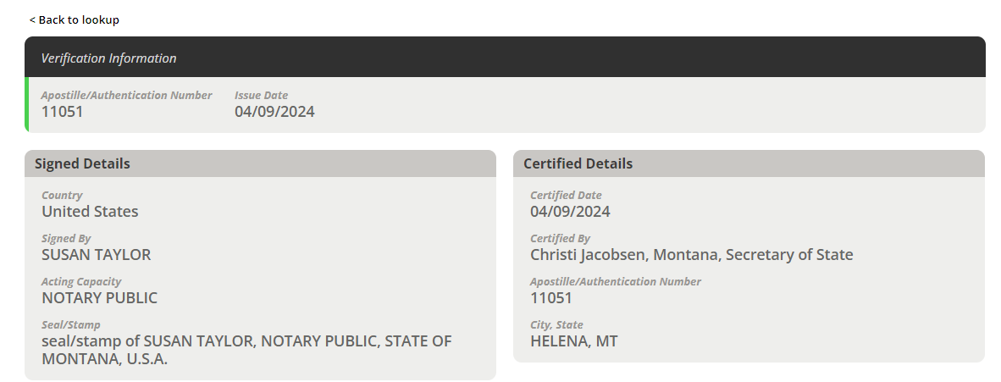
Step 1: Click the hyperlink and enter the Apostille number.
Step 2: Compare the information here to the information on the
e-Apostille.
A
MONTANA’S e-REGISTER

Slide 14
20+ TYPES OF DOCUMENTS
Powers of Attorney
Agency Certifications
Copies of Passports
Marriage Certificates
FBI Background Reports
State Background Reports
Medical Certificates
Financial Documents/Dossiers
Business Records
Professional Licenses
Driver’s License
Diplomas
Transcripts
Certificates of Insurance
Social Security Benefits Statements
Bank Statements
Property Deeds
MONTANA SUCCESS RECORD – OVER 500 ISSUED

Slide 15
44 DESTINATION COUNTRIES
Argentina
Australia
Austria
Belgium
Bolivia
Bosnia & Herzegovina
Brazil
Chile
China
Columbia
Costa Rica
Dom. Republic
El Salvador
Georgia (Country of)
Germany
Greece
Guatemala
Honduras
Hungary
India
Indonesia
Ireland
Israel
Italy
Jamaica
Latvia
Luxembourg
Mexico
Moldova
Netherlands
Panama
Peru
Philippines
Portugal
Russia
Saudi Arabia
South Korea
Spain
Switzerland
Turkey
Uruguay
Ukraine
United Kingdom
Venezuela
MONTANA SUCCESS RECORD – OVER 500 ISSUED

Slide 16
COMPETENT AUTHORITY
CUSTOMER
FASTER
MORE RELIABLE
MORE SECURE
LESS EXPENSIVE
  No Shipping Costs
  One e-Ap – Multiple uses
  Easily replaced if lost or undelivered
FASTER
MORE SECURE
LESS STRESS
  No Paper Handling
  No lost documents
MORE EFFICIENT
BENEFITS

Slide 17
A Montana company contracted with the government of South Korea to provide 45 trained forest firefighters during the peak fire season. They needed all personnel to have FBI background checks submitted prior to departure in 30 days.
THE PROCESS:
  Day 1: Employee obtains fingerprints locally
      Contractor sends the electronic fingerprint card to the FBI
      Electronic FBI report returned to Contractor
  Day 2: FBI file sent to MT SOS for notarization and apostillisation
      Completed e-APP returned to Contractor
  Day 3: File sent to South Korea Forest Service and accepted
STORIES BEHIND THE NUMBERS

Slide 18
Financial Dossier – Paper Process
Registering a Business Abroad
(6 documents, 3 states, 2 countries)
  Law firm in California
  Company registered in Texas
  Principals located in California and Peru
  Notaries in California and Montana (RON)
  Transaction in Turkey
Minimum
At least
24 – 30 days*
$650 - $????
* …and hope nothing gets lost in the mail along the way
STORIES BEHIND THE NUMBERS

Slide 19
Financial Dossier – e-Apostilles Process
Registering a Business Abroad
(6 documents, 3 states, 2 countries)
Transaction initiated 3/11/24 - 10:30 a.m.
  [details arranged with RON & MT SOS]
  Documents notarized 3/12/24 10:20 a.m.
  Apostilles requested 3/12/24 10:37 a.m.
e-APPs sent to & accepted in Turkey 3/12/24 - 2:13 p.m.
Total Time:
< 28 hours
Est. cost:
$250 - $350
STORIES BEHIND THE NUMBERS

Slide 20

ADOPTION DOSSIER FOR INDIA
Medical Certificates
    Copies of Passports
    Background Checks (State & FBI)
    Reference Letters
    Employment Verification
    Home Study
    Psych Evaluations
    Marriage Certificate
    Birth Certificates*
All documents were created, notarized,
e-Apostillised, submitted, and accepted in less than three weeks!
STORIES BEHIND THE NUMBERS

Slide 21


PASS UP THE PAPER
  Give up the Grommets
  Skip the Staples
  Stop with the Stamp
  Embrace the FOMO
  Get over the FOF
e-Apostilles are stress-free, sufficient, and secure, with immediate results.
It’s instant gratification for both the sending and receiving parties.
~ Em

Slide 22
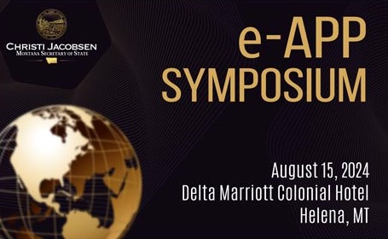

Slide 23
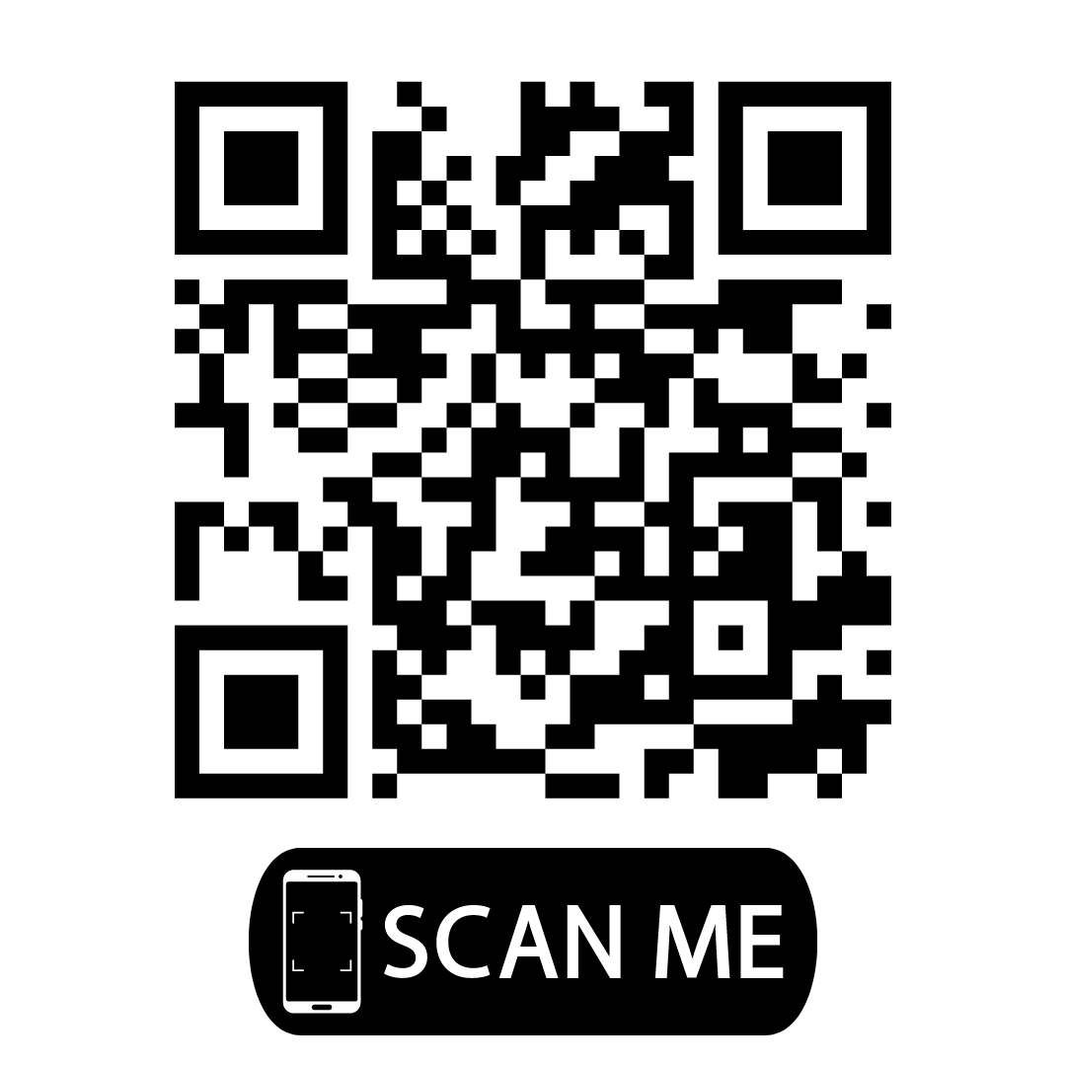
For more information or to register for the e-APP Symposium
media.sosmt.gov/2024-symposium
DON’T MISS IT!

